Slide 1
K-5 Narrative Writing
Strategies for Writing in the Elementary Classroom

Slide 2
Common Core Anchor Standards: Text Types and Purposes
1. Write arguments to support claims in an analysis of substantive topics or texts, using valid reasoning and relevant and sufficient evidence.
2. Write informative/explanatory texts to examine and convey complex ideas and information clearly and accurately through the effective selection, organization, and analysis of content.
3. Write narratives to develop real or imagined experiences or events using effective technique, well-chosen details, and well-structured event sequences.
Notes:
There are 10 College and Career Readiness Standards for Writing which can be divided into four categories. This presentation focuses on the text type and purpose of narrative structure. Strategies and the development of this particular writing form will be discussed throughout although narrative is designed to have elements overlap into all the text types.
2

Slide 3
Three Text Types
Argument/Opinion
Informative/Explanatory
Narrative
Notes:
3

Slide 4
Three Types of Writing
 | Narrative | Explain/ Inform | Opinion/ Argumentative
Elementary | 35% | 35% | 30%
Middle School | 30% | 35% | 35%
High School | 20% | 40% | 40%
Notes:
While narrative writing is given prominence in early grades, as the grade level increases, the standards shift focus to writing arguments or informational pieces that analyze sources including writing about research students have performed. The standards and the Model Content Frameworks are organized with the expectation that students will respond to high quality, text dependent prompts about what they have read by framing a debate or informing the reader about what they have learned through writing.
If the question comes up that these are the breakdown of the assessment items on the PARCC tests: To our knowledge, in elementary, students write narrative 35% of the time and gradually decrease to 20% in high school. This is in an instructional recommendation from NAEP (National Assessment of Educational Progress), not necessarily the breakdown of the PARCC assessment requirements.

Slide 5
Narrative
Narrative elements
Narrative story
Real or imaginary story
Time is deep structure
Narrative description
Vivid impression
Person, phenomenon, event or procedure
Notes:
In 3rd-5th, narrative elements may include: establishing a situation, organizing a logical event sequence, describing scenes, objects, or people, developing characters personalities, and using dialogue as appropriate.
Examples of narrative story are creative fiction and memoirs, anecdotes, biographies/autobiographies. Examples of narrative description: students might write about individuals and events selecting from their sources only the most relevant information. In science, students might write narrative descriptions of step by step procedures of investigations so that others can replicate their procedures to test their results.
Focus points require importance of organization, word choice, reflection of real or imagined experiences or events that reflect what student are learning elsewhere. Close attention to detail required by students to craft an effective and coherent narrative calls on a skill set similar to that being developed by other literacy tasks. For example to tell an interesting story effectively or to provide an accurate description of a historical incident requires students to present vivid, relevant details that situate events in a time and place while crafting a narrative structure that lends coherence and significance to those details.
Nonfiction vs. Literary Nonfiction nonfiction is designed to communicate information in circumstances where the quality of the writing is not considered as important as the content. Practical nonfiction appears mainly in popular magazines, newspaper Sunday supplements, feature articles, and in self-help and how-to books. . . . "Literary nonfiction puts emphasis on the precise and skilled use of words and tone, and the assumption that the reader is as intelligent as the writer. While information is included, insight about that information, presented with some originality, may predominate. Sometimes the subject of literary nonfiction may not at the onset be of great interest to the reader, but the character of the writing may lure the reader into that subject.

Slide 6
Notes:
The Standards goal is not to target a certain length essay, such as a 5 paragraph formula but to provide a process to writing.

Slide 7
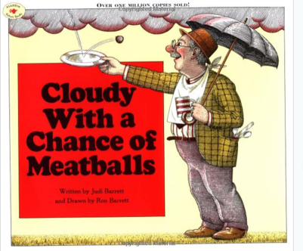
Strategy Ideas for Writing from Sources
Using Photos
Using Picture Books as Mentor Texts

Slide 8
Notes:
Photographs can be used in other ways as well. This is a routine writing example of utilizing a photograph from writingfix.com. This is part of a digital photograph contest. Brooke entered her poem about her hair after the photograph had been posted of this child’s hairdo. Pause and read what she wrote.
Poetry has a special placement in the standards as well. Not only will students be required to read and comprehend more poems and their structure but will be required to write them as well.

Slide 9
Mentor Texts
Possible Focus:
Organization
Word Choice
http://writingfix.com/Picture_Book_Prompts/Cloudy1.htm
Notes:
Using Mentor Texts or Anchor Texts is a time honored strategy
Cloudy with a Chance of Meatballs may be a text used to show students how this author used adjectives. This mentor text can also show how an author organizes the story.

Slide 10
Production and Distribution of Writing
4. Produce clear and coherent writing in which the development, organization, and style are appropriate to task, purpose, and audience.
5. Develop and strengthen writing as needed by planning, revising, editing, rewriting, or trying a new approach.
6. Use technology, including the Internet, to produce and publish writing and to interact and collaborate with others.
Notes:
As we move through the writing standards, expectations are rooted in the same design. Organization and purpose must be identified and adhered to while the writing process is to include planning, revising, editing and rewriting. New approaches are encouraged such as the use of technology and collaboration with others as in the case of Writers’ Workshop. These types of approaches are also encouraged during the production and publishing stages as well.

Slide 11
Production and Distribution of Writing
CCRA.W.4
Appropriate Writing for Audience, Task & Purpose
CCRA.W.5
Improve Writing by Editing and Rewriting
CCRA.W.6
Use Technology
Notes:
The second category of Anchor Standards for Writing is the Production and Distribution of Writing. Anchor Standards 4, 5 and 6 are found in this category and it is important to be aware of these standards. They require the students to consider their audience when writing, to edit and rewrite which will improve their writing and to use technology in their work.

Slide 12
Research to Build and Present Knowledge
7. Conduct short as well as more sustained research projects based on focused questions, demonstrating understanding of the subject under investigation.
8. Gather relevant information from multiple print and digital sources, assess the credibility and accuracy of each source, and integrate the information while avoiding plagiarism.
9. Draw evidence from literary or informational texts to support analysis, reflection, and research.

Slide 13
Research to Build and Present Knowledge
CCRA.W.7
Short Research Projects
K-2 – Participate in shared research and writing…
3 & Up - Conduct short research projects….
Extended Research Projects
CCRA.W.8
Gather Information from Multiple Sources
CCRA.W.9
Supporting Evidence
Notes:
The third category is Research to Build and Present Knowledge.

Slide 14
Range of Writing
10. Write routinely over extended time frames (time for research, reflection, and revision) and shorter time frames (a single sitting or a day or two) for a range of tasks, purposes, and audiences.

Slide 15
Range of Writing
CCRA.W.10: Routine Writing For Various Purposes and Audiences
Extended Time Frames
Research projects
Multimedia products
Analytic Writing
Formal compositions with multiple revisions
Shorter Time Frames
Notes
Summaries
Learning logs
Journal entry
Check grade level standards for specifics.
Notes:
The fourth and final category of Anchor Standards for writing is the Range of Writing. This standard calls for students to write routinely over extended time frames as well as shorter time frames for various purposes and audiences.
Writing to texts is critical for improving reading comprehension as well as for building writing skills. Studies show that learning to present important information in an organized piece of writing helps students generate a deeper understanding of a text. Whether taking notes or answering questions about a text, or crafting a summary or an extended response regarding what they have read, students improve both their reading comprehension and writing skills when writing in response to text
The model content frameworks give special prominence to research tasks, reflecting the deep connection research has to building and integrating knowledge while developing expertise on various topics. When possible, research should connect to texts selected for close readings, requiring students to closely read and compare and synthesize ideas across multiple texts. One avenue is to ask students to extend their analytical writing on a text or texts by gathering additional information as part of a research project. Through a progression of research tasks, students are called on to present their findings in a variety in a variety of modes in informal and formal contexts such as oral presentations, argumentative or explanatory compositions or multimedia products.
**In keeping with the standards, such responses should leverage technology, expanding on more traditional modes of written expression to include using digital sources to draft, revise and edit work as well as to conduct research, including evaluating websites for authenticity and credibility.

Slide 16
Routine Writing
Notes
Summaries
Learning logs
Journal entry
Notes:
Writing to texts is critical for improving reading comprehension as well as for building writing skills. Studies show that learning to present important information in an organized piece of writing helps students generate a deeper understanding of a text. Whether taking notes or answering questions about a text, or crafting a summary or an extended response regarding what they have read, students improve both their reading comprehension and writing skills when writing in response to texts.

Slide 17
Routine Writing
Writing to learn tasks
Response to short text selections
Open ended questions
Informal writing projects
Notes:
Give examples of these types of tasks. Writing to learn tasks are tasks that provide students opportunities to engage in process learning such as summarizing text, synthesizing information, critically analyzing characters or actions. Response to short text is showing evidence of comprehension of a text in writing such as drawing pictures of characters or simply stating events in a sequence. Open ended writing and informal writing projects require students to draw upon skills that fulfill demands of the everyday work place such as writing letters to classmates or taking notes.

Slide 18
Long Term Writing
Research projects
Multimedia products
Formal compositions with
multiple revisions
Check grade level standards for specifics.
Notes:
The model content frameworks give special prominence to research tasks, reflecting the deep connection research has to building and integrating knowledge while developing expertise on various topics. When possible, research should connect to texts selected for close readings, requiring students to closely read and compare and synthesize ideas across multiple texts. One avenue is to ask students to extend their analytical writing on a text or texts by gathering additional information as part of a research project. Through a progression of research tasks, students are called on to present their findings in a variety in a variety of modes in informal and formal contexts such as oral presentations, argumentative or explanatory compositions or multimedia products.
**In keeping with the standards, such responses should leverage technology, expanding on more traditional modes of written expression to include using digital sources to draft, revise and edit work as well as to conduct research, including evaluating websites for authenticity and credibility.

Slide 19
PARCC Rubric
Narrative elements
4th – 5th Draft Rubric
Analytic and narrative
Scoring
Writing is based on textual evidence
Constructs measured
Notes:
KEY STATEMENT: The narrative writing task for PARCC assessment will consist of a series of tasks that may include any of the following: writing a story, detail a scientific process, convey experiences or events, (real or imaginary), write a historical account of important figures, or to describe an account of events, scenes or objects. These are just some of the tasks that could be asked of students. These tasks are ultimately aligned with the skills and knowledge outlined in the CCSS writing standards. The standards require that students incorporate narrative elements effectively into other writing tasks such as writing arguments and informative/explanatory texts.
2nd bullet: Serves both analytic and narrative. Analytic is for informative/explanatory and argumentative writing. In the CCRS Anchor standards, informative and argumentative writing both use analysis in the language of the writing standards. A 4 isn’t obtainable at the 4th and 5th grade level with the exception of conventions.
3rd Bullet: Expectations are similar to reader response tasks from former assessments with regards to organization.
4th bullet: Constructs Measured—packaged programs such as 6 Trait Writing still consistently work for this area. This area is tied directly to the reading standards regarding vocabulary and academic language. A comprehensive knowledge of comprehension strategies such as sensory imaging and visualization may assist in demonstrating concrete words and sensory details.
Hyperlinks are in draft form from PARCC—go to item and task prototypes and sample rubrics are at the bottom left side of screen.

Slide 20
PARCC Rubric
Grade 3 Rubric
Grade 4/5 Rubric
Notes:
Go to www.parcconline.org for additional information or updates concerning the rubrics.

Slide 21
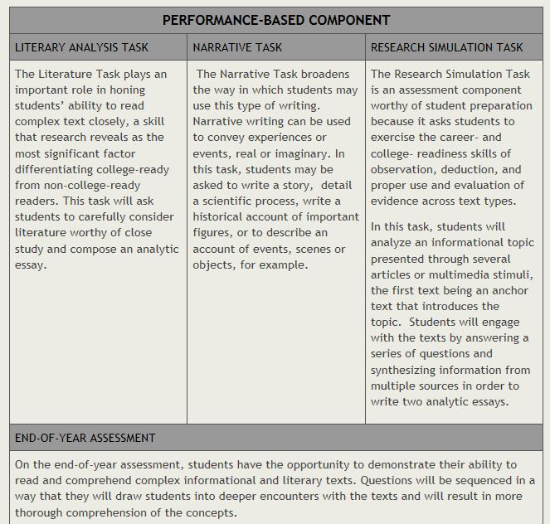
PARCC Summative Assessment with EBSR, TECR, and PCR Items
Notes:
Check PARCC at www.parcconline.org for additional information regarding narrative assessment samples.

Slide 22
Closing Activity
As our closing activity today, on an index card please complete a 3-2-1 exit card.
Write 3 new things you learned…
Write 2 questions you have….
Write 1 thing you will implement in your classroom….
Notes:
A variation of the exit ticket is known as 3-2-1: Have students write three of something, two of something, then one of something. For example, students might explain three things they learned, two areas in which they are confused, and one thing about which they’d like to know more or one way the topic can be applied.
Pass out index cards and have participants complete the instructions on the slide. Depending on how much time you have left in the session, have participants share their 3-2-1 aloud. Collect the cards as participants leave. This will provide the presenters will feedback about the presentation.

Slide 23
Resources
www.isbe.net
www.parcconline.org
www.writingfix.net
Notes:
Discuss learning progressions tool as it applies to writing.
Click on Common Core ELA/Math.
Look on the right side of the screen for the Progression Tool.
PARCC has writing rubrics.
Writing Fix has 6 trait writing lessons with mentor text samples and rubrics geared towards 6 Trait Writing which is effective instruction for the CCSS.

Slide 24
Contact
Questions or comments?
Please contact English Language Arts Specialists at: plscomments@gmail.com
Notes:
This slide lists the English Language Arts Content Specialists for the Illinois State Board of Education who created the presentation.

