Slide 1
Literacy in the Content Area Classroom
Grades 6-12
Illinois State Board of Education
ELA Content Area Specialist

Slide 2
Today’s Outcomes
Discuss Literacy in Today’s World
Review the Illinois Learning Standards
Determine Literacy Needs in Content Classrooms
1. What’s Happening
2. What Needs to Happen
3. How To Make it Happen
--Strategies for the Classroom

Slide 3


Students who develop an even broader set of in-demand competencies will be at an even greater advantage in work and in life:
- the ability to think critically about information,
- solve novel problems,
- communicate and collaborate ,
- create new products and processes, and
- adapt to change .
Notes:
Literacy skills are imperative for students…21st century learning which includes: (from P21.org)
Global Awareness,
Financial, Economic, Business and Entrepreneurial Literacy
Civic Literacy
Health Literacy
Environmental Literacy,
Information, Communications and Technology Literacy
And the list goes on…

Slide 4

Employers Expect More
Reading and Writing
Collaboration
Independence
Critical Thinkers
Perseverance
Problem Solvers
Notes:
Employers Expect More
Students who can read and write
Work with a team
Work with less supervision
Identify problems and critically think to problem solve - persevere
It’s not enough to just graduate from high school.
Employers expect more – in fact, they are demanding more from the people that they hire.
Employers are looking for team members who will be able to acquire new skills quickly, work with less supervision and be able to identify sophisticated problems and make crucial decisions.
The bottom line is the most good jobs require some type of postsecondary education or advanced training.

Slide 5
Literacy for the 21st Century
“Adolescents entering the adult world in the 21st
century will read and write more than at any other
time in human history. They will need advanced
levels of literacy to perform their jobs, run their
households, act as citizens, and conduct their
personal lives. They will need literacy to cope
with the flood of information they will find
everywhere they turn. In a complex and
sometimes even dangerous world, their ability to
read will be crucial.” (IRA, 1999)

Slide 6
Overview of your 10 Reading Standards
Cite evidence to support analysis...
Determine central idea… provide a summary….
Identify key steps, sequences…. (analyze in high school)
Determine meanings of words…
Describe how a text presents information.. sequentially, comparatively (analyze in high school)
Author’s purpose/point of view (compare two or more authors)
Integrate visual information with other information
Distinguish among fact, opinion (M.S.) Assess whether text support’s the author’s claim(s). (H.S.)
Analyze the relationship between a primary and secondary source on the same topic. (H.S. Compare and contrast….)
Read and comprehend texts in your content independently….

Slide 7
Overview of Your 10 Writing Standards
1. Write opinion/arguments
2. Write informative/explanatory texts
3. Write narratives
Standards 4-10 help accomplish standards 1,2 or 3
Produce clear coherent writing….
Develop and strengthen writing…
Use technology to produce, publish….
Conduct short as well as more sustained research projects…
Gather relevant information from multiple print and digital sources…
Draw evidence from texts…
Write routinely for extended and shortened time frames….

Slide 8

Schools/Districts Have Choice
All students in all districts are expected to demonstrate the same reading and writing skills at each grade level standards.
Notes:
Districts aren’t mandated to buy certain course materials or teach lessons in a certain way. Students in Springfield could read an entirely different set of texts than their peers in Carbondale, just expected to meet grade level standards by end of year.

Slide 9
Increased quantity of materials and instructional time devoted to informational text
English Language Arts Teachers
Literature
fiction, drama, poetry
Literary Nonfiction
Memoir
Biography
Social Studies, Science, Technical Subjects
Other informational Text
70% of the reading instruction students receive
across their instructional day will be devoted to
informational text.
Notes:
“One of the most significant instructional impacts of the CCSS is the increase in the quantity of literacy materials and amount of instructional time devoted to informational text. However, this does not mean that senior English classes, for example, will devote 70% of their reading time to informational texts. Rather, 70% of the reading instruction students receive across their instructional day (in social studies and science, as well as ELA, for instance) will be devoted to informational text.
Nonetheless, fulfilling the Standards for 6-12 ELA will require much greater attention to a specific category of informational text – literary nonfiction – than has been traditional in the English language arts classes.”
Literary Nonfiction
Nonfiction that reads like fiction and includes elements of fiction (plot, characters, conflict, etc.)

Slide 10
Science, Health, Ag, Family Consumer Science , etc.
Literary
Social Studies
Science
& Tech
English Classes
Are students really reading in all of the subjects?
US History, Civics, etc.
Notes:
This is a shared task.
Explain that the 6-12 grade standards follow NAEP in calling for an equal proportion of text drawn from science/technical subjects, history/social studies, and literary sources.
For instance, the facilitator might say,
“One of the most significant instructional impacts of the CCSS is the increase in the quantity of literacy materials and amount of instructional time devoted to informational text. Seventy percent of the reading instruction 6-12 students receive across their instructional day (in social studies, science and other subjects, as well as ELA) will be devoted to informational text.
In following NAEP, the standards call for about one-third of the text from each of three areas: social studies, science, and literary.
In social studies, that includes both primary and secondary sources. In science and technical subjects, it includes journal articles and quantitative information presented in different formats (formulas, charts). In English language arts, that includes literary nonfiction with an emphasis on foundational U.S. documents.
By the secondary level, most of the informational text students experience will be discipline-specific text in the content areas. This is also the text that will be similar to the type of material they will experience in college and career training situations. The goal is for students to be able to learn content through the text they read.”

Slide 11

Two Biggest Problems Faced by Teachers
Students have difficulty reading the texts of various content areas
Students don’t want to read
C. Shanahan, 2013

Slide 12

Simply assigning hard books
will not ensure that students
learn at high levels!
www.fisherandfrey.com

Slide 13
The New Illinois Learning Standards Cannot Be Met without
Reading and Writing
Across all content areas students should…
  Read
  Write
  Listen/view
  Discuss/present
  Think critically and creatively
  Use language and vocabulary to read and comprehend text to support the content
https://www.teachingchannel.org/videos/reading-like-a-historian-corroboration
Notes:
Turn and Talk: What are the specific literacy skills that students must be able to use in order to read and comprehend the text required for mastery of content standards for science, social studies, math, and English language arts? DO NOT CLICK…allow participants to come up with literacy skills first and then share these…
Grid for discussion using the read, write…elements. Share video as to why these skills matter (11 min). This is an example in a history class however, if you are studying in ANY content area, the skills outlined, are essential for critical thinking in ALL content areas…This is actually a video series that showcases primary source documents, how to create an essential question, sourcing, contextualizing, and other skill sets that are important.

Slide 14
Content Area vs. Discipline Literacy
Chemistry: experiments, processes; connections between texts, formulas, graphs & charts.
History: Consider author’s perspective, contextualize the text with historical period & place, corroborating information across sources.
“Content-area literacy”
  Generalizable routines, generic comprehension strategies intended to be taught by reading and content teachers alike and applied across the curriculum
“Disciplinary literacy”
  Specialized ways of learning and communicating in each specific discipline
  Includes the language differences across disciplines
Notes:
Explain that research has shown that both content-area and disciplinary literacy are important for students to learn, and readers need to learn and apply the language of each discipline.
For instance, the facilitator might say,
“We have two areas of research to draw from, termed content area literacy and disciplinary literacy.
You may recognize phrases from content area literacy such as “reading across the curriculum” and “all teachers are teachers of reading.” This approach emphasizes generic comprehension strategies that are usefully applied to informational text on a wide variety of subjects. These are generalizable routines such as anticipation guides, guided note taking, questioning routines such as KWL, etc. They are intended to be taught by reading and content teachers alike, but in reality may be far more familiar to reading teachers than to content area teachers.
The more recent research area focuses on disciplinary literacy, the specialized ways of learning and communicating the different disciplines. For example, chemistry reading requires a full understanding of experiments and processes, the ability to make connections among and between connected text, formulas, graphs, and charts. Historians approach informational text by considering the author’s perspective, contextualizing the text within its historical period and place, corroborating information across sources. Only teachers trained in the specific disciplines are in a position to use the best of both approaches.”

Slide 15




Math – Disciplinary Reading
Close reading is highly important
Heavy emphasis on
error detection
Goal: arrive at truth
Precision of
understanding
essential
Notes:
So Dr. Shannahan discusses terms such as corroboration during disciplinary reading. This term means that a reader is evaluating information across sources. Another term is transformation which is repeated exposures to multiple perspectives of the same idea, process, procedure or task. Both of these ideas are actual standards that are required in both the literary and informational CCSS.
As teachers begin working in their content and asking students to evaluate sources and bring in multiple perspectives within the discipline of the area they are teaching, students need to be able to critically think like a scientist, mathematician, artist or historian and know what that means when they are in that classroom.

Slide 16

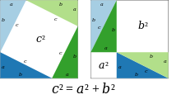
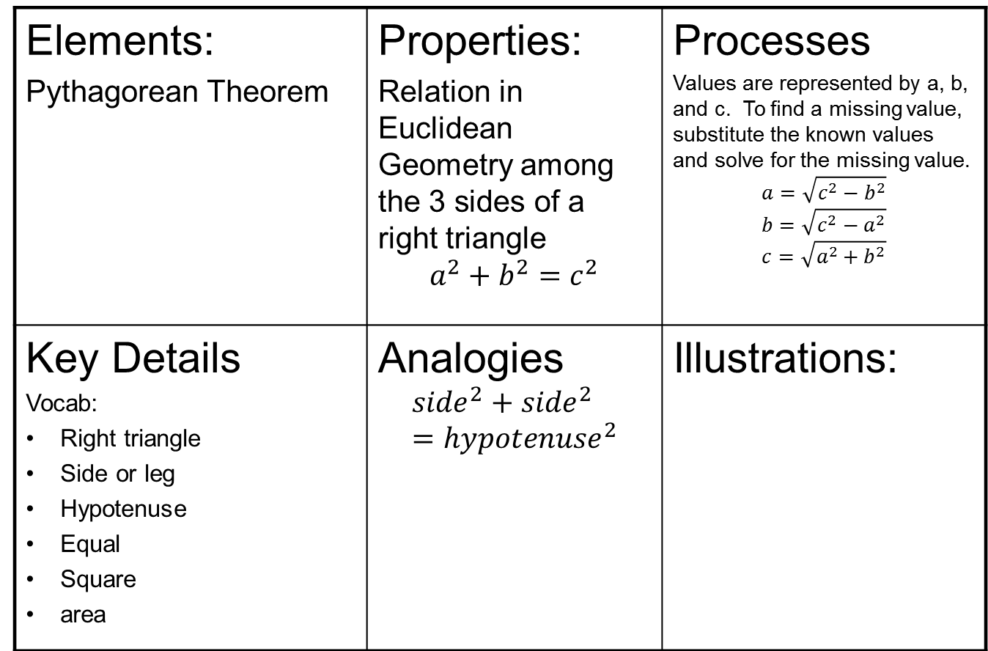
Elements: Pythagorean Theorem | Properties: Relation in Euclidean Geometry among the 3 sides of a right triangle $$a^{2}+b^{2}=c^{2}$$ | Processes Values are represented by a, b, and c. To find a missing value, substitute the known values and solve for the missing value. $$a=\sqrt{c^{2}−b^{2}}$$ $$b=\sqrt{c^{2}−a^{2}}$$ $$c=\sqrt{a^{2}+b^{2}}$$
Key Details Vocab: Right triangle Side or leg Hypotenuse Equal Square area | Analogies $${side}^{2}+{side}^{2}={hypotenuse}^{2}$$ | Illustrations:
Notes:
Why is Math reading so tough?
1. Reading mathematics often requires reading from right to left, top to bottom, bottom to top, or diagonally bc they look at symbols and graphs.
2. The text in mathematics textbooks has more concepts per sentence, per word, and per paragraph than ordinary textbooks.
3. Mathematical concepts are often abstract and require effort to visualize.
4. The text in mathematics textbook is terse and compact—that is, there is little redundancy to help readers uncover the meaning.
5. Words have precise meanings which often are not fully understood.
6. Formal logic connects sentences so the ability to understand implications and make inferences across sentences is essential.
7. In addition to words, mathematics textbooks contains numeric and nonnumeric symbols.
8. The layout of many mathematics textbooks can make it easy to find and read worked examples while skipping crucial explanatory text.
9. Mathematics textbooks often contains complex sentences which can be difficult to parse and understand.
In addition, definitions are to be read and used in an unusual way, and play an especially important role in mathematics.
What can help students? Reading strategies for mathematics should advocate that students actively engage in working from their concept images (well developed background knowledge as it pertains to an image in their mind) to the actual definitions, and vice versa, in order that they come to a reasonable semblance of the meaning intended by textbook authors.
The research done by Drs. Mary Shepherd, and Selden and Selden states:
Repeat or reread parts of passage.
Write notes or copy important ideas onto paper.
Create a concrete visualization of a concept; for instance, comparing the wrapping function to a ribbon.
Construct analogies, identifying the u-v coordinate system as the x-y coordinate system.
Paraphrase

Slide 17




Science – Disciplinary Reading
Understanding of processes and experiments
Close connections among graphs, charts, and formulas
Reading
strategies
are
corroboration
and
transformation
Allows prediction of how world works
Notes:
The chemists were most interested in the transformation of information from one form to another. That is, when reading prose, they were visualizing, writing down formulas, or if a diagram or a chart were on the page, going back and forth between the graph and the chart. One chemist explained, “They give you the structure, the structure of the sensor is given, so I was looking at the picture as I was reading, and I tried to relate what was in the picture to what they were saying about how mercury binds to one part of the molecule.” This explanation, corroborated by the chemists’ other comments, helped us to understand that in chemistry, different or alternative representations (e.g., pictures, graphs or charts, text, or diagrams) of an idea are essential for a full understanding of the concepts. These various representations are processed recursively as reading progresses.
Unlike historians, chemists create knowledge through experimentation. The findings of experiments are somewhat dependent upon the quality of the instrumentation, the design, and the statistical analysis. However, these variables are all decided upon prior to the actual experiment. The findings are generalizable to other experiments under the same conditions. Although chemists are not uncritical readers, we found that the chemists we studied did have more confidence than historians in the utility of the knowledge that had been created; they believed they could use that knowledge to predict what would happen under similar conditions. What is important to them in reading, consequently, was a full understanding of the way in which an experiment took place and the processes the experiment uncovered. Gaining that full understanding required them to think about the phenomenon being presented in prose, to visualize it, and to manipulate it in formulas and equations.

Slide 18
Chemistry Note-taking
Substances | Properties | Processes | Interactions | Atomic Expression
Notes:
Shanahan’s summarization technique for Chemistry is showcased here: a strategy that is based specifically on teachers’ insights about chemistry reading. Using this strategy, students take notes in a chart format. Each section of the chart reflects the information that chemistry specialists said are essential to reading chemistry text. Because chemistry is about the properties of substances and their reactions, a reader who pays attention to this would be engaged in a disciplinary-focused reading. Shanahan illustrated the chart using information from one of the chemistry textbooks the team members had shared with us. One of the chemists who had been dismissive of teaching content area reading strategies (such as summarization) in chemistry reacted by saying, “Well, if they used this, they would be learning chemistry.” He then suggested a modification (the inclusion of a place to summarize atomic expression). The difference between this strategy and summarization was its subject-matter specificity. This strategy was not just about understanding text; it was also about understanding the essence of chemistry.
This structured-summarization strategy meshed well with concerns the chemists had expressed earlier when they examined high school chemistry textbooks: the need to identify where the chemistry was. That is, although they understood that some of the information in the text was included purely for motivational purposes or to establish context for students, they were concerned that what students were actually supposed to learn about chemistry was obscured and hidden by these devices. One of the chemistry teachers bitterly complained about a text she had to use in which each chapter began with a real-life problem (such as lake pollution) that was then followed by an explanation of the chemistry behind the problem. She complained that the students were not learning the chemistry. Chemistry learning is somewhat hierarchical in nature. The concepts build on each other, and these concepts can then be applied to situations. That is, the principles are taught as abstractions, and the particulars are exemplars of the abstractions. This chemistry book, however, perseverated on the particular, providing students with little real opportunity to learn the abstractions that could be used to solve other problems.

Slide 19

History/Social Studies –
Disciplinary Reading
Single texts are problematic
(no corroboration)
Interpretive, authors and sourcing are central in interpretation
(must consider bias/perspective)
Notes:
For example, in the History/Social Studies classroom that is practicing disciplinary literacy, the teacher offers several different sources and authors to interpret. Students are expected to consider any bias that an author might bring to the craft of a text and infer why. They will look at time periods and other events that are taking place that might influence other writings such as primary source documents. They understand corroboration and implement it with one another in discussions and employ it in their writing.

Slide 20
History Sources
Who is the author? Can I trust what he/she says? Why or why not?
Who was the author writing to? Why?
When did the author write it? Does that make a difference?
Do others agree? If not, who is more credible?
What does the author say that makes him/her believable?
https://sheg.stanford.edu/rlh
Notes:
Multiple texts are important to utilize when in history or social studies due to the different perspectives of human nature that are brought to the table. Students must consider the bias of every article written and every side of the timeline.

Slide 21
Multiple Text Discussion Web
YES
NO
Text 1 Evidence
Text 1 Evidence
Text 2 Evidence
Yes/No Question
Text 2 Evidence
Our View
Text 3 Evidence
Text 3 Evidence
Notes:
A web like this is great for debating whether a law was fair such as should women have been given the right to vote? Or is the Patriot Act a viable option for the US to continue? When giving multiple texts with shortened research questions, it allows the students to look for one piece of evidence and summarize the information that is necessary to answer the question. They can then analyze and weigh both sides of the arguments and synthesize the information to formulate their own opinion. This IS 21st century learning and there really isn’t mounds of homework expected but critical thinking does happen and this type of task is a PARCC like task.

Slide 22
Inquiry Chart
 | Q 1 | Q 2 | Q 3 | Credible?
Text 1
Text 2
Text 3
My Opinion

Slide 23
 | Is Oprah dangerous? | Is Oprah self-serving? | Is Oprah compassionate? | Credible?
Text 1 Answer/ evidence | No: [her accomplishments] “speak …to touching hearts, and leaving each one uplifted”
Text 2 Answer/ evidence
Text 3 Answer/ evidence | Yes: “Oprah is a conduit to lead people to hell”
My Opinion

Slide 24



Literature –
Disciplinary Reading
Conveys themes about the human experience
Deals with the human condition
Has features such as author’s use of purpose and genre
Notes:
In the literature classroom that employs disciplinary literacy, b/c the literature teacher did not come to teach reading, they came to teach literature just as the science teacher came to teach chemistry or biology, the literature teacher would focus on themes and human relations. The teacher would consider morality, survival and community with features such as author’s craft and genre.

Slide 25

Academic Disciplines Have Distinct Literacy “Practices”
Reading in history is different from reading in science, which is different from reading literature, which is different from…….
https://www.teachingchannel.org/videos/reading-like-a-historian-corroboration
Notes:
Reading Like a Historian – video from The Teaching Channel – 11 minutes – Corroboration
Take some time to locate the resources that many of the videos include. They are on the right side of the page – scroll down.

Slide 26
Text Structure
Fiction/Narrative
Nonfiction
Purpose: Tell a Story
Beginning, middle, end
Time is deep structure
Specific elements: Characters, Setting, Plot, Conflict, Resolution
Realistic or imaginative
Purpose: Inform or Describe
Sequential
Description
Comparison
Cause and Effect
Problem and Solution
Notes:
Share with participants that informational text and narrative texts are written in different text structures. Narrative text is always written in a “beginning, middle and end” structure. Informational text can be written in one or more different structures. Participants should be informed that informational text can encompasses many of the structures in one piece of text and that many time the structures are not necessarily clear cut.

Slide 27
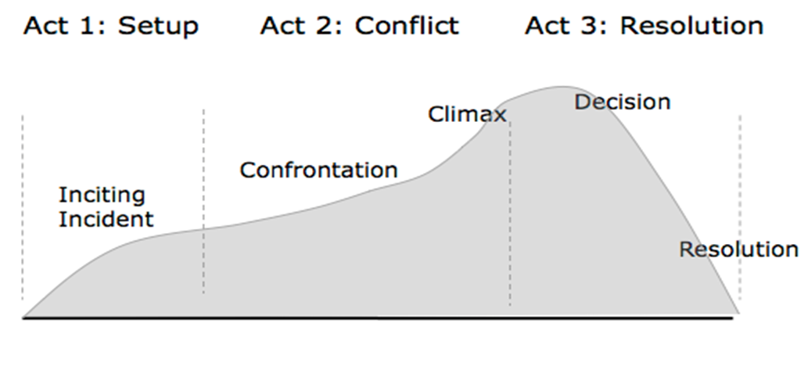

Narrative Story Arcs
or Falling Action
Notes:
This slide is the narrative story arc that most are familiar with which has always been called beginning, middle and end for early elementary. Most instruction through elementary school follows the traditional arc but never develops students past it. CCSS is asking that we require students to become so familiar with this arc by second grade that the focus for third through fifth grade for students can be on fully developing characters, scenes, theme, mood and other elements.
Mastery of the other parts of narrative structure occurs when using mentor texts during reading and then allowing students to develop the skills through their writing. The next few slides will discuss the different aspects of narrative elements and how they can be advanced for elementary writers. The terms on this particular arc have a variety of names for the actual elements. The CCSS does not dictate which terminology to use but rather a concentration on organization and sequence.

Slide 28

Character Presentation
Six methods
  Appearance
  Action
  Dialogue
  Thought
  Authorial
  interpretation
  Interpretation by
  another character
Notes:
Appendix A states that “over time, students should learn to provide visual details of scenes, objects, or people; to depict specific actions (for example, movements, gestures, postures, and expressions); to use dialogue and interior monologue that provide insight into the narrator’s and characters’ personalities and motives; and to manipulate pace to highlight the significance of events and create tension and suspense. Much of this can be done through character presentation and scene setting: two of the elements set at the beginning of a story.
There are six methods of presentation common to many narrative types but not all need to be offered in every narrative and not at every grade level. Some of the higher level may be saved for introduction and 5th and mastered in 6th-8th grades. The methods are:
dialogue: this is speech that is exchanged between characters and should only be used when dialogue can add to defining something about the characters or advance the action of the story.
appearance: describing in detail the appearance of the characters can set the mood or tone as well and is very important to understanding the character’s character.
actions and thoughts: the action and thoughts of the characters should advance the rising action and climax of the narrative.
authorial interpretation: also referred to as Authorial intent which is the meaning the author intends to convey
and interpretation by another character: how the author allows the other characters in the story to interact/interpret each other. (Burroway, Stuckey-French, & Stuckey-French, 2011)
Appearance and actions would be the most easily conveyed character presentation methods however, using actions and thoughts to advance the climax is a more progressive skill and should be introduced in later grades.
Students in more advanced grades must move past the mere task of simply telling what happened in detail. Plot occurs when the writer examines human reactions to situations that are always changing. How does love, longing, regret and ambition play out in a story? It depends on the character the writer has created.
Character presentation begins as early as 2nd grade so the focus for MS and HS as new skills can be using action to advance the plot, authorial interpretation and interpretation by another character and more advanced dialogue.

Slide 29

Setting or Scenes
Atmosphere
  Locale, period,
  weather, time of day
Mood
  Sets up character’s
  character
Tone
  Can add conflict
  Can evoke emotion
Notes:
Next, the scene setting, or world that the characters exist in must be established. Characters rarely ever stay in one place so consider spinning a story in a series of episodes. If reading standards are asking for mood and tone, begin to model these in the classroom with mentor texts and begin to creatively call for them in writing pieces. As a student progresses through MS and HS, this is when the expectation of mood as denoted on this slide and tone would be well established expectations to evoke emotions and conflict.
Writers call scene setting the atmosphere and it consists of the locale, period, weather, time of day, and mood. “Part of the atmosphere is its tone, an attitude taken by the narrative voice that can be described in terms of a quality—sinister, facetious, formal, solemn, and wry. The two facts of atmosphere, setting and tone, are often inextricably mixed” (Burroway, Stuckey-French & Stuckey-French, pg. 167). Scene setting should serve a larger purpose by creating the tone and mood. Scene setting can do a number of things. Describing how a character would set up their space, such as a room they occupy, like a locker or a kitchen, is an efficient way to also sketch the character’s character. Scene setting also can add conflict or even evoke emotion according to Jack Hart (Hart, 2011).

Slide 30

Action
Change or possibility of change
Climax
Leads to
resolution
Notes:
Plot is what happens in a story, but action itself doesn’t constitute plot. Plot is created by the manner in which the writer arranges and organizes particular actions in a meaningful way. It’s useful to think of plot as a chain reaction, where a sequence of events causes other events to happen. (OWL, Purdue).
The CCSS make very clear statements about time or sequencing events and to that end, action can be clarified through sequencing events. Action is also clarified by the change or possibility of change that a character will make leading them towards a resolution. Authors need to “include which chunk of time they will share in their stories, how to organize those events within the story, highlight the important moments in time for audiences, decide when to begin and close the presented time in a story, and how to link the events together” (Frederickson, Wilhelm & Smith, pg. 59).
The CCSS suggest ways to incorporate time and present action. These include, but are not limited to, using temporal words and phrases to signal order of events, using an assortment of transition words and phrases to signal sequence or designate shifts from one time frame to another, sequence events for a particular effect or tone to the story, and providing a closure that signals a logical end to the events preceding it (Frederickson, Wilhelm, & Smith, 2012). The arc of the story or climax is the single moment in the character’s life that culminates in a defining choice after which nothing will be the same again. It is the power struggle between the antagonist and protagonist whereas the reader is left in doubt about the outcome (Burroway, Stuckey-French, & Stuckey-French, 2011). Power can be represented by using strength or weakness, looks, artistic talent, and social privilege.

Slide 31

So What is My Role?
You do have the responsibility to provide instruction in the kinds of reading and writing that are specific to your academic discipline.
Notes:
Small group instruction to those students who are not able to access the text; that means you scaffold to the small group of students who have plans set in place for them or you know cannot access the text without great assistance, and we emphasize great. The rest of the class must grapple with the text in order to improve their academic reading, writing and speaking/listening skills in that content area. This means that providing strategy instruction

Slide 32
Who teaches Writing?
Everyone!
What types of writing do you teach?
Argumentative
Informational/expository
narrative nonfiction
Notes:
Please be clear that we are not asking content teachers who are preparing students for scientific inquiry to abandon their traditional expository methods of writing a lab report. We are asking that a healthy diet of essays, such as argument writing for a specific engineering device be written…scientists have to lobby for their research on a regular basis if they are to win grants so writing arguments is a natural form of discourse in the science classroom. We are also asking that a healthy diet of descriptive writing be infused into the art classroom upon occasion so that students understand imagery and sensory details and how this can transfer to other content areas. Finally we ask that history classes and other social sciences infuse narrative nonfiction so that students understand human nature and that rising action has moved most historical events forward.

Slide 33

Mixing Genre
Explanatory
Narrative
Nonfiction
Historical or
Scientific
Essay
Notes:
These are a couple of types of writing that tend to overlap as students progress to MS and students will experiment with these genre more readily.
PARCC begins to assess narrative elements in narrative nonfiction as early as 4th grade. Students should have a command of recognizing all writing types including when genre is blended.
**As a note if teachers would like to know these types of writing, they may visit the writing website and view the research base. Explanatory Narrative Nonfiction is used by many news stations when they tell a story on TV and Historical or Scientific Essay tends to take a topic and make a claim and substantiate it with evidence in one of the subject areas.

Slide 34
Narrative Nonfiction
or Falling Action
Description of vast potato fields in Idaho through use of imagery. Time is deep structure and potato farm is part of McDonald’s Corp.
Potato is harvested by field hands who have cared for it, sent it for washing, and send it to a processing center. It is here that it will be sliced, seasoned, and packaged. The potato will then be sent along with many others on a journey.
Climax is revealed by its arrival to a destination which may be in Japan, Italy, Germany or your local McDonald’s. It is cooked and served for it’s anxiously awaiting customer.
(J. Hart, 2012: Storycraft)
Notes:
Although narrative writing is traditionally and for the most part still the responsibility of the ELA teacher, writing is everyone’s responsibility. This is one example of how easy it is to transfer the duty of narrative nonfiction into many other content areas.
A genre that has narrative elements but is expository in structure is the narrative nonfiction piece. It is mentioned in this presentation due to it’s narrative base. Narrative nonfiction is another structure that students will need exposure to in order to understand the differences in genre. This type of writing is used in countless storybook structures and can be modeled with even HS students. Books that describe the life of a person and include dialogue are generally narrative nonfiction as well.
Again, students need to begin to recognize this structure through read alouds and locate the elements as they are repeatedly exposed. As the Illinois Learning Standards progress, students from elementary should come to you with this knowledge as they will have been assessed on it by PARCC.

Slide 35

“You can teach more and faster, but students will simply forget more and faster.”
Eric Jensen

Slide 36

Research is clear!
The only way to become a better reader is to READ!
(Allington, 2011)
Notes:
There is extensive research to support the premise that the best way to become a better reader is to read more. (Allington, 2011)
In order to address the reading and writing standards, student will need to read and write. How much reading and writing is occurring in a school day, a school year, in a K-12 education.
The strategies that will be presented today will help teachers “get at the CCSS” and prepare students for world which is full of reading and writing.

Slide 37
What Happened to Phineas?
Attend the tale of Phineas Gage. Honest, well liked by friends and fellow workers on the Rutland and Burlington Railroads, Gage was a young man of exemplary character and promise until one day in September 1848. While tamping down the blasting powder for a dynamite charge, Gage inadvertently sparked an explosion. The inch thick tamping rod rocketed through his cheek, obliterating his left eye, on its way through his brain and out the top of his skull.
Strategy #1:
Close Reading

Slide 38
The rod landed several yards away, and Gage fell back in a convulsive heap. Yet a moment later he stood up and spoke. His fellow workers watched, aghast, then drove him by oxcart to a hotel where a local doctor, one John Harlow, dressed his wounds. As Harlow stuck his index fingers in the holes in Gage’s face and head until their tips met, the young man inquired when he would be able to return to work.

Slide 39
Within two months the physical organism that was Phineas Gage had completely recovered - he could walk, speak, and demonstrate normal awareness of his surroundings. But the character of the man did not survive the tamping rod’s journey through his brain. In place of the diligent, dependable worker stood a foul-mouthed and ill-mannered liar given to extravagant schemes that were never followed through. “Gage,” said his friends, “was no longer Gage.”

Slide 40





Slide 41
Questions
How did Phineas survive this penetrating brain injury?
For how much longer did he live?
Where’s the evidence?
Notes:
These two questions are solid key ideas and details questions as they relate to the standards. They require students to return to the text to answer them but do they require students to gather evidence to support their answer? This is stated specifically in standard one…We also said earlier in the presentation that the learning standards cannot be met without reading AND writing…so how could we take the article just read and plan some other questions that would meet more of the standards?
Allow participants time to try this at their tables…return to the slide 40 and view the Close Reading process for informational texts in order to assist them… How could they include a writing task to meet the standards as well?

Slide 42
Close Reading RI grades 6-12
Key Ideas and Details
Craft and Structure
Interpret words and phrases
Focus on Tier Two Vocabulary
Integration of Knowledge and Ideas
Evaluate the different medias.
Integrate information from several sources to address related themes and concepts.
State what the text says explicitly and support it with evidence.
Identify the central idea and theme(s).
Analyze relationships, concepts, or events.
Discuss purposes and points of view.
Analyze features and structures of text.
Focus on 6 Text Structures
Notes:
Students can conduct a close read on any shorter chunk of text that will have the expectation of multiple reads but the purpose for those reads will uncover different layers or meanings. This is not a new concepts and was actually born into practice in monasteries but became a more popular form of educational practice in the 19th century.
For example in a SS or History class, a teacher might select a primary source such as Patrick Henry’s Speech to the Second Virginia Convention or a science teacher may select journal pages from DaVinci’s notebooks, all which are available online. The first time students would study these documents looking for key ideas and details. This will consist of stating what the text says explicitly and identifying the central idea. Students will analyze any events and relationships to other events that may be going on at the same time.
On a second reading, the teacher and students will focus on the author’s craft and structure of the text by interpreting words and phrases and the intent with which those words were written. A focus on tier 2 vocabulary will be made along with an analysis of the features and structures of the text. Is the text written in problem/solution format, cause and effect, compare/contrast, question/answer, or other structures? What point of view has the writer taken and what would have been the reasons for that view point? Is there bias involved and why? Did the audience provide that bias and why? This is a completely different lens to which students must begin viewing texts through.
And finally, on a third or final reading, teachers would ask students to look at different medias that the same writing may have been given, in an artistic representation, a recorded speech, lyrics in a song or another author may have written about the topic in a news article and took a different viewpoint. Or if the same topic is written about in multiple ways, such as the civil rights movement, students should evaluate these sources and address their themes and concepts.
It is important to note that these do not have to happen in a particular order necessarily but in order to meet the standards, it is important that you choose a meatier piece of text that allows you to meet many of these options.
Close Reading should always have a writing task integrated within it so as to foster the reader/task portion of the text complexity model, speaking and listening standards, writing and language standards and assist with possible summative assessment tasks that will align with standards implementation as well.

Slide 43
Notes:
Use the next two slides to assist with questions for integration of knowledge and ideas.

Slide 44
A dentist found the source of the toothache Patrick Lawler was complaining about on the roof of his mouth: a four-inch nail the construction worker had unknowingly embedded in his skull six days earlier.
http://vms.vale.k12.or.us/sites/vms.vale.k12.or.us/files/u13/ebola.pdf
Notes:
Link is just about how a text should look after a close reading—how annotating should look…it’s ok to mark text and should be encouraged. At end of presentation, there will be resources and links that share how this can be incorporated in the classroom.

Slide 45

The brain can only pay attention for so long before it needs to stop and think about what was just said, heard or seen.
Notes:
After a small chunk of information is acquired, processing must take place. Once this chunk is understood and mastered, the learner is ready for the next chunk of related information. Then processing time is given for this chunk. This continues until the grand finale processing activity is used to pull all the learning chunks together.

Slide 46


Ten Important Words and
The Frayer Model RI 4
Vocabulary Word
Definition
Characteristics
Examples
Non-examples
Strategy #2
Notes:
Word knowledge is highly related to comprehension and should receive focused attention across the curriculum. Explicit instruction of words and the establishment of an environment that promotes word consciousness are key ways to enhance students’ vocabulary.
The strategy Ten important Words Plus is based on principles of effective vocabulary instruction and can be used at any grade but can be very useful with content area texts when paired with the Frayer model.
Distribute a text to be read and 10 sticky notes to each student.
Students read the text and, while reading, identify and record 10 words from the text they consider key to the content.
Students construct a bar graph with their notes. As identical words are contributed, vertical columns are constructed.
Each new word begins a new column.
Engage students in a discussion about the graph and choose the words that the group feels most identifies the
key concepts of the text.
Distribute a Frayer model chart to pairs of students. Pairs will choose one of the words from the graph and fill in the Frayer model chart. Students can replace examples and non-examples with synonyms and antonyms if need be.
Students find other ways to use the word in context and share their findings in a group setting.
OR: Share Marcia Grant’s lesson from Teaching New Literacies in Grades K-3: Resources for the 21st Century by Barbara Moss and Diane Lapp. (Reading a Science Experiment: Deciphering the Language of Scientists, p. 174-182).

Slide 47
Franklin D. Roosevelt’s State of the Union Address (1941)
For there is nothing mysterious about the foundations of a healthy and strong democracy. The basic things expected by our people of their political and economic systems are simple. They are:
Equality of opportunity for youth and for others.
Jobs for those who can work.
Security for those who need it.
Notes:
Ask participants to read the text—short speech…will think, pair, share about 2 things:
what are the components of this economic system that are eye opening to you personally after almost 75 years later?
consider this to be an introduction to a study of economics…what are ten important words that are necessary to understand this text? Can you think of some tasks that might be created?

Slide 48
The ending of special privilege for the few.
The preservation of civil liberties for all.
The enjoyment of the fruits of scientific progress in a wider and constantly rising standard of living.
These are the simple, basic things that must never be lost sight of in the turmoil and unbelievable complexity of our modern world. The inner and abiding strength of our economic and political systems is dependent upon the degree to which they fulfill these expectations.

Slide 49
Many subjects connected with our social economy call for immediate improvement. As examples:
We should bring more citizens under the coverage of old-age pensions and unemployment insurance.
We should widen the opportunities for adequate medical care.
We should plan a better system by which persons deserving or needing gainful employment may obtain it.
I have called for personal sacrifice. I am assured of the willingness of almost all Americans to respond to that call.

Slide 50
A part of the sacrifice means the payment of more money in taxes. In my Budget Message I shall recommend that a greater portion of this great defense program be paid for from taxation than we are paying today. No person should try, or be allowed, to get rich out of this program; and the principle of tax payments in accordance with ability to pay should be constantly before our eyes to guide our legislation.
If the Congress maintains these principles, the voters, putting patriotism ahead of pocketbooks, will give you their applause.

Slide 51
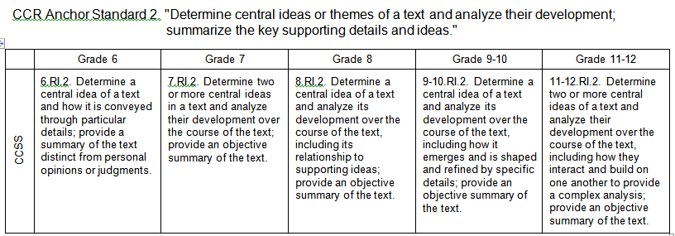
Central Ideas and Summarization
Standard #2
Strategy #3

Slide 52
Resources for Teaching Summarizing
http://www.adlit.org
Click on Classroom Strategies
Click “Paragraph Shrinking” or “Summarizing”
www.readingquest.org
Click on Strategies
Click on Selective Underlining/Highlighting
Click on Summarizing

Slide 53

Article of the Week www.kellygallagher.org
https://www.teachingchannel.org/videos/teaching-science-with-current-events
http://www.northbergen.k12.nj.us/Page/2853
http://vms.vale.k12.or.us/articles-week

Slide 54
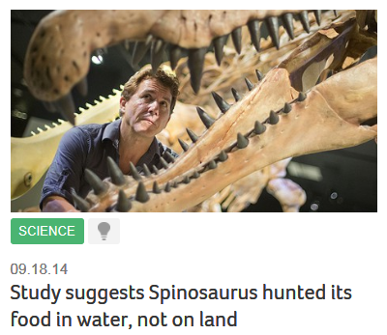
Newsela.com
Newsela is free for students to explore a world of nonfiction
and test their comprehension.
Updated daily with real-world news from major publications.
Every article at 5 levels: Grades 3-12
Common Core-Aligned
High Interest Topics
www.newsela.com
Notes:
Read to participants and ask if anyone is currently using this resource and if so how they like it and how they use it. If time, go to the site.
For students who are special education or ELL teachers can alter the text by
Alter:
Pace
Task
Complexity
Chunk

Slide 55
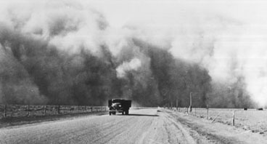
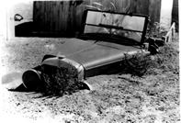

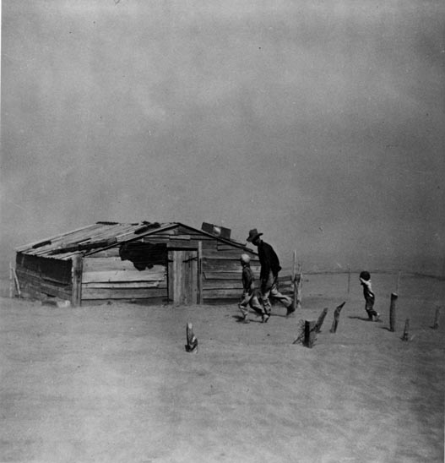
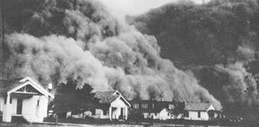
Teaching with Documents
Strategy # 4
Notes:
The activity is taken from Teaching With Documents www.edteck.com/dbq Developed by Peter Pappas.
Teaching with documents is a fun strategy that can be used with photographs as you will see us utilize here. It can also be done with posters, paintings, advertisements, etc.
Teachers will complete the activity posted on chart paper as a research starter. (Presenter will place three columns on chart paper listing the 3 steps below)
Participants should have a working knowledge of their grade level standards and then view these pictures. They have three columns on a chart paper that need to be answered. These are quick writes and the inferring allows the teachers to springboard the questions that are formed at the end of the activity into a mini research paper.
Step 1. Study the photograph for 2 minutes. Form an overall impression of the photograph and then examine individual items. List people, objects, and activities in the photograph.
Step 2. Inference
Based on what you have observed above, list three things you might infer from this photograph.
Step 3. Questions
What questions do these photographs raise in your mind? Now choose one and use that question to formulate a short research paper.

Slide 56
Contact Information
Questions or comments?
plscomments@gmail.com

