Slide 1
Using Teacher Evaluation Data for Differentiated
Professional Development and School-Wide Improvement
Responsive Professional Development
Maryellyn Friel, NBCT
maryellyn.friel@comcast.net
Notes:
Welcome everyone
Give background on me and how I got here today.
Let everyone know—that the beginning of this session will be responding to 3 questions. There is a hope that all will share at least with a partner. I know this can be an awkward way to start but I think we all need a sense of the room—especially the many journeys and experiences around this topic.

Slide 2
Background in Teacher Evaluation
Appraisal
Educator for 32 years
National Board Certified Teacher in 2007
On the bargaining team that negotiated a standards based (Danielson) system 2007
Worked as a trainer to implement system TAP
Served on my district’s Teacher Appraisal Plan Oversight Committee since 2008
NEA Foundation Team developed Peer Assistance and Review (PAR)
Teacher Co-chair of PAR Panel
State Certified to Evaluate Practice
Led conversations on Peer Evaluation
Participate in Danielson training whenever possible
New Teacher Center Induction Training Modules
District mentor since 2010
Learning Focused Conversation Training—in district
Exploratory Team for Student Growth 2016-present
Committee for Student Growth Support Development
Led/Developed a site based Frameworks Workshop
Love participating in conversations about teacher practice and potential
Notes:
This is me establishing my credibility and giving you a sense of where my journeys have been that have influenced my thinking

Slide 3
Where are you now linking teacher evaluation and professional development?
Take a moment and write on a sticky note.
Notes:
After a few minute—ask participants to share with an elbow partner. Then ask for 3 people to share conversations.

Slide 4
What are your key beliefs around teacher evaluation and professional development?
Take a moment and write on a sticky note.
Notes:
After a few minute—ask participants to share with an elbow partner. Then ask for 3 people to share conversations.

Slide 5
How would your evaluate staff readiness?
What roadblocks do you face?
Take a moment and write on a sticky note.
Notes:
After a few minute—ask participants to share with an elbow partner. Then ask for 3 people to share conversations.
My role today is to share what I have learned and perhaps

Slide 6
Where are you now?
What do we know about what impacts
student learning?
  Teacher Practice
  School Leadership
  Principal’s Role
  School Culture
    Trust
    Candor
Notes:
The most direct impact on student learning is teacher practice.
School Leadership is the second more indirect factor that impacts student learning and achievement. School Leadership, to me, includes EVERYONE. Some district—personal bias—believe only someone with a title can be a school leader—I would submit—and I’m moving to the next topic—EVERYONE in the school needs to looked at as a leader bc that’s what you do everyday when you step into a classroom—you lead!
I tend to use Principal and Administrator interchangabally—for purposes of today—know that I am refering to
School leadership is the second influential factor, after classroom instruction, that contributes to student learning and achievement (Leithwood, Day, Sammons, Harris, & Hopkins, 2006). Principals influence student learning in many ways, including monitoring instruction, fostering a positive climate, and evaluating teachers (Bryk, Sebring, Allensworth, Luppescu, & Easton, 2010; Leithwood, et al., 2006; Louis, Leithwood, Wahlstrom, & Anderson, 2010; Wallace Foundation, 2012). How principals conduct themselves in these activities is a result of their beliefs.

Slide 7
Key Beliefs of Evaluators
Opportunity
Vehicle for Improvement
Communicating
Relationships
Teachers as the Owners
All evidence
Context Matters
Growth Mind Set
Notes:
See evaluation as an opportunity for increasing quality of instruction
Vehicle that can lead to improved outcomes for students
Invest time to build relationships
Teacher evaluation IS communicating about evidence presented
View Teachers as the Owners of their Practice
Vetting of Evidence—what does this mean? the conversation has led to a discussion on evidence context, all evidence brought forth has been considered—not just evaluators

Slide 8
Key Belief—Growth Mind Set
Collaborative Process
Supports Efforts to Improve
Encourage Persistent Learning
Evidence Promotes Thinking
“Aha” Moments NOT “Gotcha”
ACTIONS follow BELIEFS
Notes:
Foster a Growth Mind Set in Teacher Evaluation
Approach learning as a collaborative process by supporting a teacher’s efforts to improve
Encourage persistent learning by initiating discussions around instruction
Be aware of teachers needs and interests
Use observational evidence to generate questions and promote thinking
Not a Gotcha Moment with no way to recover—these are “Aha” Moments

Slide 9
Challenges
Compliance
District Mandates
Other Duties—One Man Band
Developing & Maintaining Relationships
Not Taking it Personally
YOUR Practice
TIME, TIME, TIME,
Resistive Staff
And More
Notes:
Compliance aspect of evaluation—deadline and contractual agreements
District Mandates
Other duties—one man band
Developing and Maintaining relationships
Not taking it personally—ladder of inference
Improving your practice—improving your background knowledge to enhance your practice
TIME, TIME, TIME
How do you get to classroom/make time—discussion??? Schedule it and stick to schedule—start year with a plan…
Are there more—yes—name them

Slide 10
Resistive Staff
Engage/Empower
Reflect/Build Relationship
Offer Choices
Remove Yourself as Expert
Reflect/Share on Adult Learning
Meet where they are at--Time
“Treat people as if they were what they ought to be and you help them to become what they are capable of being.” Johann Wolfgang von Goethe
Notes:
Engage—look for ways for these staff members to be in a leadership position—ex—present on an attended PD OR invite them to observe a learning conversation—use self assessment—WE will talk more about this in a moment OR invite to be on a school committee OR depending on practice—ask to mentor
Sometime resistive people need more time to trust…or need to see the impact on someone else to trust…
Offer choices—put it back on them—self assessment, LOP—even if they move it to a rating you don’t agree with—ask to present or ask how to move from proficient to distinguished--

Slide 11
Where is Staff at now?
Leverage Existing Evaluation Structures
Involve staff in assessment
Don’t assume Determine
Include the why

Slide 12
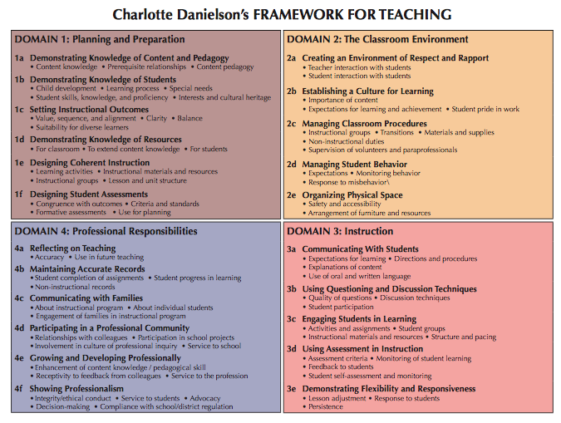
Where are WE now?
Leverage Evaluation Structures

Slide 13
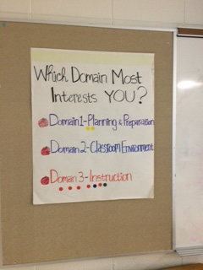
Where are WE now?
Leverage Evaluation Structures

Slide 14
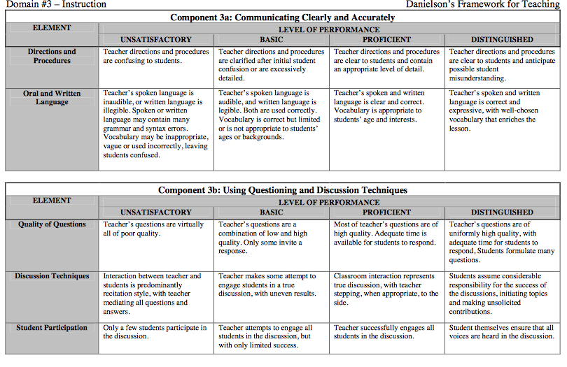
Where are WE now?
Leverage Evaluation Structures

Slide 15
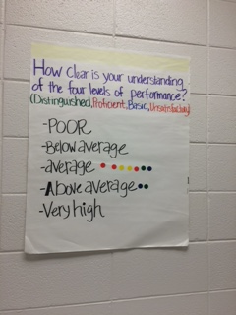
Where are WE now?
Leverage Evaluation Structures

Slide 16
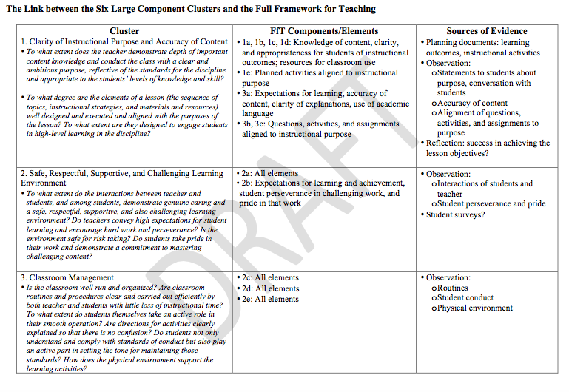
Where are WE now?
Leverage Evaluation Structures
Notes:
Here’s my DIAS---this tool is an under

Slide 17
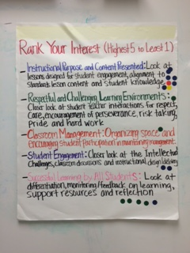
Where are WE now?
Leverage Evaluation Structures

Slide 18
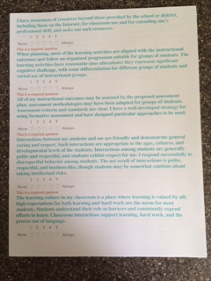
Where are WE now?
Leverage Evaluation Structures
Notes:
This is a Needs Assessment put together based on Component Descriptors for PAR. It’s just another format to get feedback—if you want an anonymous format using a self reporting system.

Slide 19
Where are WE going?
“…professional development … extends beyond mere support for teachers' acquisition of new skills or knowledge. Professional development today also means providing occasions for teachers to reflect critically on their practice and to fashion new knowledge and beliefs about content, pedagogy, and learners.”
“Teacher development must focus on deepening teachers' understanding of the processes of teaching and learning and of the students they teach. Effective professional development involves teachers both as learners and as teachers and allows them to struggle with the uncertainties that accompany each role.”
Linda Darling-Hammond (1995)
Notes:
Policies that support professional development in an era of reform Authors Darling-Hammond, Linda; McLaughlin, Milbrey W. Close:bloPhi Delta Kappan Close:block:publicationBlock 76.8 (Apr 1995): 597.

Slide 20

Where are WE going?
Responsive Professional Development
Differentiated Professional Development
Sustainable
Meaningful Change
Build Capacity

Slide 21
How do we get there?
Moving the Evaluation Conversation Towards PD
Individual
Site/School/Department

Slide 22
How will WE get there? Relationships
  Trust Building—small before big
  Nurture the Trust
  Active Listener
  Model Honesty
  Share Responsibility
  Build Shared Understanding
Notes:
Speed up trust building
Small conversations before big builds trust—Do you know me or just my name?
Activity—Possible—Use sticky notes
Think about the qualities of someone you trust—What words come to mind? List out loud
Think of a time when you were given advice about your practice and you refused? What caused your refusal?
Active listener-not a rating giver
Model honesty—disclose personal thinking
Share responsibility—the what you do may be decided but the how should be shared
Shared Understanding—be mindful of where individuals are at in their understanding of Teacher Standards Based components, LOP, evidence, etc.

Slide 23
Examine Trust
Think about the qualities of someone you trust—What words come to mind?
Think of a time when you were given good or solid advice and you refused? What caused your refusal?

Slide 24
Know Me Not Just My Name
ACEs training
Self-assessment
Write all names of staff on a card
Rate/Star/Highlight relationship
Challenge—flip activity

Slide 25
How will WE get there? With Intention
  Danielson says evaluators should “assess accurately, provide meaningful feedback, and engage teachers in productive conversations about practice.”
  Skills required for this were covered this morining
Notes:
Speed up trust building
Small conversations before big builds trust—Do you know me or just my name?
Activity—Possible—Use sticky notes
Think about the qualities of someone you trust—What words come to mind? List out loud
Think of a time when you were given advice about your practice and you refused? What caused your refusal?
Active listener-not a rating giver
Model honesty—disclose personal thinking
Share responsibility—the what you do may be decided but the how should be shared
Shared Understanding—be mindful of where individuals are at in their understanding of Teacher Standards Based components, LOP, evidence, etc.

Slide 26
How will WE get there? With Intention
  Focus on the Evidence
  -linking to standards, interests, strengths or needs
Use Coaching Conversations
  Paraphrase
  Clarify Questions
  Interpreting
  Meditational Questions
  Summarizing
  Non Verbal
  Guidelines for Effective Feedback
  Plan but be flexible
Notes:
Plan your feedback BUT be open and ready to move where the conversation/evidence takes you
PLANNING is yet another way to build school culture and build TRUST.
The ability to plan your feedback is CRITICAL, but should be added to one of your CHALLENGES—planning is key is all aspects of education not just the classroom…by planning your feedback—you are intentionally shaping the “ahas”

Slide 27
How do we get there?
Conversation Structures
Point and Describe Love & Logic
I noticed you _______ and as a result_______.
    I noticed you wrote the directions as you said the directions and as a result I saw 3 students tracking as your wrote with their eyes.
    I noticed you asked for 5 more minutes and as a result 1 of 3 students stopped packing to leave.
    At this point, I’d rate classroom management at proficient.
Notes:
Point and Describe—from Love & Logic—I noticed you ________ and as a result _____________.
Positive example—I noticed that you wrote the directions as you said the directions and as a result I saw 3 students tracking as your wrote with their eyes. Discuss link to FfT—3A. This focus here may lead to next steps.
I noticed 5 students begin to pack up to leave and as a result you asked them to give you 5 minutes with 1 student stopping. Here might be an opportunity for conversation on 2d managing classroom behavior
I rate your classroom management as basic.
Last comment does not lend itself to conversation

Slide 28
How will WE get there?
Next Steps Structures
Goal, Status, and Plan
  Identify standard/component/outcome desired
  Identify where individual/group is in relations to goal
    Requires either agreement on meeting goal such as what the evidence should look like and/or understanding of LOP in Danielson
  Identify Steps and Supports needed
    Agree on a timeline to check in and complete
    Discuss how decision will be made—majority, consensus
    Remember greatest resource is each other
Notes:
“Goal, Status, and Plan for the Goal”—Identify the standard/outcome—this can be a strength, a need or an interest—don’t limit options to only need based. Then have the teacher identify where they are in relations to the goal. This requires an understanding of the standard and LOP. Last, the TEACHER or GROUP identifies the steps and supports needed to extend, deepen the identified goal.
Here’s What, So What, Now What
Here’s What—data, factual statement, NO commentary
So What—Patterns of Practice does the teacher see, what does this say about practice
Now What—Next Steps—plan of action

Slide 29
How will WE get there?
Next Steps Structures
Here’s What, So What, Now What
  Here’s What—data, factual statement, NO commentary
  So What—Patterns of Practice
  Now What—plan of action
  Either of these structures can be used with individuals or group/committees or students
Notes:
Here’s What, So What, Now What
Here’s What—data, factual statement, NO commentary
So What—Patterns of Practice does the teacher see, what does this say about practice
Now What—Next Steps—plan of action

Slide 30
In Summary—Where to Begin………
Explore Your Evaluation Values & Beliefs
Take a Personal Inventory
Actions and Beliefs are in sync
Assess where your staff is at and your staff’s Knowledge of Assessment Standards/LOP/Evaluation System Requirements
Responsive
Professional
Development
Develop or Deepen Individual Relationships
When staff is ready, intentionally connect evidence to
PD Next Steps
Create a Plan
Leverage existing
structures
Examine Relationships.
Is there trust?
What Challenges do you face?
Are there other factors?
Utilize Conversations Structures
Coaching Conversations
What is the baseline of the staff’s knowledge?
Where are WE now?
How will WE
get there?
Sustainable
Change
Don’t Assume
Determine Readiness
Link Evidence to Standards
Where are WE going?
Coaching Conversation
Structures
Teacher
Directed
Teacher Ownership
Know Me Not Just My Name
Capacity
Building
Small conversations
before big ones
Differentiate
Develop/Nurture TRUST

Slide 31
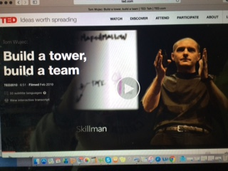
In Closing
Notes:
https://www.ted.com/talks/tom_wujec_build_a_tower?language=en#t-185803

Slide 32
Lessons Learned from Marshmallows
Don’t be CEO of Spaghetti Inc.
No one right way—no one right path
Skills of Facilitation
Manage the Process—don’t control the outcome
Rewards of Risk Taking
Informed Attempts led to success
Hidden Marshmallow Agenda
Shared Experience
Common stance to work together
Common Language
Common Goal
“Oh No” moment to a “Ta Da” moment

Slide 33
Your Next Step to Yourself
One envelope, one blank piece of paper
Summary—Where to Begin
Write one short-term goal—Oct date
Write one long-term goal—June 2015
Share as feel comfortable…..
Thank you for today!
Notes:
By the way…this is another structure to engage staff toward their next steps!!!!!!!!!!!!

