Slide 1
Welcome: We’ll begin shortly.
Background:
LINC seeks to promote greater understanding of early childhood and help school and early childhood leaders use knowledge about the field of early childhood education to foster improvements in all education from birth to grade 12.
The LINC curriculum is a flexible set of lessons.
Universities can incorporate LINC into their redesigned ed leadership programs.
Professional developers can include LINC in their training efforts.
Think: What do you want to learn about the LINC curriculum? What do you expect from this overview of it?
After the webinar begins, we’ll ask you to share one sentence about your expectations or one question you would like answered.

Slide 2
WELCOME TO THE LINC Curriculum on the Learning Continuum
Overview of the Curriculum

Slide 3
Agenda
Welcome
The Curriculum
Four Strands: 14 Lessons
How the Materials are Organized
Q&A

Slide 4
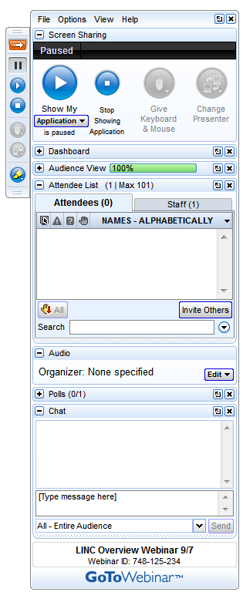
Norms for Webinar
Raise your hand when you have a question or a comment.
Use Chat to send text messages during the session.
Close other applications for best performance.
Keep your phone on mute when you are not speaking.

Slide 5
Introductions
Name
Organization
I want to learn about the LINC curriculum because…
In this webinar, I hope to learn…

Slide 6
Overview of the Curriculum

Slide 7
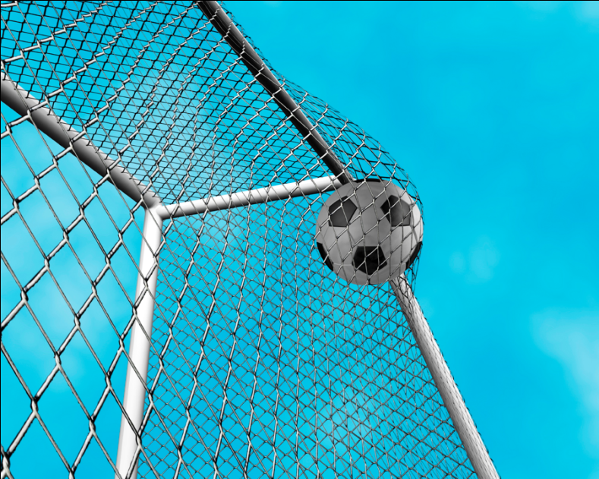
The Goal
Promote greater understanding of early childhood
Help school leaders and early childhood directors use knowledge about the field of early childhood education to foster improvements in all education from birth to grade 12.

Slide 8
The Solution
A series of lessons that…
Universities can incorporate into their redesigned educational leadership programs
Professional developers can include in their training efforts.

Slide 9
The Methodology
Three focus groups (21 participants) plus discussion with UIC faculty
Identify key skills, knowledge, and resources
Initial scope and sequence
LINC Curriculum Design Team
Big ideas
Skills and knowledge
Final scope and sequence
Resources/literature search

Slide 10
Design Team Accomplishments
Many, many resources
Prioritization
Recency
Relevance
Continual editing
Best of the best

Slide 11
LINC Design Team Members
Jodi Scott, Henderson/Mercer/Warren Regional Office of Education
Steve Tozer, University of Illinois at Chicago
Anthony Perone, University of Illinois at Chicago
Luann Shields, Prairie Children Preschool
Teri Talan, National Louis University
Dennice Ward Epstein, Illinois Alliance of Administrators of Special Education
Robin Miller Young, Prairie Children Preschool
Lynette Chandler, Northern Illinois University
Patti Palagi, Winfield Primary School
Johnna Darragh, Heartland Community College
Anissa Norris, Pershing Early Learning Center

Slide 12
Key Features of Final Curriculum
Flexibility
Resources
Links to web resources
Pre-lesson activities, in-class activities, and follow-up assignment
Worksheets and lecture notes

Slide 13
The Rollout
The LINC Curriculum Module can be found on the LINC website at: www.leadershiplinc.illinoisstate.edu
You will be asked to provide a username and password which Lisa can give you.

Slide 14
Overview of the Four Strands

Slide 15
The Four Strands
Strand 1: Birth Through Grade 12 as a Continuum and a Single System
Strand 2: Foundations of Early Childhood Education
Strand 3: Making Decisions About Curriculum, Assessment, and Instruction Across the Continuum
Strand 4: Building Effective Partnerships

Slide 16
Strand 1: Lessons
1.1
1.2
1.3
1.4
The Continuum
System Relationships
Features of Different Levels of Education
Successful Transitions
Strand 1: Birth Through Grade 12 as a Continuum and a Single System

Slide 17
1.1 Key Concepts
Learning: a continuum from birth through adulthood.
Understand where your learners come from and where they are going.
Alignment is important to enhancing learning across the continuum.
Building continuum requires cultural change.
Collaboration and communication are key to building an effective continuum.
Improving continuum requires leadership.
Strand 1: Birth Through Grade 12 as a Continuum and a Single System

Slide 18
1.2 Key Concepts
Education birth to grade 12 is a system.
What happens at age 3 impacts what happens at age 16.
Investments in early childhood programs benefit all other parts of the educational system.
Strand 1: Birth Through Grade 12 as a Continuum and a Single System

Slide 19
1.3 Key Concepts
Effective leaders at any age/grade level have a solid understanding of the levels that precede and/or succeed their own.
Strand 1: Birth Through Grade 12 as a Continuum and a Single System

Slide 20
1.4 Key Concepts
Transitions are often difficult for children.
Successful transitions are built on much more than the activities that occur immediately before, during, and after the transition.
Strand 1: Birth Through Grade 12 as a Continuum and a Single System

Slide 21
Strand 2: Lessons
2.1
2.2
2.3
Foundations of Early Childhood Education, Part I
Foundations of Early Childhood Education, Part II
Curriculum Models
Strand 2: Foundations of Early Childhood Education

Slide 22
2.1 Key Concepts
Birth to age 5: opportunity and vulnerability for physical, emotional, social, and cognitive development.
Risk factors may limit development in early years.
Variations in early experiences result in disparities in school readiness, and these gaps often persist.
Early childhood interventions are designed to counteract stressors in early childhood and promote healthy development.
Research: early childhood interventions can improve the lives of children and families.
Program features may be associated with better outcomes: well-trained caregivers, smaller child-to-staff ratios, and greater intensity of services.
Can translate into dollar benefits for the government, participants, and society.
Strand 2: Foundations of Early Childhood Education

Slide 23
2.2 Key Concepts
An understanding of early childhood education standards is essential for leaders.
There is not a single set of standards that apply to every program.
Strand 2: Foundations of Early Childhood Education

Slide 24
2.3 Key Concepts
A curriculum model is a framework.
Curriculum models primarily used in center-based and community-based early childhood settings.
Curriculum models in early childhood settings influenced by two federal programs in the 1960’s.
Curriculum models are based on theories of how children learn.
Strand 2: Foundations of Early Childhood Education

Slide 25
Strand 3: Lessons
3.1
3.2
3.3
3.4
Child Development and Educational Programs
Effective and Efficient Instructional Practices
Meeting the Needs of All Students
Assessment, Instruction, and Data-based Decision Making
Strand 3: Making Decisions About Curriculum, Assessment, and Instruction Across the Continuum

Slide 26
3.1 Key Concepts
Children develop in different domains.
The literature on developmental domains largely focuses on early childhood.
All the domains of children’s development and learning interrelate.
Strand 3: Making Decisions About Curriculum, Assessment, and Instruction Across the Continuum

Slide 27
3.2 Key Concepts
Developmentally appropriate practice: meeting children where they are and enabling them to reach challenging and achievable goals.
All curricula should be developmentally appropriate.
Learning experiences should be aligned across continuum.
Adult-child interactions are key.
Play-based learning supports growth in all developmental domains.
School principals and early childhood program directors must support teachers.
Strand 3: Making Decisions About Curriculum, Assessment, and Instruction Across the Continuum

Slide 28
3.3 Key Concepts
We can reduce the achievement gap.
The concept of Inclusion can be used to improve early childhood services for all children.
Differentiation improves achievement when done well.
Universal Design for Learning (UDL) is an approach to effective differentiation.
Response to Intervention (RtI) is an approach for redesigning and establishing teaching and learning environments.
Strand 3: Making Decisions About Curriculum, Assessment, and Instruction Across the Continuum

Slide 29
3.4 Key Concepts
Assessments are decision making tools that have multiple purposes.
To achieve their multiple purposes, teachers and leaders should use a variety of assessment tools.
Expectations for targeted student outcomes should be clear.
Assessments for dual language learners should be sensitive to the student’s first language.
Leaders play a special role.
Strand 3: Making Decisions About Curriculum, Assessment, and Instruction Across the Continuum

Slide 30
Strand 4: Lessons
4.1
Understanding Family-School Relationships
4.2
4.3
Building Effective Family-School Relationships
Building Collaborative Staff Relationships
Strand 4: Building Effective Partnerships

Slide 31
4.1 Key Concepts
Families matter.
Family-school partnerships matter.
The family-school relationship changes as the child matures.
Cultural factors influence family involvement.
Community supports for families strengthen the positive impact of families.
Strand 4: Building Effective Partnerships

Slide 32
4.2 Key Concepts
Family engagement skills must be learned.
Diversity matters.
Relationships come first.
Family engagement extends past the school walls.
Principals/directors lead the way.
Strand 4: Building Effective Partnerships

Slide 33
4.3 Key Concepts
In a birth to grade 12 system, communication and relationships matter.
Communication and building trust is the first step in establishing a true continuum.
Strand 4: Building Effective Partnerships

Slide 34
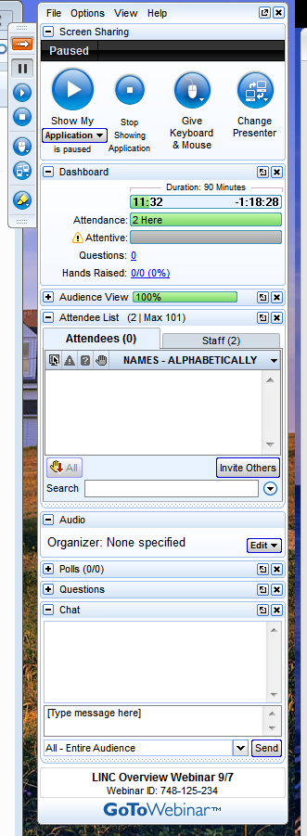
Questions About Strands?
Options:
Raise your hand to ask a question on audio.
Type your questions/comments in the chat box, then press SEND.
Type here

Slide 35
Overview of the Material Organization

Slide 36
At the Beginning of Each Strand
Purpose of the strand
Structure of the strand
Lessons in the strand
How to this incorporate strand into existing courses or existing curricula
Mix and match strands
Strand 1: Birth Through Grade 12 as a Continuum and a Single System
Strand 2: Foundations of Early Childhood Education
Strand 3: Making Decisions About Curriculum, Assessment, and Instruction Across the Continuum
Strand 4: Building Effective Partnerships

Slide 37
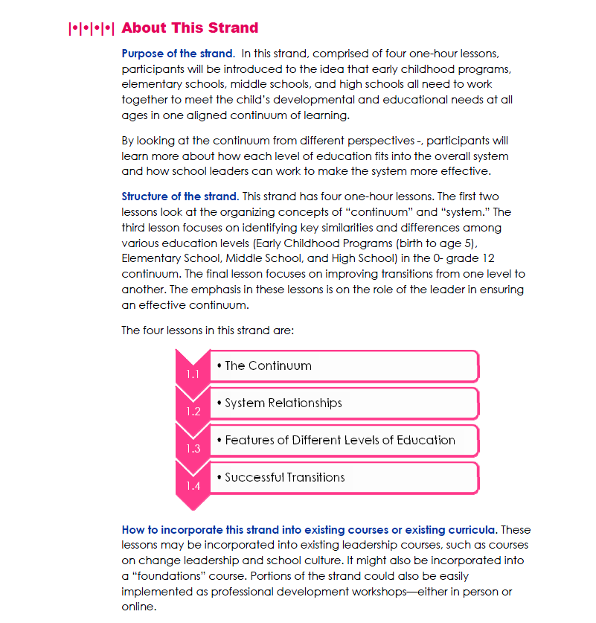
Strand Introduction: Example
Mix and match strands

Slide 38
In Each Lesson
Name of Lesson
Description
Prior to the lesson
During the lesson
After the lesson
Objectives
Lesson Summary Chart (with materials list)
Key Concepts to Teach
Your Essential Library
Pre-lesson Activities
For the instructor
For the student
Lesson Outline
Post-lesson Activities for the Students
Handouts and Resources
1.1
1.2
1.3
1.4
The Continuum
System Relationships
Features of Different Levels of Education
Successful Transitions
Strand 1: Birth Through Grade 12 as a Continuum and a Single System

Slide 39
In Each Lesson: Example
Name of Lesson
Description
Prior to the lesson
During the lesson
After the lesson
Objectives

Slide 40
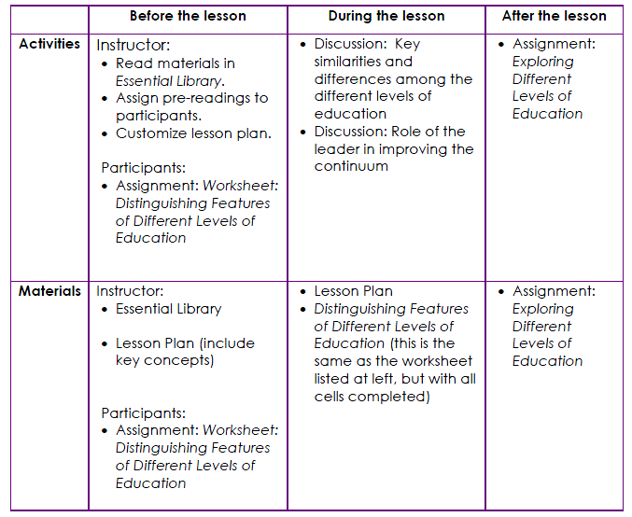
In Each Lesson: Example
Lesson Summary Chart
Use the activities
that best meet
your needs.

Slide 41
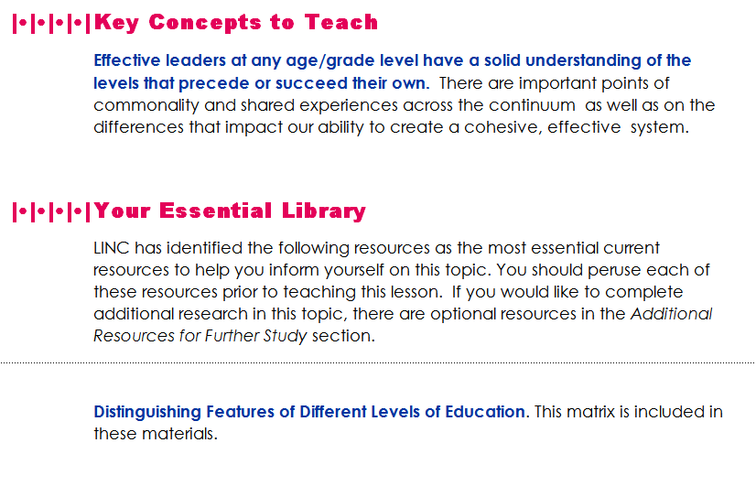
In Each Lesson: Example
Key Concepts to Teach
Your Essential Library

Slide 42
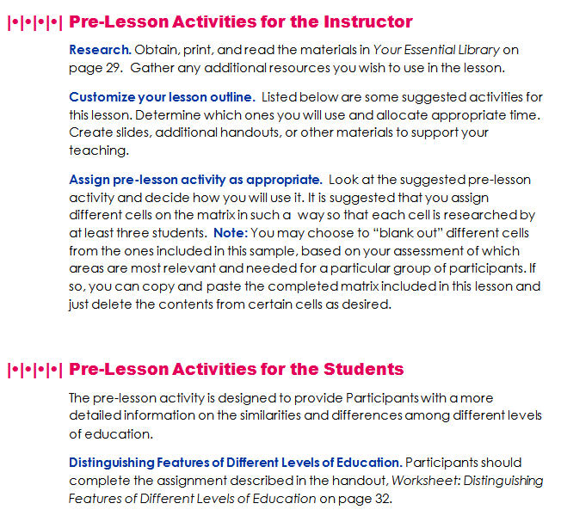
In Each Lesson: Example
Pre-lesson activities

Slide 43
In Each Lesson: Example
Lesson Outline
Post-lesson Activities for the Students
Suggestions for engaging learners

Slide 44
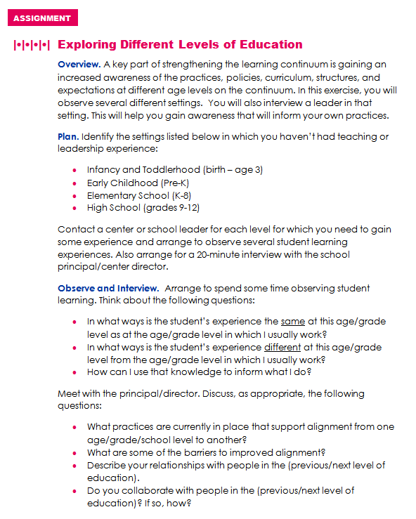
In Each Lesson: Example
Handouts and Resources
Assignment worksheets to enhance learning

Slide 45
Questions About the Format?
Options:
Enter your questions in the chat box.
Raise your hand to ask a question on audio.

Slide 46
Summary
We welcome…
… you to use the materials in ways that benefit your students.
… feedback on how the materials meet your needs.
… suggestions for new resources or research that can improve the curriculum.

Slide 47
Q&A

Slide 48
Wrap Up

