Slide 1
Classroom Strategy Cards
Cards can be printed out and kept close to help!
If printing from powerpoint, select 6 slides per page for a convenient size!

Slide 2
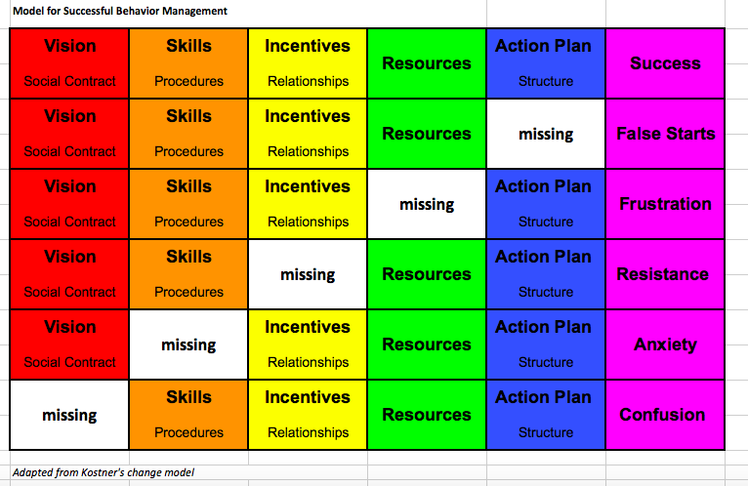

Slide 3
2 x 10
Choose a student (or 3) that challenge you the most
Spend 2 minutes a day talking to them about anything that interests them
Repeat this process for 10 days IN A ROW

Slide 4
Paper Clipping
Find a staff buddy in the building
Have an agreed upon arrangement for time outs or breaks
Give student the number of paper clips that corresponds to the number of minutes needed.
You cannot give a student an entire box!

Slide 5
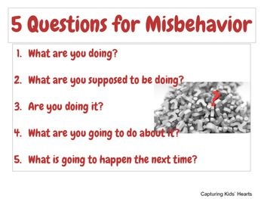

Slide 6
Positive Communication Strategies
Give clear directions
Use a neutral, calm voice
Give yourself and the student time
Use enforceable statements
Use few words
Offer choices
Discipline in private
Tag team
Follow through with consequences

Slide 7
An Effective No has no_____
Blame
Disrespect
Bias
Sarcasm
Apology
Frustration
Confusion
Anger
Guilt
Hesitation
Reactivity
Drama
Ambivalence
Explanation
Loop holes
Inconsistency

Slide 11
CHAMPS
Conversation: Can students talk to each other during this activity?
Help: How do students get the teacher’s attention and their questions answered?
Activity: What is the task/objective? What is the end product?
Movement: Can students move about during this activity?
Participation: How do students show they are fully participating? What does work behavior look/sound like?
Success: When students meet CHAMPS expectations, they will be successful!

Slide 12
CHAMPS 3:1
Three positive interactions for every negative interaction.

Slide 13
Proximity Proximity Proximity
Stay on your feet
Stand close but don’t hover
Set the expectations early
Make yourself available
Avoid using words
Notes:
One of the main reasons why proximity control works is because students become hyperaware of the teacher’s presence and the implicit standard that presence demands of them. When the teacher is at the front of the classroom talking to all students, then no particular individual or group feels “singled out.” If instead the teacher stands close to a few students, those students feel that slightly more specific attention is directed towards them, and adjust their behaviors in a way that better fits the teacher’s expectations.

Slide 14
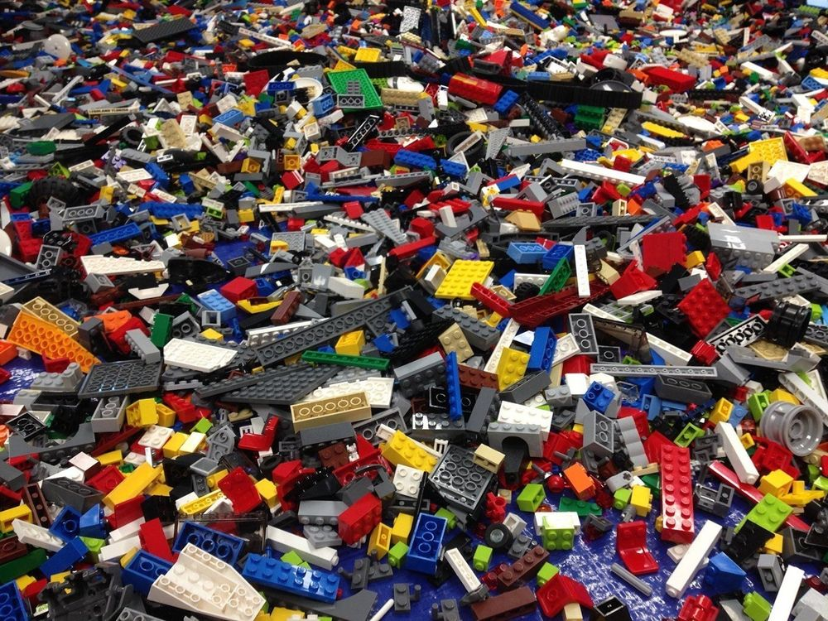
Chunking
Break challenging tasks into smaller or easier “chunk” that students are more willing to undertake.
You may need to include a reward or “fun” break

Slide 15
Positive, Positive, Positive
Remind your student of what you want them to do, rather than the negative
Remind your student of what they are working towards rather than what you will take away
Acknowledge effort and choices
Use empathetic statements (I understand….)
Give choices and opportunities

Slide 16
“I” Messages
Allow for a respectful conversation or direction
Spell out the specific behaviors
Give a chance to the student to “fix it”

Slide 17
Brain Breaks
Movement breaks
Music breaks
Sensory breaks
Brain breaks regularly incorporate short movement activities into the instructional day not only allows children to get their 'wiggles' out, but energizes them and increases their ability to focus on the next learning activity as well.

