Slide 1
Close Reading Modeling Method: Example Tasks for 6-12
Created by Content Area Specialists for Illinois State Board of Education
Notes:
Introductions—note the facilitator’s guide that is used in conjunction with this presentation and task worksheets. Presentation lasts approximately an hour.
Define simply that Close Reading is a portion of the Text Complexity Model found in the Common Core State Standards made up of three portions. These parts will be defined more carefully in this presentation but the Reader and Task portion will discuss more fully.

Slide 2
Objectives
Discuss Text Complexity Model
Expand knowledge of reader and task considerations
Model close reading activity for literature
Model close reading activity for informational text
Notes:
The objectives of this presentation are outlined here. If time, we will practice the close reading activity. The activity outlined here is adapted from a text by Dr. Doug Fisher and Dr. Nancy Frey and Diane Lapp entitled Text Complexity: Raising Rigor in Reading.

Slide 3
Notes:
If you visit www.corestandards.org, click on “The Standards” tab, this page is what is seen....
Appenidces A, B, and C are worth reading but A is where the Text Complexity Model is located and defined in more detail.
Appendix B holds all the Text exemplars and Task examples
Appendix C holds writing samples and task examples as well

Slide 4
Text Complexity
Text complexity is defined by:
Qualitative measures – levels of meaning, structure, language conventionality and clarity, and knowledge demands often best measured by an attentive human reader.
Quantitative measures – readability and other scores of text complexity often best measured by computer software.
Qualitative
Quantitative
Reader and Task considerations – background knowledge of reader, motivation, interests, and complexity generated by tasks assigned often best made by educators employing their professional judgment.
Reader and Task
Notes:
Appendix A defines the 3 components of text complexity. They are:
Qualitative will discuss figurative language, mood, poetic structure, rhetoric, etc.
Quantitative which measures the readability levels such as Fry and Flesch Kinkaid—how sentence length, structure of a word, repetition of a word in a sentence and paragraph, etc.
Reader and task is what we will discuss today....as you read the considerations above, they hold components that cannot be judged by a machine, but rather using a trained educator’s expertise.

Slide 5
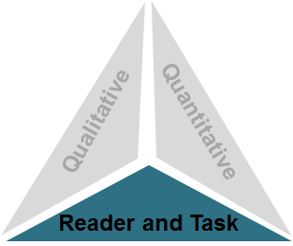
Step 3: Reader and Task
Considerations such as:
Motivation
Knowledge and experience
Purpose for reading
Complexity of task assigned regarding text
Complexity of questions asked regarding text
Notes:
The 3rd step is the step that must be determined by the teacher.
Is the student motivated to read this text?
What knowledge and experience do they have about the topic they will be reading about?
What is the teacher having the students do with the text as they read?
What types of critical thinking are expected of a student as they read the text?
This third and final component is to be measured by educators using their professional judgment. This can change given what unique backgrounds and experiences each child brings to the text and tasks an educator may ask a student to complete.
For example, simply put, a child who has had a great deal of exposure to dinosaur material may have a higher reading level in certain subject areas and texts but may have limited knowledge and a lower reading level when placed in material related to simple machines.

Slide 6
What practices should continue?
Media and interlibrary loan availability
Opportunities for choice
Variety of genres
Media exposure
Word study and vocabulary instruction
Journal writing
Strategy instruction
Opportunities for group discussions
Notes:
Therefore in the spirit of the Common Core, there are certain common teaching practices and ideas that CCSS would like to see continue in classrooms...They are listed on the slide above.

Slide 7
What could we do better?
Revisit critical thinking questioning.
Incorporate writing with all curricular areas daily.
Infuse technology instruction regularly.
Collaborate cross curricular genre studies.
Join cultural perspectives and relationships.
Regular opportunities for small group or peer discussions.
Take charge of your own learning and professional development.
Notes:
What practices CCSS are asking teachers to include or continue to include in their classroom practices now...

Slide 8
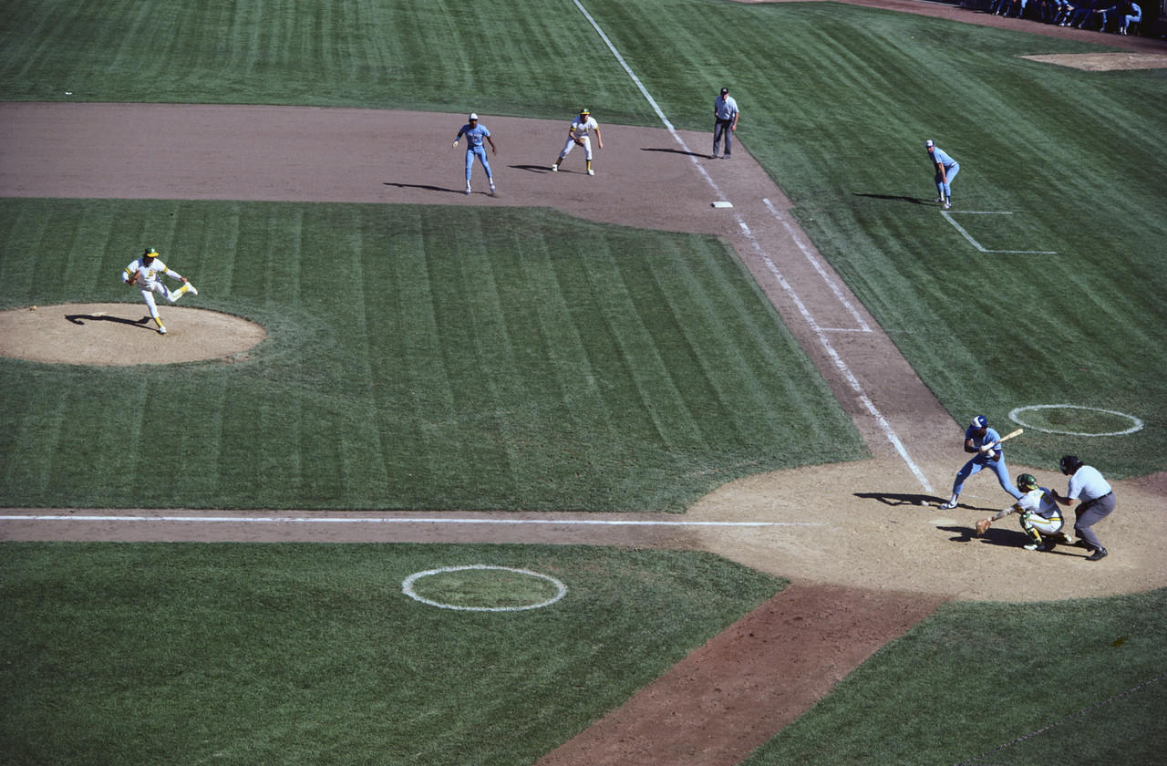
Baseball vs. Reading
Notes:
This slide is in reference to a highly regarded literacy expert, Kelly Gallagher. In several of his presentations, he references a story about taking his daughters to a baseball game and their reaction to this sport...bored to death…The girls summarized the event in the following way: they watched a ball, some guys threw it around the bases, one guy ran, sometimes people cheered.
Mr. Gallagher was horrified that they missed the hand signals, the nuances and intricacies, the timing of coaches yelling at referees or asking for time outs, which pitch the catcher would tell the pitcher to throw, the drama of looking to see if they would try to throw out the guy leading off, etc…he took his daughters to many more games and shared these minute details with his daughters who love the game today.
Today, as we go through the presentation, we are going to follow a process created around text dependent questioning and how the CCSS standards are clustered. The first time you read, you will focus on key ideas and details, 2nd time reads will be around author’s craft and structure and any subsequent reads will focus on integration of ideas.

Slide 10
! = I have an idea about this,
Symbol | Stands for: | Means:
∞ | Connections you have to the text. | You have seen, read, or thought about that before.
? | Question | I don’t understand. I need more information.
! | Main Idea | This is the important point the author is trying to get across.
+ (E) | Agree | I agree with the author on this point. (Support with (E)vidence)
- (E) | Disagree | I disagree with the author. I think differently. (Support with (E)vidence)
NEW | New information | This is brand new to my thinking.
Highlight | Word analysis | Structure/figurative language
Notes:
Give them a pencil and some note cards with an easy labeling system is best: You can make up your own coding system but sticking to just a few at first that are systematic reading strategies that can be supported by evidence from the text will best align with the CCSS.
As a teacher begins a year, this is a typical research based strategy chart that may be posted at the front of the room. Students need to be well versed in how to code a text using shorter texts to practice with prior to being asked to utilize this chart independently but once students are familiar with how to code text, a teacher may give a poem to students and ask them to do a first read.
This first time, the student will focus only on the actual chronological events and supporting details and the questions that fall under the key ideas and details cluster.

Slide 11
A Poem for My Librarian, Mrs. Long by Nikki Giovanni, Acolytes
Notes:
The first read will be from Nikki Giovanni’s Acolytes book: “A Poem for My Librarian, Mrs. Long. You may code it using the chart on the previous page as you read.

Slide 12
A Poem for My Librarian, Mrs. Long by Nikki Giovanni, Acolytes
A Poem for My Librarian, Mrs. Long
(You never know what troubled little girl needs a book)..........
There was a bookstore uptown on gay street
Which I visited and inhaled that wonderful odor
Of new books
Even today I read hardcover as a preference paperback only
As a last resort
And up the hill on vine street
(The main black corridor)sat our carnegie library
Mrs. Long always glad to see you
The stereoscope always ready to show you faraway
Places to dream about
Notes:
Ask participants to read the poem quietly to only look for the main events and what key ideas and details are going on. (Note: facilitator may wish to have copies of the poem printed for participants).

Slide 13
A Poem for My Librarian, Mrs. Long by Nikki Giovanni, Acolytes
Mrs. Long asking what are you looking for today
When I wanted Leaves of Grass or alfred north whitehead
She would go to the big library uptown and i now know
Hat in hand to ask to borrow so that I might borrow
Probably they said something humiliating since southern
Whites like to humiliate southern blacks
But she nonetheless brought the books
Back and I held them to my chest
Close to my heart
And happily skipped back to grandmother’s house
Where I would sit on the front porch
In a gray glider and dream of a world
Far away

Slide 14
A Poem for My Librarian, Mrs. Long by Nikki Giovanni, Acolytes
I love the world where I was
I was safe and warm and grandmother gave me neck kisses
When I was on my way to bed
But there was a world
Somewhere
Out there
And Mrs. Long opened that wardrobe
But not lions or witches scared me
I went through
Knowing there would be
Spring
Notes:
Review events and summarize here...participants should turn and talk. Discussion points and events that occurred are trips to library, narrator preferred hardcover over paperback, Mrs. Long had a caring attitude, enough to endure a hostile environment to obtain a book, Mrs. Long searched for the perfect book, the narrator took the book home and felt safe in her world. It is ok to infer early on...what kinds of troubles would a little girl know in this era?

Slide 15
A Poem for My Librarian, Mrs. Long by Nikki Giovanni, Acolytes
Notes:
As we move into the second reading, questions will focus on the second cluster of questions from the CCSS, craft and structure. Participants will now read a second time through. Allow time for participants to do so and to code as they would like. In this portion of the power point, the text has been coded as if students have already highlighted and underlined the text according to the earlier coding system. If students had completed an actual second read in the classroom and the teacher collected it, the words and phrases highlighted offer the teacher the opportunity to scaffold and differentiate instruction the next day by utilizing questions from the students’ work. (Some words or phrases have been underlined, colored, highlighted or bolded for discussion purposes only). Participants may utilize these as discussion points but the objective here is to discuss with a partner the craft and structure of the text after the second read:
What structure is used in the poem?
What figurative language is used? Is there any visualization that can be drawn from this that is powerful?
Compare the viewpoint of the southern whites to Mrs. Long
Compare the viewpoint of narrator of the poem from the child to the writer many years later.

Slide 16
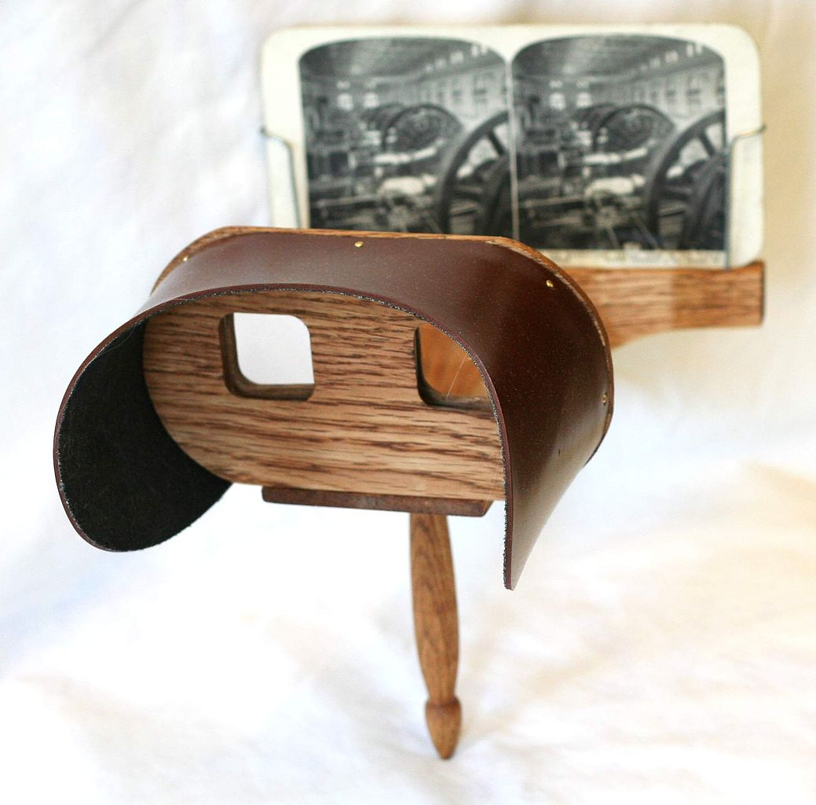
A Poem for My Librarian, Mrs. Long by Nikki Giovanni, Acolytes
Page 1 of 3
A Poem for My Librarian, Mrs. Long
(You never know what troubled little girl needs a book)..........
There was a bookstore uptown on gay street
Which I visited and inhaled that wonderful odor
Of new books
Even today I read hardcover as a preference paperback only
As a last resort
And up the hill on vine street
(The main black corridor)sat our carnegie library
Mrs. Long always glad to see you
The stereoscope always ready to show you faraway
Places to dream about
What figurative language is used?
What structure is used in the poem?

Slide 17
A Poem for My Librarian, Mrs. Long by Nikki Giovanni, Acolytes
Page 2 of 3
Mrs. Long asking what are you looking for today
When I wanted Leaves of Grass or alfred north whitehead
She would go to the big library uptown and i now know
Hat in hand to ask to borrow so that I might borrow
Probably they said something humiliating since southern
Whites like to humiliate southern blacks
But she nonetheless brought the books
Back and I held them to my chest
Close to my heart
And happily skipped back to grandmother’s house
Where I would sit on the front porch
In a gray glider and dream of a world
Far away
Is there a visualization that can drawn
from the figurative language?

Slide 18
A Poem for My Librarian, Mrs. Long by Nikki Giovanni, Acolytes
Page 3 of 3
I love the world where I was
I was safe and warm and grandmother gave me neck kissed
When I was on my way to bed
But there was a world
Somewhere
Out there
And Mrs. Long opened that wardrobe
But not lions or witches scared me
I went through
Knowing there would be
Spring
Compare the viewpoint of narrator of the poem from the child to the viewpoint of the writer many years later.
Compare the viewpoint of the southern whites to Mrs. Long.
Notes:
Let me review the questions again—are there any participants who would like to share their answers.....
What structure is used in the poem?
What figurative language is used? Is there any visualization that can be drawn from this that is powerful?
Compare the viewpoint of the southern whites to Mrs. Long
Compare the viewpoint of narrator of the poem from the child to the viewpoint of the writer many years later.
After coding of the text has been accomplished, the following discussion can be completed as well.
When looking at the yellow underlined phrases, discuss their meanings.
Discuss the red words and how time has changed the meaning of the words.
Are pictures available that can be attached electronically to the bolded words so that students can have a better idea of the meaning of these words?
What connections to other texts can be made to the italicized words at the end?

Slide 19
A Poem for My Librarian, Mrs. Long by Nikki Giovanni, Acolytes
Notes:
After finishing just two reads, a student has chosen the areas that they are questioning, the ideas that they need more assistance with, class discussion is taking place, a powerful understanding is occurring, and a more engaged student is emerging. There was no homework, a shorter text was utilized and literary objectives and concepts are being met.
As we move to the third and final reading for this presentation, questions will focus on the integration of ideas and knowledge. When participants reread this time, they will turn and talk with their partner about the following:
What did Mrs. Long mean to the narrator?
Who are southern blacks? Why are they different than northern blacks? Can you understand the difference?
What other places in our world have these same types of issues, such as racial tensions, going on today?
What is the theme? (Someone making a difference) As someone steps in to offer a hand in times of stress/trauma, why do people not offer help more often?

Slide 20
A Poem for My Librarian, Mrs. Long by Nikki Giovanni, Acolytes
A Poem for My Librarian, Mrs. Long
(You never know what troubled little girl needs a book)..........
There was a bookstore uptown on gay street
Which I visited and inhaled that wonderful odor
Of new books
Even today I read hardcover as a preference paperback only
As a last resort
And up the hill on vine street
(The main black corridor)sat our carnegie library
Mrs. Long always glad to see you
The stereoscope always ready to show you faraway
Places to dream about
What did Mrs. Long mean to the narrator.

Slide 21
A Poem for My Librarian, Mrs. Long by Nikki Giovanni, Acolytes
Mrs. Long asking what are you looking for today
When I wanted Leaves of Grass or alfred north whitehead
She would go to the big library uptown and i now know
Hat in hand to ask to borrow so that I might borrow
Probably they said something humiliating since southern
Whites like to humiliate southern blacks
But she nonetheless brought the books
Back and I held them to my chest
Close to my heart
And happily skipped back to grandmother’s house
Where I would sit on the front porch
In a gray glider and dream of a world
Far away
Who are southern blacks? Why are they different than northern blacks? Can you understand the difference?

Slide 22
A Poem for My Librarian, Mrs. Long by Nikki Giovanni, Acolytes
I love the world where I was
I was safe and warm and grandmother gave me neck kissed
When I was on my way to bed
But there was a world
Somewhere
Out there
And Mrs. Long opened that wardrobe
But not lions or witches scared me
I went through
Knowing there would be
Spring
What other places in our world have these same types of issues, such as racial tensions, going on today?

Slide 23
Other texts to compare...
Notes:
The poem used to day had a theme of making a difference. One of the ways that CCSS tries to foster a range of reading and different cultural perspectives is to make connections across multiple texts and media. The above texts have the same theme as the poem and could easily be related in excerpts or as full novel studies in a 6-12th grade classroom.

Slide 24
Sample Process for Literature
Key Ideas and Details
State what the text says explicitly and support it with
evidence.
Identify the central idea and theme(s).
Analyze characters and events.
Craft and Structure
Interpret words and phrases.
Analyze structures of text and how styles relate.
Discuss purposes and points of view.
Integration of Knowledge and Ideas
Evaluate the different medias.
Compare and contrast the different cultural experiences and themes.
Notes:
These are the clusters and the ideas that each cluster represents.

Slide 25
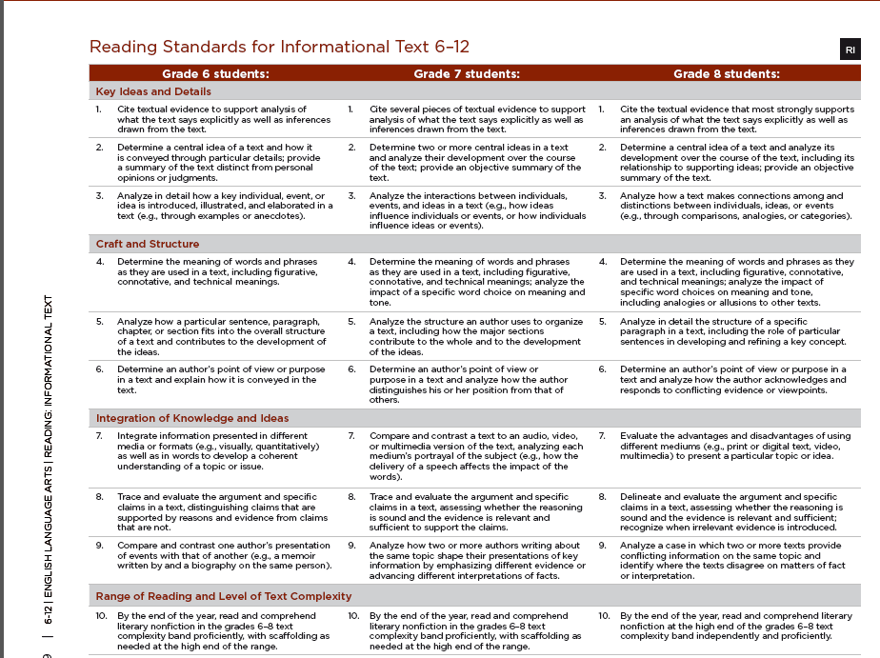
Notes:
Next, we move onto the informational process for close reading strategy. Notice the standards are clustered the same in informational text as they are in literature: key ideas, craft and structure, and integration of knowledge and ideas.

Slide 26
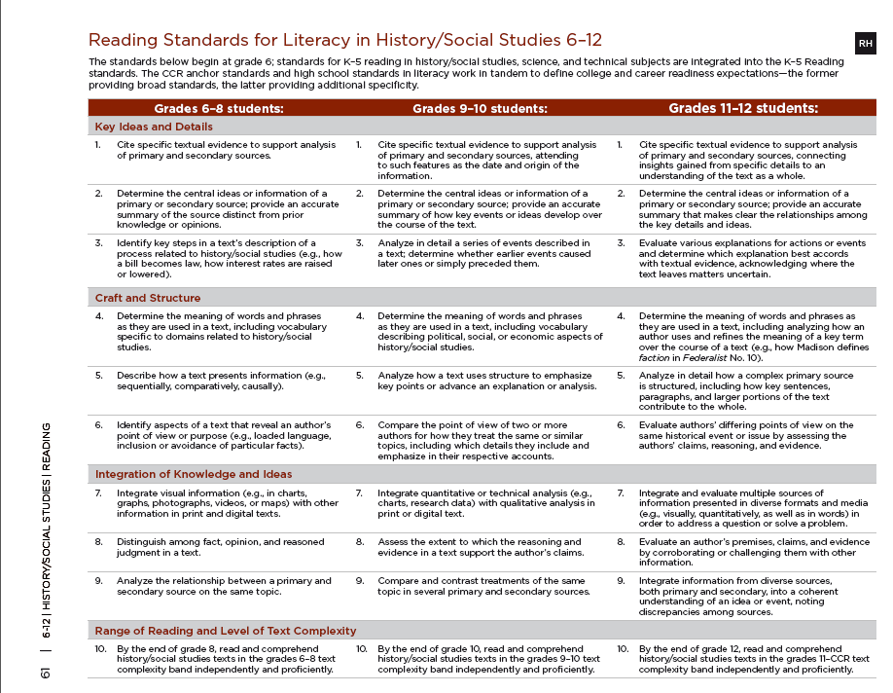
Notes:
The Reading Standards for Literacy in History and Social Studies are organized in the same clusters as literature and informational texts. Standard 1 is also regarding understanding the text as a whole and citing specific textual evidence which is the same in literature as it is in the informational standards, and the science and technical standards. Standard 6 will focus on point of view or author’s intended purpose of an explanation. So as we look at the strategy of close reading, it doesn’t matter what subject area we use, the strategy will work in any content area.

Slide 27
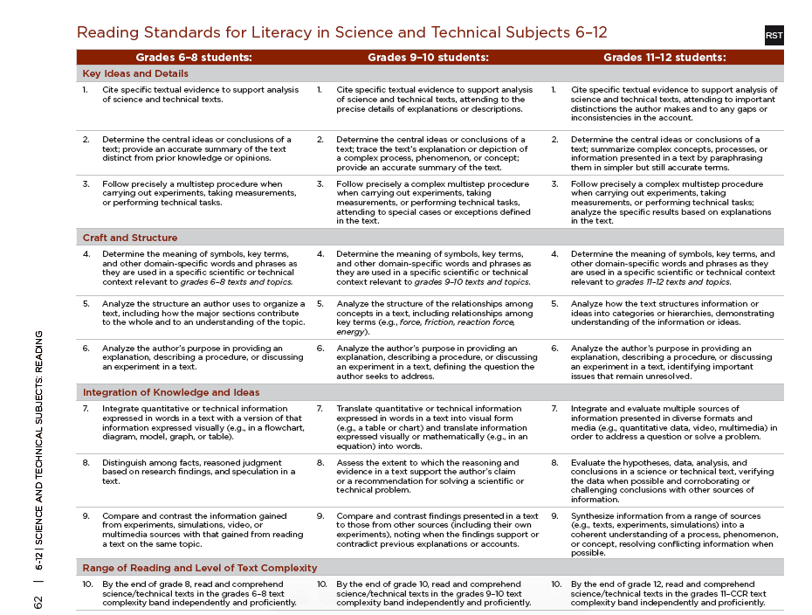
Notes:
This is the Reading Standards for Science and Technical Subjects and is organized with the same structure.

Slide 28
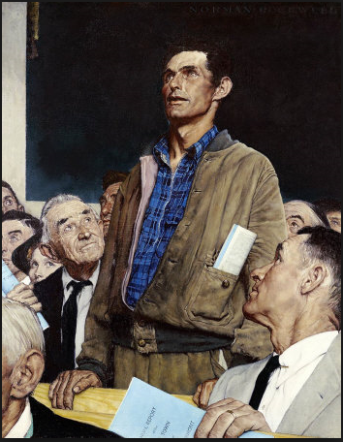
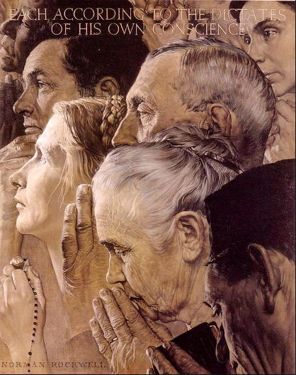
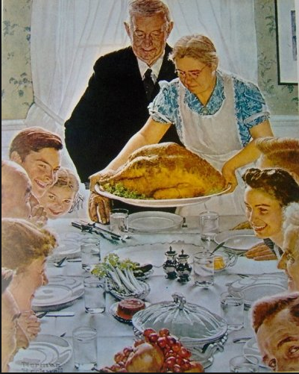
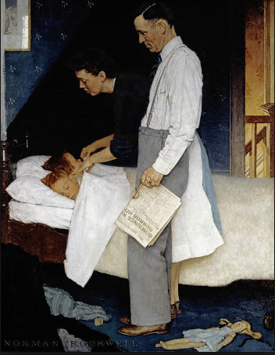
Franklin D. Roosevelt’s State of the Union Address (1941)
Notes:
Listen to the speech of the Franklin Delanor Roosevelt’s Four Freedom’s. This is powerful as we entered into a world war.

Slide 29
Franklin D. Roosevelt’s State of the Union Address (1941)
Notes:
As we move into sharing the close reading strategy with the use of an informational text, Norman Rockwell completed these four famous paintings of Roosevelts’ Four Freedom’s Speech. Close reading can be done with pictorial representations and other media just as it is done with text. In the first exposure of the paintings, students would be asked questions that follow the same structure of the CCSS, what are the key ideas and details of the paintings? In the first photo, why is the main character dressed in casual clothes and everyone around him in suits and ties? What is the setting? As we move to the second painting, questions would follow the craft and structure portion of the CCSS. What is the painters use of color and light? What is the meaning of the objects that are being held? Why did the painter choose the genders and cultural representations of the people especially for that time period? In the third painting, why was that holiday represented? Finally, for the final exposure to the paintings, questions should follow the integration of knowledge and ideas portion of the CCSS. Consider the time period. What else is going on in the world and how is it represented in this painting? What is the significance of the mother and father figure? And the figure of the children?

Slide 30
Franklin D. Roosevelt’s State of the Union Address (1941)
For there is nothing mysterious about the foundations of a healthy and strong democracy. The basic things expected by our people of their political and economic systems are simple. They are:
Equality of opportunity for youth and for others.
Jobs for those who can work.
Security for those who need it.
Notes:
If we move to the previous portion of the speech, we can share it in an economics class for a close read. Students would be asked to analyze the components of the economic systems that FDR suggested for their impacts on today’s economy. Let’s take a closer look at this activity and how it would unfold.
As we did a first read in the literature piece, we focused on the key ideas and details cluster. Questions will still have that same focus in this section.
What is this speech about?
Who is the intended audience?
Were any other major events going on in that would have prompted any portions of this speech?
Identify the key economic structures that would need systems in place. Were these systems built back then? Do we have them built now?

Slide 31
The ending of special privilege for the few.
The preservation of civil liberties for all.
The enjoyment of the fruits of scientific progress in a wider and constantly rising standard of living.
These are the simple, basic things that must never be lost sight of in the turmoil and unbelievable complexity of our modern world. The inner and abiding strength of our economic and political systems is dependent upon the degree to which they fulfill these expectations.

Slide 32
Many subjects connected with our social economy call for immediate improvement. As examples:
We should bring more citizens under the coverage of old-age pensions and unemployment insurance.
We should widen the opportunities for adequate medical care.
We should plan a better system by which persons deserving or needing gainful employment may obtain it.
I have called for personal sacrifice. I am assured of the willingness of almost all Americans to respond to that call.

Slide 33
A part of the sacrifice means the payment of more money in taxes. In my Budget Message I shall recommend that a greater portion of this great defense program be paid for from taxation than we are paying today. No person should try, or be allowed, to get rich out of this program; and the principle of tax payments in accordance with ability to pay should be constantly before our eyes to guide our legislation.
If the Congress maintains these principles, the voters, putting patriotism ahead of pocketbooks, will give you their applause.

Slide 34
Franklin D. Roosevelt’s State of the Union Address (1941)
Notes:
2nd Read: On a second read, teachers text dependent questions would focus on the craft and structure portion of the standards. The work was bulleted and very short statements. Yet, the words carried very weighty statements if employed by a society. Evaluate the claims of FDR and his point of view on the subject of his budget. What are his views? Support it with evidence.
Compare and contrast the political and economic systems that are stated here.
Compare and contrast those of then to those of now.
Discuss what FDR considers a healthy and strong democracy and whether or not we have those foundations in place today.
Do other societies that are considered democracies have those foundations in place?

Slide 35
Franklin D. Roosevelt’s State of the Union Address (1941)
For there is nothing mysterious about the foundations of a healthy and strong democracy. The basic things expected by our people of their political and economic systems are simple. They are:
Equality of opportunity for youth and for others.
Jobs for those who can work.
Security for those who need it.

Slide 36
The ending of special privilege for the few.
The preservation of civil liberties for all.
The enjoyment of the fruits of scientific progress in a wider and constantly rising standard of living.
These are the simple, basic things that must never be lost sight of in the turmoil and unbelievable complexity of our modern world. The inner and abiding strength of our economic and political systems is dependent upon the degree to which they fulfill these expectations.

Slide 37
Many subjects connected with our social economy call for immediate improvement. As examples:
We should bring more citizens under the coverage of old-age pensions and unemployment insurance.
We should widen the opportunities for adequate medical care.
We should plan a better system by which persons deserving or needing gainful employment may obtain it.
I have called for personal sacrifice. I am assured of the willingness of almost all Americans to respond to that call.

Slide 38
A part of the sacrifice means the payment of more money in taxes. In my Budget Message I shall recommend that a greater portion of this great defense program be paid for from taxation than we are paying today. No person should try, or be allowed, to get rich out of this program; and the principle of tax payments in accordance with ability to pay should be constantly before our eyes to guide our legislation.
If the Congress maintains these principles, the voters, putting patriotism ahead of pocketbooks, will give you their applause.

Slide 39
Franklin D. Roosevelt’s State of the Union Address (1941)
Notes:
3rd Read: Finally, students would be asked to compare other sources, perhaps from other speeches, that would be about budgets that support or disagree with the types of systems that FDR supported such as widespread medical care or higher tax rates. Research could be done on one system that requires students to make claims and support it with evidence regarding the degrees to which these have or have not been supported. Other countries or time periods could be the basis for comparison.
Compare other countries’ economic ailments to ours and consider what the causes may have been.
Are there certain “degrees” to which our society has not fulfilled these expectations? Are there areas where we have fulfilled too much? Make a claim from the speech and use evidence to substantiate the claim.

Slide 40
Franklin D. Roosevelt’s State of the Union Address (1941)
For there is nothing mysterious about the foundations of a healthy and strong democracy. The basic things expected by our people of their political and economic systems are simple. They are:
Equality of opportunity for youth and for others.
Jobs for those who can work.
Security for those who need it.

Slide 41
The ending of special privilege for the few.
The preservation of civil liberties for all.
The enjoyment of the fruits of scientific progress in a wider and constantly rising standard of living.
These are the simple, basic things that must never be lost sight of in the turmoil and unbelievable complexity of our modern world. The inner and abiding strength of our economic and political systems is dependent upon the degree to which they fulfill these expectations.

Slide 42
Many subjects connected with our social economy call for immediate improvement. As examples:
We should bring more citizens under the coverage of old-age pensions and unemployment insurance.
We should widen the opportunities for adequate medical care.
We should plan a better system by which persons deserving or needing gainful employment may obtain it.
I have called for personal sacrifice. I am assured of the willingness of almost all Americans to respond to that call.

Slide 43
A part of the sacrifice means the payment of more money in taxes. In my Budget Message I shall recommend that a greater portion of this great defense program be paid for from taxation than we are paying today. No person should try, or be allowed, to get rich out of this program; and the principle of tax payments in accordance with ability to pay should be constantly before our eyes to guide our legislation.
If the Congress maintains these principles, the voters, putting patriotism ahead of pocketbooks, will give you their applause.

Slide 44
Sample Process for Informational Text
Key Ideas and Details
State what the text says explicitly and support it with
evidence.
Identify the central idea and theme(s).
Analyze relationships, concepts, or events.
Craft and Structure
Interpret words and phrases.
Analyze features and structures of text.
Discuss purposes and points of view.
Integration of Knowledge and Ideas
Evaluate the different medias.
Integrate information from several sources to address related
themes and concepts.
Notes:
These are the clusters and their topics of discussion. Refer to the activity worksheets to assist with the process as well.

Slide 45
Notes:
This chart was found on Pinterest. It was created by a Race to the Top Network Team from Jefferson-Lewis-Hamilton-Herkimer-Oneida in New York. This gives the who, what, where, when and why close reading strategy should be employed and types of how the student and teacher text selections and preparations should be considered. This is a handout for more clarity.

Slide 46
Process
Students and teachers understand multiple reads will occur
Independently
By proficient readers including teacher
Vocabulary instruction with a focus on Tier 2 words
Questions will follow Common Core Standards structure
Notes:
A final review of the process is located here. When designing questions, they should be reflective of the clusters at the grade level you teach.

Slide 47
References
http://programs.ccsso.org/projects/common%20core%20resources/documents/Reader%20and%20Task%20Considerations.pdf
Giovanni, N. (2007). A poem for my librarian. In Acolytes New York, NY: William Morrow.
Fisher, D., Frey, N., & Lapp, D. (2012). Text Complexity: Raising Rigor in Reading. New York: International Reading Association.
Council of Chief State School Officers. , & National Governors Association, (2010). Common core state standards initiative: Appendix B. DOI: www.corestandards.org

Slide 48
Contact Information
Questions or Comments
Please contact Jill Brown or Kathi Rhodus at
plscomments@gmail.com

