Slide 1
Close Reading Modeling Method: Example Tasks for K-5
Created by Content Area Specialists for Illinois State Board of Education
Notes:
Introductions—note the facilitator’s guide that is used in conjunction with this presentation and task worksheets. Presentation lasts approximately an hour.
Define simply that Close Reading is a portion of the Text Complexity Model found in the Common Core State Standards made up of three portions. These parts will be defined more carefully in this presentation but the Reader and Task portion will discuss more fully.

Slide 2
Objectives
Discuss Text Complexity Model
Expand knowledge of reader and task considerations
Model close reading activity for literature
Model close reading activity for informational text
Notes:
The objectives of this presentation are outlined here. If time, we will practice the close reading activity. The activity outlined here is adapted from a text by Dr. Doug Fisher and Dr. Nancy Frey and Diane Lapp entitled Text Complexity: Raising Rigor in Reading.

Slide 3
Notes:
If you visit www.corestandards.org, click on “The Standards” tab, this page is what is seen.
Appendices A, B, and C are worth reading but A is where the Text Complexity Model is located and defined in more detail.
Appendix B holds all the text exemplars and task examples.
Appendix C holds writing samples and task examples as well.

Slide 4
Text Complexity
Text complexity is defined by:
Qualitative measures – levels of meaning, structure, language conventionality and clarity, and knowledge demands often best measured by an attentive human reader.
Quantitative measures – readability and other scores of text complexity often best measured by computer software.
Qualitative
Quantitative
Reader and Task considerations – background knowledge of reader, motivation, interests, and complexity generated by tasks assigned often best made by educators employing their professional judgment.
Reader and Task
Notes:
Appendix A defines the 3 components of the Text Complexity Model. They are:
Qualitative which measures the levels of meaning, structure, language conventions and clarity as well as knowledge demands. (mood, figurative language, poetic rhythms, etc)
Quantitative which measures the readability of the text and is often scored by software. (Sentence length, number of words in a paragraph, number of times a word is used, etc).
Reader and task considerations take into account the background knowledge of the reader as well as the reader’s motivation, interests and the task given. This third and final component is to be measured by educators using their professional judgment and what they have seen exhibited by a student in a classroom.

Slide 5
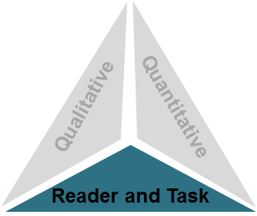
Step 3: Reader and Task
Considerations such as:
Motivation
Knowledge and experience
Purpose for reading
Complexity of task assigned regarding text
Complexity of questions asked regarding text
Notes:
The 3rd step is the step that must be determined by the teacher.
Is the student motivated to read this text?
What knowledge and experience do they have about the topic they will be reading?
What is the teacher having the students do with the text as they read?
What types of critical thinking are expected of a student as they read the text?
This third and final component is to be measured by educators using their professional judgment. This can change given what unique backgrounds and experiences each child brings to the text and tasks an educator may ask a student to complete.
For example, simply put, a child who has had a great deal of exposure to dinosaur material may have a higher reading level in certain subject areas and texts but may have limited knowledge and a lower reading level when placed in material related to simple machines.

Slide 6
What should continue?
Libraries in room and visits to larger libraries
Guided reading options
Stations or Centers
Variety of genres
Media exposure
Word study and vocabulary instruction
Journal writing
Strategy instruction
Notes:
Therefore in the spirit of the Common Core, there are certain common teaching practices and ideas that CCSS would like to see continue in classrooms...They are listed on the slide above.

Slide 7
What could we do better?
Revisit critical thinking.
Incorporate writing with all curricular areas daily.
Infuse technology and instruction daily.
Integrate thematic instruction with cross curricular genre studies.
Join cultural perspectives and relationships.
Take charge of your own learning and professional development.
Notes:
What practices CCSS are asking teachers to include or continue to include in their classroom practices now...

Slide 8
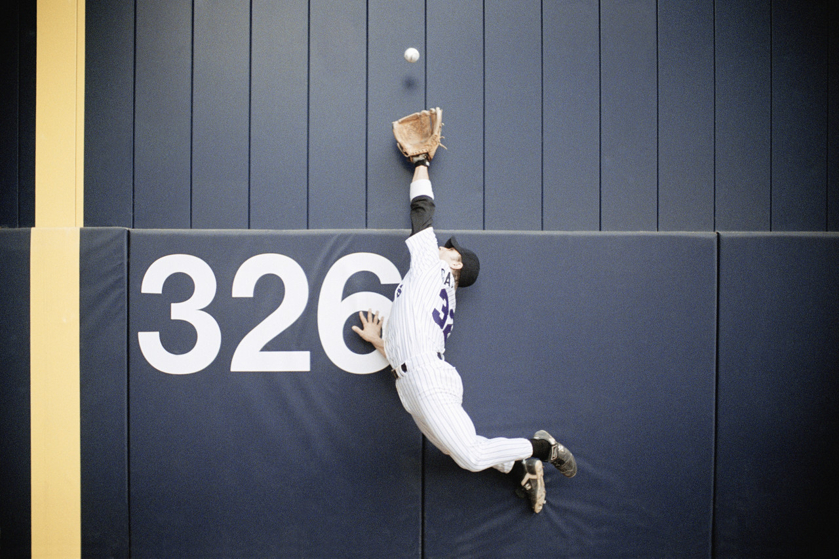
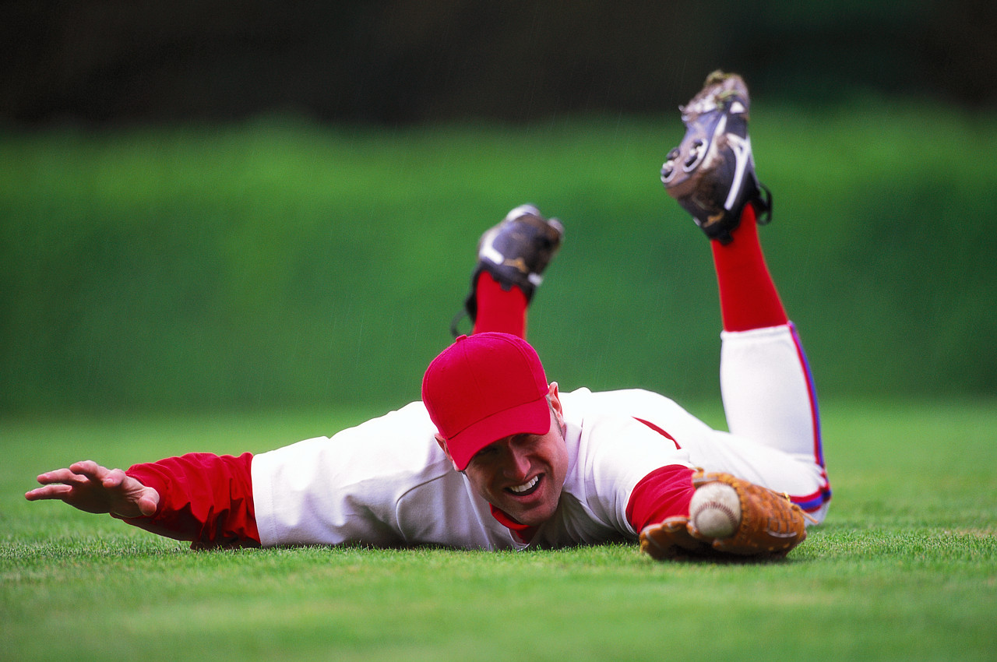
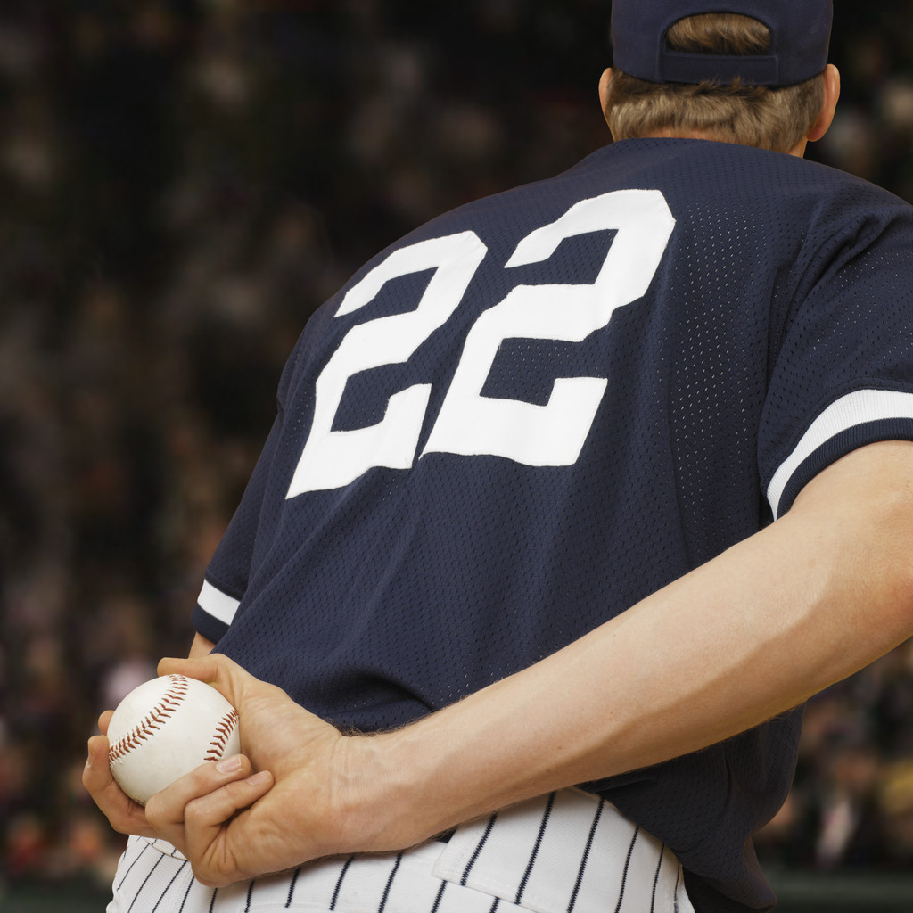
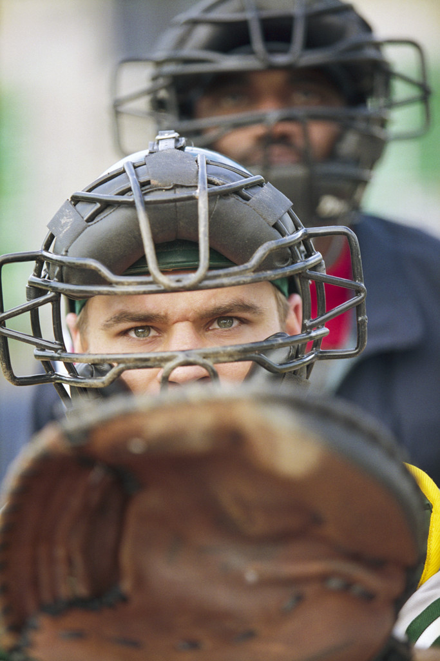
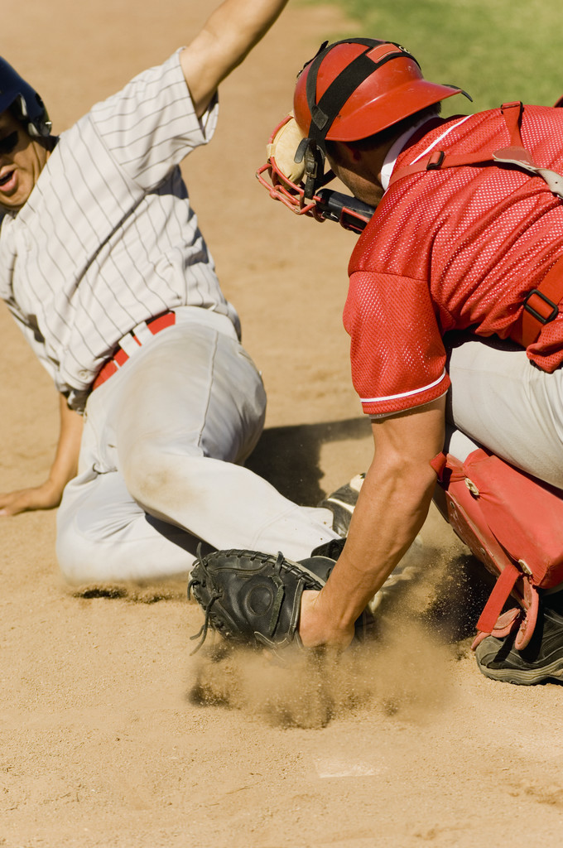
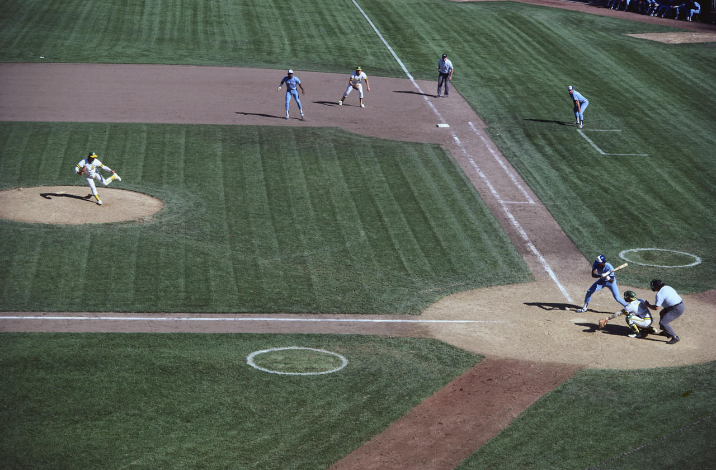
Baseball vs. Reading
Notes:
This slide is in reference to a highly regarded literacy expert, Kelly Gallagher. In several of his presentations, he references a story about taking his daughters to a baseball game and their reaction to this sport...bored to death…The girls summarized the event in the following way: they watched a ball, some guys threw it around the bases, one guy ran, sometimes people cheered.
Mr. Gallagher was horrified that they missed the hand signals, the nuances and intricacies, the timing of coaches yelling at referees or asking for time outs, which pitch the catcher would tell the pitcher to throw, the drama of looking to see if they would try to throw out the guy leading off, etc…he took his daughters to many more games and shared these minute details with his daughters who love the game today.
Today, as we go through the presentation, we are going to follow a process created around text dependent questioning and how the CCSS standards are clustered. The first time you read, you will focus on key ideas and details, 2nd time reads will be around author’s craft and structure and any subsequent reads will focus on integration of ideas.

Slide 9
Notes:
Today, as we go through the presentation, we are going to follow a process created around text dependent questioning and how the CCSS standards are clustered. The first time you read a section of a text, you will focus on key ideas and details, 2nd time reads, questions will be focused around author’s craft and structure and any subsequent reads will focus on integration of knowledge and ideas. Structuring questions and tasks around the skills that are involved in the clusters of CCSS help identify the goals and objectives students will need to discover in a text.
According to the writers of the ELA standards, we are frontloading too much and discussing too much of a text the first time through causing students to have too much support which causes a lack of need and motivation for students to find the vocabulary or main ideas themselves. This has created our gap.
It is appropriate to scaffold and provide direction and support but only after a first read. Allowing students to wonder about a text first is critical in the thought process.

Slide 10
Close Reading: Literature
Coding The Text
? = I have a question
about this
! = I have an idea about this
0-0 = I can visualize this
# = I have a connection
Notes:
Bud, Not Buddy was selected because it is listed in the text exemplars located in Appendix B as a Second and Third grade read aloud and a Fourth and Fifth Grade independent read. The book is only a suggested reading.
Give them a pencil and some note cards with an easy labeling system is best: You can make up your own coding system but sticking to just a few at first that are systematic reading strategies that can be supported by evidence from the text will best align with the CCSS. The coding system we chose is listed in the upper left hand corner and should be easily used by all 2-5th grade students.
As a teacher begins a year, this is a typical research based strategy chart that may be posted at the front of the room. Students need to be well versed in how to code a text using shorter texts to practice with prior to being asked to utilize this chart independently but once students are familiar with how to code text, a teacher may give a poem to students and ask them to do a first read.
This first time, the student will focus only on the actual chronological events and supporting details and the questions that fall under the key ideas and details cluster.
The first time you read this through, focus only on the actual chronological events and supporting details. The idea behind this is that we are frontloading too much and discussing too much of the text the first time through causing students to have too much support.
It is appropriate to scaffold and provide direction and support but only after a first read which allows students to grapple with the text and surmise which vocabulary is causing difficulty. Allowing students to wonder about a text first is critical in the thought process.
In summary, give them a pencil and some note cards with an easy labeling system is best: ? = I have a question about this, ! = I have an idea about this, #= I have a connection, 0-0 I can visualize this. You can make up your own coding system but sticking to just 4 that are systematic reading strategies that can be supported by evidence from the text will best align with the CCSS.

Slide 11
Bud, Not Buddy by Christopher Paul Curtis
Here we go again. We were all standing in line waiting for breakfast when one of the caseworkers came in and tap-tap-tapped down the line. Uh-oh, this meant bad news, either they’d found a foster home for somebody or somebody was about to get paddled. All the kids watched the woman as she moved along the line, her high-heeled shoes sounding like little firecrackers going off on the wooden floor.
Shoot! She stopped at me and said, “Are you Buddy Caldwell?”
I said, “It’s Bud, not Buddy, ma’am.”
She put her hand on my shoulder and took me out of the line. Then she pulled Jerry, one of the littler boys, over. “Aren’t you Jerry Clark?” He nodded.
“Boys, good news! Now that the school year has ended, you both have been accepted in new temporary-care homes starting this afternoon!”
Pg. 1 of 4
Notes:
Allow participants to read the next 4 slides and use the coding system provided. They may write in a different colored pencil or pen that should be provided to them at tables. At the end of the 4th slide, participants will answer only questions that focus on the cluster key ideas and details.

Slide 12
Bud, Not Buddy by Christopher Paul Curtis
Jerry asked the same thing I was thinking, “Together?”
She said, “Why no, Jerry, you’ll be in a family with three little girls…”
Jerry looked like he’d just found out they were going to dip him in a pot of boiling milk.
“…and Bud..” She looked at some papers she was holding. “Oh, yes, the Amoses, you’ll be with Mr. and Mrs. Amos and their son, who’s twelve years old, that makes him just two years older than you, doesn’t it, Bud?”
“Yes, ma’am.”
She said, “I’m sure you’ll both be very happy.”
Me and Jerry looked at each other.
Pg. 2 of 4

Slide 13
Bud, Not Buddy by Christopher Paul Curtis
The woman said, “Now, now , boys, no need to look so glum. I know you don't understand what it means, but there’s a depression going on all over this country. People can’t find jobs and these are very, very difficult times for everybody. We’ve been lucky enough to find two wonderful families who’ve opened their doors for you. I think it’s best that we show our new foster families that we’re very…”
She dragged out the word very, waiting for us to finish her sentence for her.
Jerry said, “Cheerful, helpful and grateful.” I moved my lips and mumbled.
She smiled and said, “Unfortunately, you won’t have time for breakfast. I’ll have a couple of pieces of fruit put in a bag. In the meantime go to the sleep room and strip your beds and gather all of your things.”
Pg. 3 of 4

Slide 14
Bud, Not Buddy by Christopher Paul Curtis
Here we go again. I felt like I was walking in my sleep as I followed Jerry back to the room where all the boys’ beds were jim-jammed together. This was the third foster home I was going to and I’m used to packing up and leaving, but it still surprises me that there are always a few seconds, right after they tell you you’ve got to go, when my nose gets all runny and my throat gets all choky and my eyes get all sting-y. But the tears coming out doesn’t happen to me anymore, I don’t know when it first happened, but it seems like my eyes don’t cry anymore.
Pg. 4 of 4
Notes:
Remind participants that the questions that follow will only be from the key ideas and details portion of the CCSS no matter what grade level they choose a text from.
Who is the person telling the story?
Summarize the main event and details supporting the event. What is explicitly stated in the text that supports those details?
Describe the characters in this selection with regards to age. What is the setting and time period? How do you know?
What are the main character’s true feelings about being placed in temporary care? What evidence supports that thought?

Slide 15
Focus of Teaching Skills
Synonyms/Antonyms: Red
Figurative Language: Yellow
Tier Two Vocabulary: Bold
Unknown Vocabulary: Bold/Blue
Notes:
As we move into the second reading, questions will focus on the second cluster of questions from the CCSS, craft and structure. Craft and structure focus on the language, structure of the text, viewpoint of the characters, and the comparing and contrasting of viewpoints.
Participants will now read a second time through. Allow time for participants to do so and to code as they would like. In this portion of the power point, the text has been coded as if students have already highlighted and underlined the text according to the earlier coding system. If students had completed an actual second read in the classroom and the teacher collected it, the words and phrases highlighted offer the teacher the opportunity to scaffold and differentiate instruction the next day by utilizing questions from the students’ work. (Some words or phrases have been underlined, colored, highlighted or bolded for discussion purposes only).
Participants may utilize these as discussion points but the objective here is to discuss with a partner the craft and structure of the text after the second read.

Slide 16
Bud, Not Buddy by Christopher Paul Curtis
Here we go again. We were all standing in line waiting for breakfast when one of the caseworkers came in and tap-tap-tapped down the line. Uh-oh, this meant bad news, either they’d found a foster home for somebody or somebody was about to get paddled. All the kids watched the woman as she moved along the line, her high-heeled shoes sounding like little firecrackers going off on the wooden floor.
Shoot! She stopped at me and said, “Are you Buddy Caldwell?”
I said, “It’s Bud, not Buddy, ma’am.”
She put her hand on my shoulder and took me out of the line. Then she pulled Jerry, one of the littler boys, over. “Aren’t you Jerry Clark?” He nodded.
“Boys, good news! Now that the school year has ended, you both have been accepted in new temporary-care homes starting this afternoon!”
Pg. 1 of 4
Notes:
Notice, I have bolded words that may need defining for better comprehension. These are the tier 2 words that students may see in more than one type of text or may have more than one meaning. Words in red may have synonyms or antonyms. Words that are highlighted or underlined may have figurative language attached to them and could be defined in the craft and structure portion of the CCSS. This section happened to have the title inserted and offered a point of discussion which is underlined in purple.
As students hear this section of the story, teachers begin to frame the next set of questions around the craft and structure of the story. Stop to discuss with students however during the presentation, this may only be brought to light for the participants to reflect on.
Some possible questions might be to acknowledge the perspective or point of view of the Bud, Jerry and the caseworker.
How did the beginning of the selection contribute to the ending?
How do the characters interact with one another?
What are some of the areas of figurative language that are used throughout the text? (shoes sounding like fire crackers, looked like he’s be
dipped in a pot of boiling milk, how she dragged out her words) These are underlined in yellow.
What is the author’s meaning behind these words?
What illustrations come to mind?
Is first or third person narration being used?
What could be the author’s purpose for using first or third?

Slide 17
Bud, Not Buddy by Christopher Paul Curtis
Jerry asked the same thing I was thinking, “Together?”
She said, “Why no, Jerry, you’ll be in a family with three little girls…”
Jerry looked like he’d just found out they were going to dip him in a pot of boiling milk.
“…and Bud..” She looked at some papers she was holding. “Oh, yes, the Amoses, you’ll be with Mr. and Mrs. Amos and their son, who’s twelve years old, that makes him just two years older than you, doesn’t it, Bud?”
“Yes, ma’am.”
She said, “I’m sure you’ll both be very happy.”
Me and Jerry looked at each other.
Pg. 2 of 4
Notes:
What facial expression would Jerry have on his face? Is there an emotion word that could describe this look? How could that be drawn? Make a list of all the emotions that are stated in the selection and then discuss how the true feelings of the characters might actually be exhibited. What phrases elicit the evidence?

Slide 18
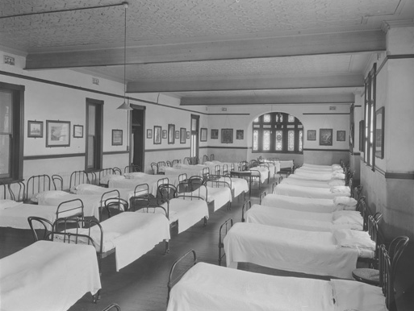
Bud, Not Buddy by Christopher Paul Curtis
The woman said, “Now, now , boys, no need to look so glum. I know you don't understand what it means, but there’s a depression going on all over this country. People can’t find jobs and these are very, very difficult times for everybody. We’ve been lucky enough to find two wonderful families who’ve opened their doors for you. I think it’s best that we show our new foster families that we’re very…”
She dragged out the word very, waiting for us to finish her sentence for her.
Jerry said, “Cheerful, helpful and grateful.” I moved my lips and mumbled.
She smiled and said, “Unfortunately, you won’t have time for breakfast. I’ll have a couple of pieces of fruit put in a bag. In the meantime go to the sleep room and strip your beds and gather all of your things.”
Pg. 3 of 4
Notes:
In this section there are conflicting emotions – the boys are being told to be “cheerful, helpful, and grateful” but how do they really feel? What evidence in the text supports the true feelings of the characters?
What are the antonyms/synonyms meanings of the words?
Does the time period have something to do with the author choosing the word sleep room?

Slide 19
Bud, Not Buddy by Christopher Paul Curtis
Here we go again. I felt like I was walking in my sleep as I followed Jerry back to the room where all the boys’ beds were jim-jammed together. This was the third foster home I was going to and I’m used to packing up and leaving, but it still surprises me that there are always a few seconds, right after they tell you you’ve got to go, when my nose gets all runny and my throat gets all choky and my eyes get all sting-y. But the tears coming out doesn’t happen to me anymore, I don’t know when it first happened, but it seems like my eyes don’t cry anymore.
Pg. 4 of 4
Notes:
What visualization comes to mind when the phrase “I felt like I was walking in my sleep” is heard?
What does the term “jim-jammed” mean?
At any point, are there terms that can have graphics inserted from online dictionaries inserted to better explain or give pictorial representation? Foster home may need identification from this time period and is a good way to incorporate technology.
Turn and talk to your neighbor about the answers....give a moment for people to offer a few responses.

Slide 20
Notes:
After finishing just two reads, a student has chosen the areas that they are questioning, the ideas that they need more assistance with, class discussion is taking place, a powerful understanding is occurring, and a more engaged student is emerging. There was no homework, a shorter text was utilized and literary objectives and concepts are being met.
As we move to the third and final reading for this presentation, questions will be framed around the cluster of integration of ideas and knowledge. When participants reread this time, they will evaluate claims made in the text and the validity of those claims, they will analyze the integration of content as it is presented in different media formats and compare different approaches that authors take on similar themes in two or more texts.

Slide 21
Bud, Not Buddy by Christopher Paul Curtis
Here we go again. We were all standing in line waiting for breakfast when one of the caseworkers came in and tap-tap-tapped down the line. Uh-oh, this meant bad news, either they’d found a foster home for somebody or somebody was about to get paddled. All the kids watched the woman as she moved along the line, her high-heeled shoes sounding like little firecrackers going off on the wooden floor.
Shoot! She stopped at me and said, “Are you Buddy Caldwell?”
I said, “It’s Bud, not Buddy, ma’am.”
She put her hand on my shoulder and took me out of the line. Then she pulled Jerry, one of the littler boys, over. “Aren’t you Jerry Clark?” He nodded.
“Boys, good news! Now that the school year has ended, you both have been accepted in new temporary-care homes starting this afternoon!”
Pg. 1 of 4
Notes:
Allow participants to reread for a final time and ask them to focus on the following questions:
How did the character’s mood change from beginning of the selection to the end of the story? Focus on the last words, “But the tears coming
out doesn’t happen to me anymore, I don’t know when it first happened, but it seems like my eyes don’t cry anymore.”
What if this story took place in a different time period, how would that change the selection? Especially if the time period is now...
What race do you assume Bud and Jerry are?
If the reader hasn’t seen the cover of the book, how does the story change if Bud is a female?
Discuss the representation of food in the text and how the author has the children leave with just a couple of pieces of fruit. Discuss poverty and what pros there might be to being in this setting and the cons. What other causes from this time period could cause children to live in this
setting?
If possible, find an informational text about foster care from a different cultural perspective and compare and contrast the temporary home
setting to this text.
Students could also create a specific visual or oral representation of the setting using descriptions and inferences from the two texts.

Slide 22
Bud, Not Buddy by Christopher Paul Curtis
Jerry asked the same thing I was thinking, “Together?”
She said, “Why no, Jerry, you’ll be in a family with three little girls…”
Jerry looked like he’d just found out they were going to dip him in a pot of boiling milk.
“…and Bud..” She looked at some papers she was holding. “Oh, yes, the Amoses, you’ll be with Mr. and Mrs. Amos and their son, who’s twelve years old, that makes him just two years older than you, doesn’t it, Bud?”
“Yes, ma’am.”
She said, “I’m sure you’ll both be very happy.”
Me and Jerry looked at each other.
Pg. 2 of 4

Slide 23
Bud, Not Buddy by Christopher Paul Curtis
The woman said, “Now, now , boys, no need to look so glum. I know you don't understand what it means, but there’s a depression going on all over this country. People can’t find jobs and these are very, very difficult times for everybody. We’ve been lucky enough to find two wonderful families who’ve opened their doors for you. I think it’s best that we show our new foster families that we’re very…”
She dragged out the word very, waiting for us to finish her sentence for her.
Jerry said, “Cheerful, helpful and grateful.” I moved my lips and mumbled.
She smiled and said, “Unfortunately, you won’t have time for breakfast. I’ll have a couple of pieces of fruit put in a bag. In the meantime go to the sleep room and strip your beds and gather all of your things.”
Pg. 3 of 4

Slide 24
Bud, Not Buddy by Christopher Paul Curtis
Here we go again. I felt like I was walking in my sleep as I followed Jerry back to the room where all the boys’ beds were jim-jammed together. This was the third foster home I was going to and I’m used to packing up and leaving, but it still surprises me that there are always a few seconds, right after they tell you you’ve got to go, when my nose gets all runny and my throat gets all choky and my eyes get all sting-y. But the tears coming out doesn’t happen to me anymore, I don’t know when it first happened, but it seems like my eyes don’t cry anymore.
Pg. 4 of 4

Slide 25
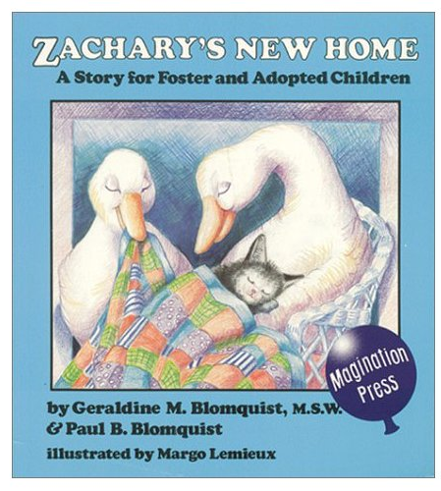
Other texts to compare...
Notes:
These texts are suggestions to help in comparing other texts to Bud, Not Buddy.

Slide 26
Other texts to compare...

Slide 27
Sample Process for Literature
Key Ideas and Details
State what the text says explicitly and support it with
evidence.
Identify the central idea and theme(s).
Analyze characters and events.
Craft and Structure
Interpret words and phrases.
Analyze structures of text and how styles relate.
Discuss purposes and points of view.
Integration of Knowledge and Ideas
Evaluate the different medias.
Compare and contrast the different cultural experiences and
themes.
Notes:
These are the clusters and their topics of discussion. Refer to the activity worksheets to assist with the process as well.

Slide 28
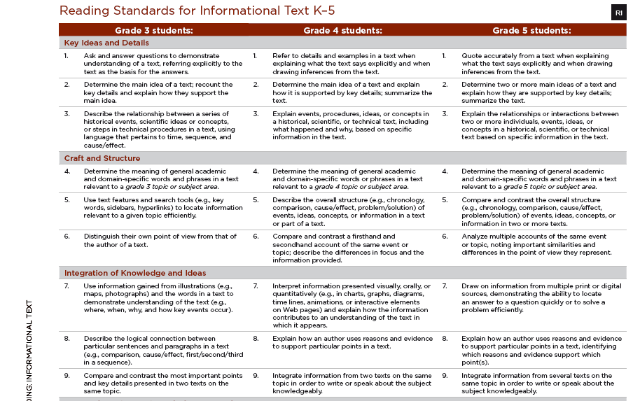
Notes:
Next, we move onto the informational process for close reading strategy. Notice the standards are clustered the same in informational text as they are in literature: key ideas, craft and structure, and integration of knowledge and ideas.

Slide 29
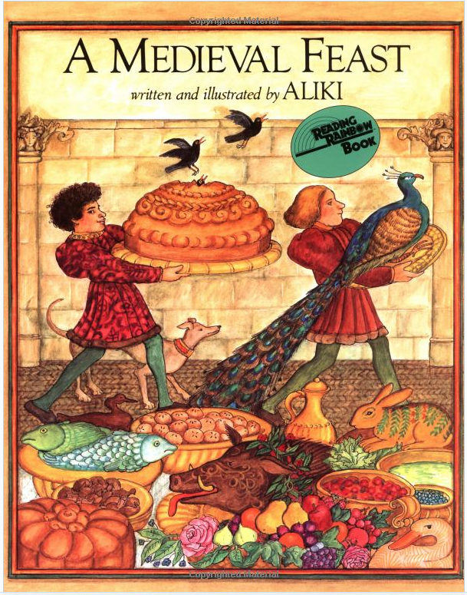
Close Reading: Informational Text
Coding The Text
? = I have a question
about this
! = I have an idea about this
0-0 = I can visualize this
# = I have a connection
Highlight = unknown vocab
Notes:
Close reading in informational text is generally the same as for literature with regards to the process. It is a transaction between the reader and the text. A teacher is still providing text dependent questions that require students to dive back into the text to search for the answers. Students are still analyzing, understanding, providing evidence and justification for their answers. Students will still code the text and a discussion will still ensue regarding the text. Allow participants to read the following text and code if they so choose. Questions after the first read will be formed around the first cluster of CCSS—key ideas and details. Discussion should include the coding of the text along with the questions from the first cluster.

Slide 30
A Medieval Feast by Aliki
It was announced from the palace that he King would soon make a long journey.
On the way to his destination, the King and his party would spend a few nights at the Camdenton Manor. The lord of the manor knew what this meant. The king traveled with his Queen, his knights, squires, and the other members of his court. There could be a hundred mouths to feed!
Preparations for the visit began at once. The lord and the lady of the manor had their serfs to help them.
The manor had its own church, which was attended by everyone on the estate.
Notes:
With regards to informational text however, students will have to critically read with analysis, which means recognizing the aspects of a text that control the meaning such as text features. They will also have to control and grapple with how to think about what is found in the text which means interpreting the data or the process of inferring.

Slide 31
A Medieval Feast by Aliki
The manor house had to be cleaned, the rooms readied, tents set up for the horsemen, fields fenced for the horses. And above all, provisions had to be gathered for the great feast.
The Royal Suite was redecorated.
Silk was spun, new fabric was woven.
The Royal Crest was embroidered on linen and painted on the King’s chair.
The lord and his party went hunting and hawking for fresh meat.
Hunting was a sport for the rich only. The wild animals that lived on the lord’s estate belonged to him. Anyone caught poaching—hunting illegally—was severely punished.
Notes:
First readings require basic comprehension. Students should restate the points in an article or text that mirror the original topic. Students focus in elementary should be to decode and read the information fluently and replicate the meaning intended by the author. The key skills at this level should be summarizing and paraphrasing both in reading and writing.

Slide 32
A Medieval Feast by Aliki
Falcons and hawks were prized pets. They were trained to attack birds for their masters to capture.
They trapped rabbits and birds of all kinds, and fished for salmon and eels and trout.
Serfs hid in bushes and caught birds in traps. They set ferrets in burrows to chase out rabbits.
There were fruits and vegetables growing in the garden, herbs and flowers for sauces and salads, and bees made honey for sweetening.
Notes:
Some discussion questions that will be a focus for the first read will be as follows:
Summarize the main points of this text.
The text says the lord knew what this meant when the King would stop at the Manor. What did it mean?
What specific preparations were made? Infer what other preparations would be made drawing on background knowledge of previous party planning.
Since there were no stores to go to, what other types of activities may have had to been made? For example, how is honey made? What time frame does this take? Insert a video showing the process.
Where do they think this took place?
What time of year? What time period?
Draw a diagram of what the manor looked like.

Slide 33
Close Reading: Informational Text
Text Structures:
Compare/Contrast
Description
Chronological
Question/Answer
Problem/Solution
Cause/Effect
Features: Diagrams, maps, illustrations, highlights, captions, timelines, etc…
Notes:
There is a difference between text features and text structures. It is important to teach both but one is a support for locating and learning information while the other is semantic and syntactic organizational arrangements used to present written information.
It’s extremely important to teach text structures to students from a very early age. Utilizing read alouds to support this is important and there is a PowerPoint listed in the references that suggests different texts for each text feature. Although teaching the text structure in isolation at first to allow for the recognition of it is necessary, it is important for students and teachers to recognize that most authors will not rely on one text structure during their writing. This is especially true in a science or social studies text book.
Synthesizing of the text structures then becomes the ultimate goal in reading informational texts. Therefore, lesson preparation is essential. A teacher must understand that literally, line by line must be studied during close reading and the structure of each sentence must be studied in order identification of the appropriate feature and full comprehension. Although this seems cumbersome at first, worthy note taking for later use eases this stress and does get easier over time.
Although maps, diagrams, illustrations, timelines, captions, etc…are important, what the students understands from those features and how the author used them to contribute to the meaning of the text is the end goal for the reader to walk away with.
Word clues do assist with text feature identification and over time, quick skimming of the text may ensue for the student and the teacher. Independence is the desired outcome.

Slide 34
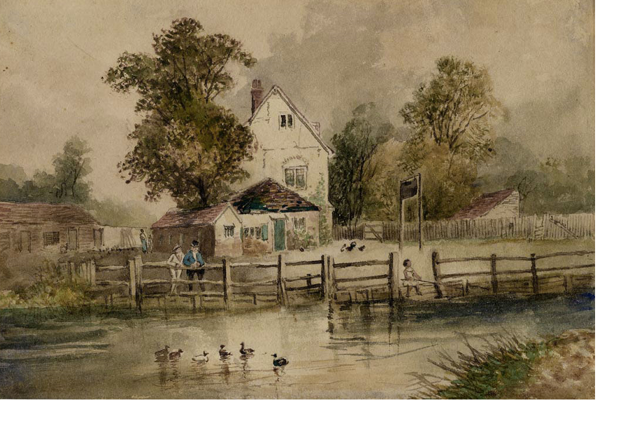
A Medieval Feast by Aliki
It was announced from the palace that he King would soon make a long journey.
On the way to his destination, the King and his party would spend a few nights at the Camdenton Manor. The lord of the manor knew what this meant. The king traveled with his Queen, his knights, squires, and the other members of his court. There could be a hundred mouths to feed!
Preparations for the visit began at once. The lord and the lady of the manor had their serfs to help them.
The manor had its own church, which was attended by everyone on the estate.
Notes:
While completing a second read, students and teachers should focus on the notes that were taken during the first read at the time of the coding of the text. Discussions should ensue around the marking of the text to identify vocabulary that might need to be discussed, both tier two and tier three. Students can have engaging conversations about utilizing the one syllable word summary strategy or 10 important word strategy. This is a handout that is in your packet with directions on how to use it. Another suggestion for vocabulary is to highlight the words and attach media just as we did in the previous literature reading.

Slide 35
A Medieval Feast by Aliki
The manor house had to be cleaned, the rooms readied, tents set up for the horsemen, fields fenced for the horses. And above all, provisions had to be gathered for the great feast.
The Royal Suite was redecorated.
Silk was spun, new fabric was woven.
The Royal Crest was embroidered on linen and painted on the King’s chair.
The lord and his party went hunting and hawking for fresh meat.
Hunting was a sport for the rich only. The wild animals that lived on the lord’s estate belonged to him. Anyone caught poaching—hunting illegally—was severely punished.

Slide 36
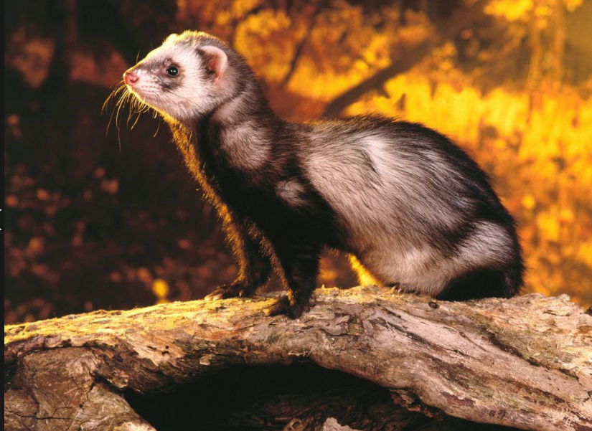
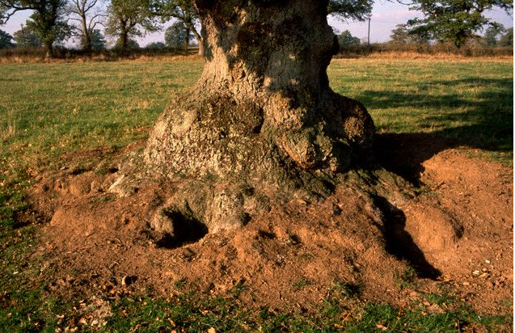
A Medieval Feast by Aliki
Falcons and hawks were prized pets. They were trained to attack birds for their masters to capture.
They trapped rabbits and birds of all kinds, and fished for salmon and eels and trout.
Serfs hid in bushes and caught birds in traps. They set ferrets in burrows to chase out rabbits.
There were fruits and vegetables growing in the garden, herbs and flowers for sauces and salads, and bees made honey for sweetening.
Notes:
At this time the text also needs to be analyzed for structure, organization, genre, purpose, and author’s perspective. As students progress through the elementary grades, an author’s perspective can be analyzed regarding their intent to persuade. Finally, the text should be carefully examined and analyzed to determine how it conveys ideas.
Some questions that would direct students to this are:
What topics are discussed?
What is the purpose of the text--This is where the type of text features are employed. Ask participants to convey what they believe the overall structure of this text is at a table discussion and what evidence supports that.
What examples of evidence are used?--students share the types of words that support this
What conclusions can be reached?
What is the author’s perspective?
Is there a motive for writing this text?
Is there any imagery, figures of speech, tone or dialogue used in the text?
Draw on the point of views of each type of employee or character involved in the preparation and write about what there particular duties were leading up to the King’s arrival. What skills would have been necessary and where would they have been taught those skills?

Slide 37
Close Reading: Informational Text
Synthesize the information
http://medievaleurope.mrdonn.org/powerpoints-manorlife.html
https://www.sbg.ac.at/ges/people/rohr/nsk11.pdf
Notes:
3rd read
The questions to focus on during a third read would be from the Integration of Knowledge and Ideas cluster of the CCSS. It is important to note that other information should be retrieved from different sources such as the internet or other texts that support this time period. These do not have to just include books but can be pictorial representations that pertain to the same subject matter or content area that is being discussed. Pull out the representations that were drawn at the beginning and find representations on the internet and compare and contrast the drawings that students made to the text and the internet representations. The websites located here are provided to assist the teacher or presenter in finding other sources to meet the standards from the cluster of Integration Of Knowledge and Ideas.

Slide 38
A Medieval Feast by Aliki
It was announced from the palace that he King would soon make a long journey.
On the way to his destination, the King and his party would spend a few nights at the Camdenton Manor. The lord of the manor knew what this meant. The king traveled with his Queen, his knights, squires, and the other members of his court. There could be a hundred mouths to feed!
Preparations for the visit began at once. The lord and the lady of the manor had their serfs to help them.
The manor had its own church, which was attended by everyone on the estate.
Notes:
After reading a third time, break the class into three or four groups and ask the students to research a particular group: the serfs, the nobility, the manor owners and the court members. What would their life have been like? This is different than their duties with regards to the preparations for the feast. How did one manage to become a particular member of the group they are researching? Could they ever elevate to another group? What could be the pros/cons to being a member of that particular group? What if the belief systems did not match the member of the group? What would be the cost of leaving it?
Are there connections to this type of activity that students can make? Other festivals or events that this much preparation would be made? Describe that event and use the same amount of detail in a writing assignment that would demonstrate the same amount of understanding with key ideas and details of this event.

Slide 39
A Medieval Feast by Aliki
The manor house had to be cleaned, the rooms readied, tents set up for the horsemen, fields fenced for the horses. And above all, provisions had to be gathered for the great feast.
The Royal Suite was redecorated.
Silk was spun, new fabric was woven.
The Royal Crest was embroidered on linen an painted on the King’s chair.
The lord and his party went hunting and hawking for fresh meat.
Hunting was a sport for the rich only. The wild animals that lived on the lord’s estate belonged to him. Anyone caught poaching—hunting illegally—was severely punished.

Slide 40
A Medieval Feast by Aliki
Falcons and hawks were prized pets. They were trained to attack birds for their masters to capture.
They trapped rabbits and birds of all kinds, and fished for salmon and eels and trout.
Serfs hid in bushes and caught birds in traps. They set ferrets in burrows to chase out rabbits.
There were fruits and vegetables growing in the garden, herbs and flowers for sauces and salads, and bees made honey for sweetening.

Slide 41
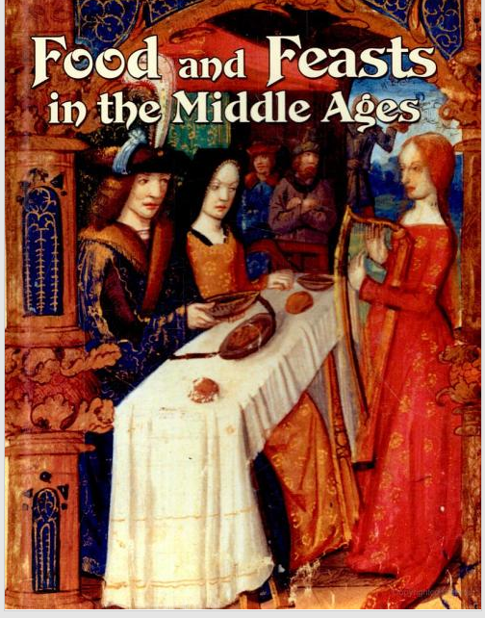
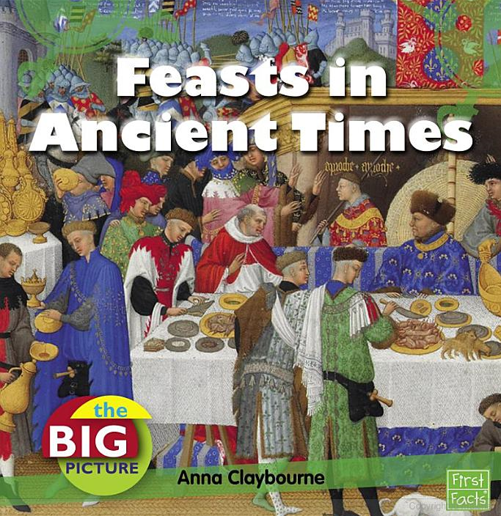
Other texts to compare
Lynne Elliott

Slide 42
Sample Process for Informational Text
Key Ideas and Details
State what the text says explicitly and support it with
evidence.
Identify the central idea and theme(s).
Analyze relationships, concepts, or events.
Craft and Structure
Interpret words and phrases.
Analyze features and structures of text.
Discuss purposes and points of view.
Integration of Knowledge and Ideas
Evaluate the different medias.
Integrate information from several sources to address related
themes and concepts.
Notes:
As a final review for informational text, these are the clusters and their topics of discussion. Refer to the activity worksheets to assist with the process as well.

Slide 43
Notes:
This chart was found on Pinterest. It was created by a Race to the Top Network Team from Jefferson-Lewis-Hamilton-Herkimer-Oneida in New York. This gives the who, what, where, when and why close reading strategy should be employed and types of how the student and teacher text selections and preparations should be considered.

Slide 44
Process
Students and teachers understand multiple reads will occur
Independently
By proficient readers including teacher
Vocabulary instruction with a focus on Tier 2 words (see next slide)
Questions will follow Common Core Standards structure
Notes:
A final review of the process for close reading whether in literature or informational text is located here. When designing questions, they should be reflective of the clusters at the grade level or content area you teach.

Slide 45
References:
Curtis, C. (1999). Bud, Not Buddy. New York: Delacorte Books for Young Readers.
Aliki. (1986). A Medieval Feast. New York: Harper Collins.
Fisher, D., Frey, N., & Lapp, D. (2012). Text Complexity: Raising Rigor in Reading. New York: International Reading Association.
Council of Chief State School Officers. , & National Governors Association, (2010). Common core state standards initiative: Appendix B. DOI: www.corestandards.org
Handout Links:
Text Features PowerPoints http://t4.jordan.k12.ut.us/cbl/images/litfac/binfo.pdf
http://t4.jordan.k12.ut.us/cbl/images/litfac/nutshellinfo.pdf
Florida Center for Reading Research
http://www.fcrr.org/curriculum/PDF/G4-5/45CPartTwo.pdf
Reader and Task Considerations Worksheet
http://programs.ccsso.org/projects/common%20core%20resources/documents/Reader%20and%20Task%20Considerations.pdf

Slide 46
Contacts
Questions or comments?
Please contact English Language Arts Specialists at: plscomments@gmail.com

