Slide 1
Text Complexity:
English Language Arts Common Core State Standards
Illinois State Board of Education
English Language Arts Content Specialists

Slide 2

Text Complexity
3
“The Common Core Standards hinge on students encountering appropriately complex texts at each grade level in order to develop the mature language skills and the conceptual knowledge they need for success in school and life” (p. 3).
(National Governors Association Center for Best Practices, Council of Chief State School Officers, 2010)
Notes:
As we begin looking into the CCSS we are consistently reminded that when we are in doubt about where to begin, we should look to the standards themselves for guidance. While we understand that the standards contain the skills and knowledge that we will be including in our curriculum and instruction, we also must understand that doing so requires an acknowledgement of text complexity. The standards make up the most substantial portion of the Common Core, but they lose their substance and their weight if we are not implementing them through the use of increasingly challenging and complex texts.
In this way, the texts that we choose are the foundation on which we begin building the skills and knowledge embedded in the standards. If we try to implement the standards within the context of texts that are either to easy, too difficult, or otherwise inappropriate, then it becomes impossible for us to achieve an authentic integration of the CCSS.
So at every turn, we need to come back to the question: “Is this text appropriately challenging?” “Does it offer multiple opportunities to teach content and skills outlined by the CCSS?” “Am I teaching it in a way that is relevant and engaging?” and so on….
The Common Core gives us a roadmap by which we can measure if we are on the right track regarding text complexity.

Slide 3

This workshop will address the following questions:
What do the Common Core Learning Standards mean by text complexity, and why is it important?
What is a grade level text complexity band?
Notes:
This presentation seeks to answer these questions.

Slide 4

This workshop will address the following questions:
How do we ensure the texts that we use are appropriately complex, and align to the correct grade level band?
What are the three measures for text complexity, and how do we use these measures to evaluate a text for its complexity?

Slide 5

Why Text Complexity Matters
Please read the excerpt from the Common Core Appendix A : “Why Text Complexity Matters,” that begins on page 2 and ends on the middle of page 4.
As you read-annotate, highlight, underline, and make notes in the text.
Notes:
Have participants read and then share out briefly with a table partner about what they have read, and what line or lines that have chosen. Briefly share out with the large group before proceeding to the next slides.
See the annotating activity on the next slide.

Slide 6
Coding the Text: Appendix A
This is a simple strategy that can help your students as you navigate difficult texts.
As you read this excerpt from the CCSS document, try and model the process. You may use your own set of symbols if you choose.
Underline : I already know this.
Circle : I didn’t know that.
Star: : I think this is important/It makes a lot of sense.
Question Mark : I don’t understand/I disagree with this.
?

Slide 7
Why is this so important?
“Reading Between the Lines”, a 2006 report released by ACT explains that when students didn’t achieve benchmark on the ACT, their struggles stemmed more from the levels of complexity in the passages than from deficits in the specific skills called for by the questions.” “What students could read, in terms of complexity, was at least as important as what they could do with what they read.” (ACT, 2006)
“Making textbooks easier ultimately denies students the very language, information, and modes of thought they need most to move up and on.” (Adams, 2009)
“K-12 Reading texts have seen a decline in the levels of difficulty over the last half-century.” (Appendix A)
“For this group of nearly a half million high school students, critical thinking does not distinguish those who are college and career ready from those who are not; facility with reading complex text does.” (Liben, 2010)
Notes:
This slide provides educators with some of the evidence that suggests this issue is becoming increasingly important and emergent. The first quote suggests that, despite recent trends to adopt more critical thinking models into school curriculum, the complexity of the text being assigned is of equal importance.
The trends suggest that our texts have become much easier over time, and text that offers too many supports undermines a student’s ability to develop into proficient readers.
While critical thinking is important, we must not fall back on these models as the only measures for success. Recent studies suggest that teachers have begun to sacrifice the assignment of difficult, complex texts for easier, more relatable text, in an effort to increase engagement and create interest in reading.
The CCSS suggests that we must have both, reading must be both regular and challenging, or we run the risk of not giving students the skills they need to function in college and the workplace.

Slide 8
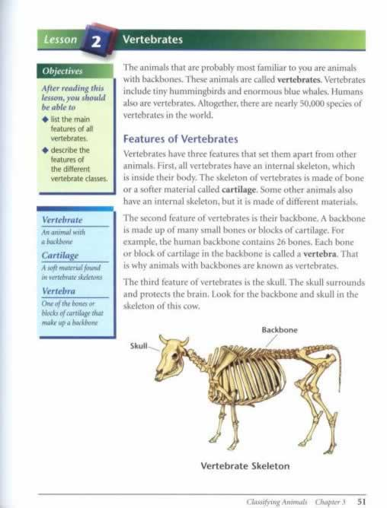
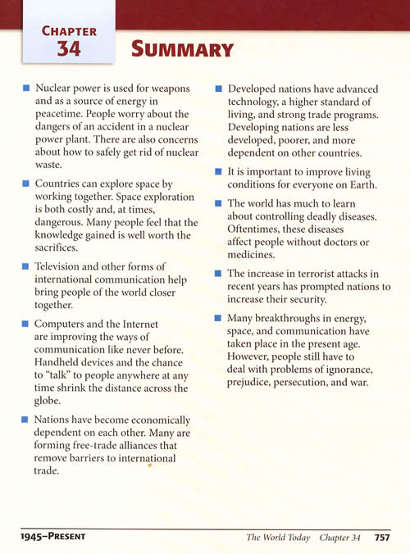
Declining complexity of text; Too many supports.
Notes:
Note the features of the textbooks here, there are bullet points, objectives for the page; the key ideas and vocabulary are already set aside so that the student need not actually read the text itself; a summary of the important points is given at the end of the chapter.
In this case, the features act as reading strategies that have been completed already by the text itself. While these features are undoubtedly designed to assist students in the independent reading of complex texts, studies suggest that the pervasive use of in-text features may be undermining our efforts to create readers who can negotiate difficult text independently.
A problem arises when these high school texts are compared with the college texts seen on the next page (from a Norton Anthology) in which there are little or no textual supports offered.
Headings: Identifies the main ideas
Objectives: identifies the most important information
Vocabulary: Is already set aside, inference is not necessary, and there is no need to look up a word.
Picture: Visualization is done for the student already
Summary: The evaluation and analysis that must take place has been completed
Questions for review: highlights important information, and promotes surface level reading by scanning.
Compare this to the text you annotated at the beginning of the workshop. What is the difference?
The Common Core is not suggesting we do away with our textbooks, or scrap textual supports, but merely that these kinds of textual supports should be part of the scaffolding process, and it should be accompanied by raw text that does not have these supports in order to promote independence.

Slide 9

Notes:
Note that the strategies are employed by the text, not the reader: connection to background, visualization, visual prompts, highlighting and annotating and key vocabulary isolation. Students need not annotate this text, it is already done for them.

Slide 10
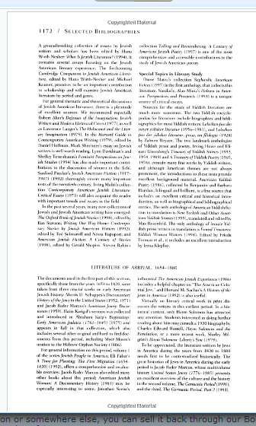
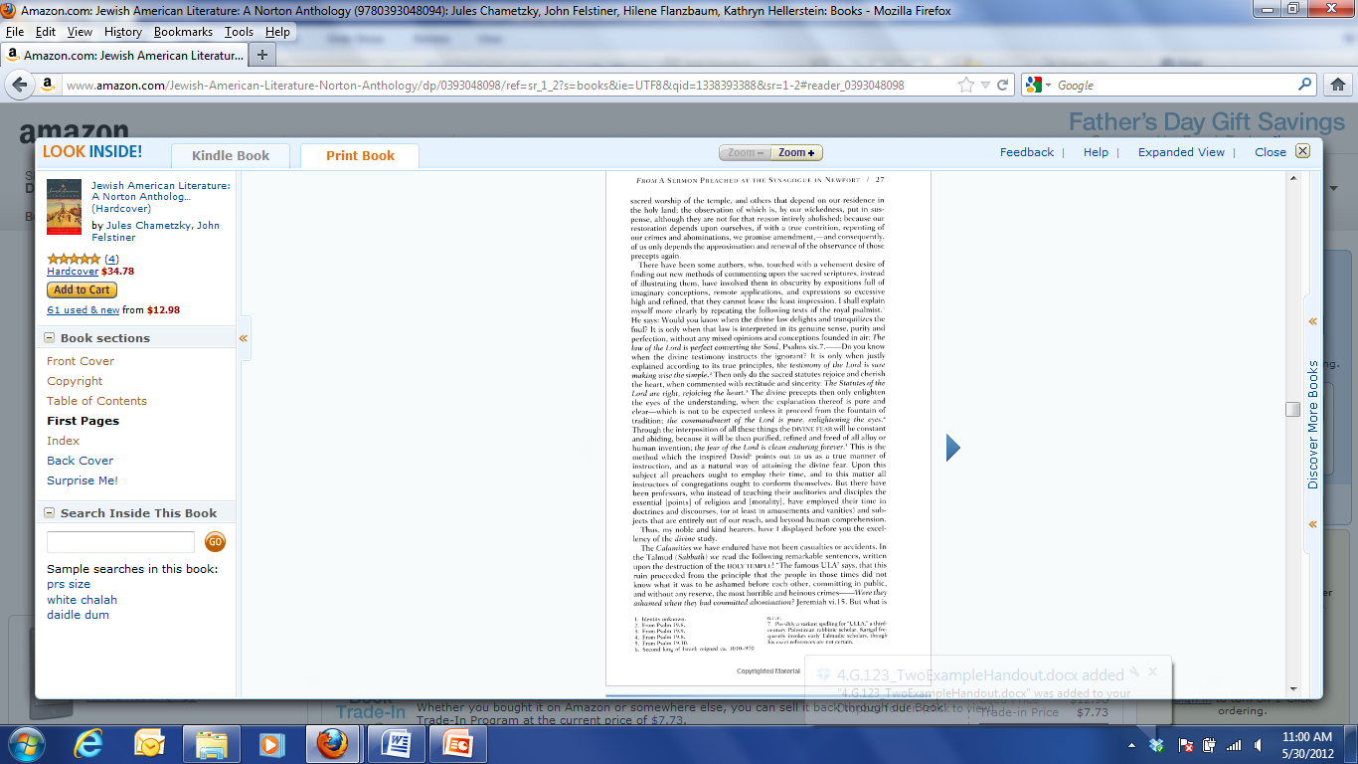
Notes:
Not only are college professors asking students to read from a rawer form of text, they are asking them to do it independently, without supports, and read much greater amounts in a much shorter period of time.
On top of this, students must extract theme and deep meaning and then connect it cross-textually to compose a paper. At this level, there are no more reading check questions, the multiple choice tests all but disappear, and many students are left not having any idea of how to engage this type of complex, unsupported text.

Slide 11
Why Text Complexity Matters
Text Lexile Score
CD‐DVD Instructions 1080
USA Today 1100
AV/Communications/Tech. Manual 1190
College Textbooks 1215
Baltimore Sun 1250
W4 Forms 1260
Applications for Student Loans 1270
The Chicago Tribune 1310
Wall Street Journal 1320
Architecture/Construction Manuals 1340
Washington Post 1350
The New York Times 1380
Agriculture/Natural Resources text 1510
Law/Public Safety 1740
*Scores listed are averages
The Majority of High School Seniors
Only reach levels within the 940-1200 range
Notes:
Note that there is a 350L gap between what is read at the end of high school and what is read at the outset of college. Only 50% reach the 940-1200 levels. According to this study, that means one of every two students is most likely not ready to read college textbooks, or engage with real-world texts.

Slide 12
The Consequences: Too many Students Read at too low a level
Students need to take remedial, no-credit courses when they reach college.
Only 30% of these students will graduate (Wirt, Choy, Rooney, Provasnik, & Tobin, 2004).
Reading Levels among adults are also low, reading proficiency has declined 15% since 1992 (Wirt, Choy, Rooney, Provasnik, Sen & Tobin, 2004).
The percentage of adults who read regularly has dropped from 54% in 1992 to 46% in 2002.
“A turning away from complex text is likely to lead to a general impoverishment of knowledge…and the decline of richness of text itself.” (CCSS Appendix A).
Notes:
These are some of the facts that support these claims. The most alarming aspect is this last suggestion, that eventually, as our culture becomes less literate, text will become less complex, and this can lead to a general impoverishment of knowledge. If this occurs, where then does our country stand on the global stage?
How does this affect the United States in the global market? Where does this leave our students? What happens to our country when the population can’t read beyond an 8th grade level? What does this mean for generations to come?

Slide 13
A Strong Emphasis on Independence and Informational Texts
More Informational Text is emphasized as well:
Expository text makes up the vast majority of the required reading in college and the workplace. (Achieve, 2007)
Students are asked to read very little expository text in the school day-as little as 7 to 15 percent at the middle school level. (Yopp and Yopp, 2006)
“There is also evidence that current standards, curriculum, and instructional practice have not done enough to foster the independent reading of complex texts so crucial for college and career readiness, particularly in the case of informational texts.” (CCSS, Appendix A)
Notes:
So, how do we begin dealing with this important issue?
Two primary suggestions arise from the CCSS:
Informational text: The NAEP suggests that we increase informational text exposure to a 50:50 ratio at the K-5 level, increase the ratio to 60:40 in middle school and finally arrive at a 70:30 split at the high school level.
Independent Reading: As we saw in a few of the previous examples, we are good at teaching reading strategies, and offering in-class and in-text supports, but when do we withdraw the supports and allow the strategies and guidance to become life-long independent reading skill?
All of the reading that is done in college and the workplace is done without support, as well as the reading on standardized testing.

Slide 14

Use the Standards as a Roadmap
Specifically, within Reading Standard #10:
College and Career Readiness Anchor Standard:
R.CCR.10. Read and comprehend complex literary and informational texts independently and proficiently.
Example Grade-level Common Core Standard (6thgrade):
RI.6.10. By the end of the year, read and comprehend literary nonfiction in the grades 6-8 text complexity band proficiently, with scaffolding as needed at the high end of the range.
(National Governors Association Center for Best Practices, Council of Chief State School Officers, 2010)
Notes:
This slide shows the correlation between the anchor standard #10 and 6th grade standard #10. The anchor standards mark what our students should know and be able to do by the time that they graduate from high school. There are 32 anchor standards Each grade level standard represents a stepping stone, or checkpoint, on the progression toward the corresponding college and career readiness anchor standard.
The standards offer a roadmap for text complexity through standard ten, which will remind us at every grade level to turn back to the question of whether or not the texts we are assigning are sufficiently complex.

Slide 15
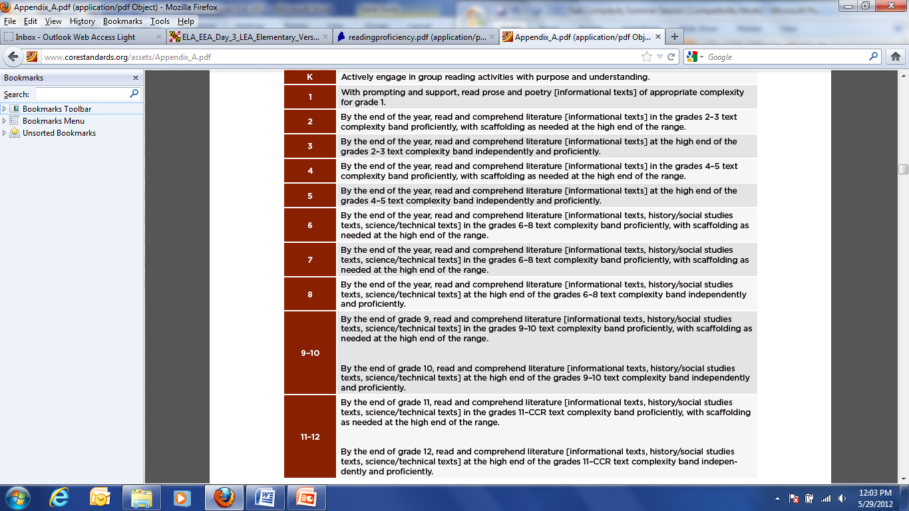
Notes:
Ask the participants to read each grade level standard from top to bottom. What pattern emerges when you read these? (Look to the end of each.)
At each grade level, the Common Core recommends either introducing a new grade level band “…with scaffolding” or promoting the independence of the readers “…independently and proficiently.”
Note that one of the key ideas/themes in this slide is the scaffolding, and then withdrawal of scaffolding as needed. Studies suggest that we do not assign enough independent reading tasks, and when we do, we re-read, and we explicate. This is not to say that we should not do these things. In fact, scaffolding is the most important part of building a foundation for struggling readers, but if we do not withdraw our supports eventually, then we leave students without the necessary skills to move forward in college and career.

Slide 16
Grade Bands
K-1
2-3
4-5
6-8
9-10
11-12
Notes:
These are the grade bands in which you will classify a text based on the three measures, the CCSS appendix B has a list of suggested texts at each grade level band if we need a clearer picture of what they would consider grade-level appropriate.
The grade level text bands also provide a roadmap for teachers, by which they can scaffold, support, and then withdraw to support reading proficiency and independence.

Slide 17

Know Your Readers: A Word of Caution
Students may not be ready to independently read texts that are above their reading level.
When using complex texts, the instructor needs to assess student need, and apply scaffolding as needed, with the long-term goal of creating independent readers.
Research suggests that if students are assigned independent reading tasks that
are above a student’s reading level, then
reading ability does not improve.
Notes:
As always, the teacher must be cautious and use their own discretion when choosing texts, when to scaffold, and when to withdraw support. If a student is given an independent reading task at the frustration level, then reading proficiency only stagnates. The texts that are assigned for independent reading should be comfortable for the student. The most difficult texts may be read with supports in class, and then gradually integrated into independent reading.

Slide 18
  Text complexity is defined by three measures in the CCSS:
Quantitative measures – readability and other scores of text complexity often best measured by computer software.
Qualitative measures – levels of meaning, structure, language conventionality and clarity, and knowledge demands often best measured by an attentive human reader.
Qualitative
Quantitative
Reader and Task considerations – background knowledge of reader, motivation, interests, and complexity generated by tasks assigned often best made by educators employing their professional judgment.
Reader and Task
Notes:
Appendix A defines the 3 components of text complexity. They are:
Qualitative: which measures the levels of meaning, structure, language conventions and clarity as well as knowledge demands.
Quantitative: which measures the readability of the text and is often scored by software.
Reader and task considerations take into account the background knowledge of the reader as well as the reader’s motivation, interests and the task given. This third and final component is to be measured by educators using their professional judgment.

Slide 19
Group Activity: Three Measures
In your table groups, read your assigned section of handout B (Quantitative, Qualitative, or Reader and Task).
Read your assigned description as it appears from pages 4-10. Annotate and take notes on your section.
Report out any information, thoughts, and/or insights about your assigned dimension of text complexity to the group members at your table.
On a sheet of poster paper, write out some of the key points you discussed, or create a drawing that symbolizes your measure.
Choose a spokesperson to report out to the large group.
Notes:
If you are a facilitator, this activity may be set aside to save time. If you choose to do so, you may wish to hide the slide as well.

Slide 20
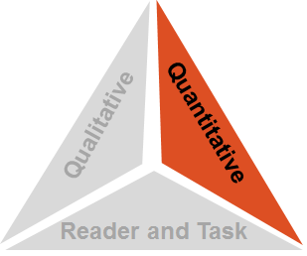
Step 1: Quantitative Measures
Measures such as:
  Word length
  Word frequency
  Word difficulty
  Sentence length
  Text length
  Text cohesion
Notes:
Step #1 asks educators to determine the quantitative measures of the text being read. When determining the quantitative measure, word length, word frequency, word difficulty, sentence length, text length and cohesion are usually evaluated by a system such as Fry’s Readability, Lexile, Dale-Chall, Flesch-Kincaid, or others.

Slide 21
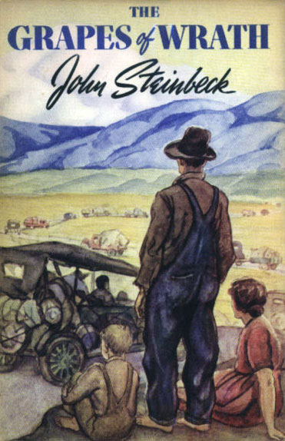
Quantitative Measures: Limitations
Sometimes, quantitative measures for text complexity can be limiting, or measure a text inappropriately. Why might this be the case?
For example: John Steinbeck’s, The Grapes of Wrath
This novel is given a Lexile rating of grades 2-3.
Notes:
Describe the controversial nature of the novel, and then have participants make a guess at what grade level the Lexile score places this novel. Discuss how this is an inaccurate measure, and that one cannot rely solely on quantitative measures.

Slide 22
Quantitative Measure Options
12
The Kansas Department of Education has a document listing common measurement options.
http://www.ksde.org/Default.aspx?tabid=5575
Scroll down to Text Complexity Resources
Click on Resources for Accessing Quantitative Measures Tools
Notes:
Kansas has compiled a listing of the most common measurement options. The document can be found in the link provided. After clicking the link, scroll down to where you will find a plethora of text complexity resources. Listed within the text complexity resources is a document entitled “Resources for Accessing Quantitative Measures Tools.”

Slide 23
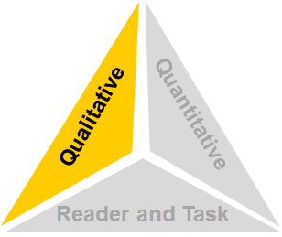
Step 2: Qualitative Measures
Measures such as:
  Structure
  Language demands and conventions
  Knowledge demands
  Levels of meaning/purpose
Notes:
Qualitative measures involve text structure, language demands and conventions, knowledge demands, as well as levels of meaning and purpose.

Slide 24

Qualitative Measures: Other Factors
14
Word difficulty and language structure
Dialect
Text structure
Discourse style (e.g., satire, humor)
Genre and characteristic features of the text
Background knowledge and/or degree of familiarity with the content (including historical, geographical or literary references)
Level of reasoning required (e.g. difficulty of themes or ideas in the text, abstract concepts in the text)
Format and layout of the text
Length of the text
                (Hess and Biggam, 2004)
Notes:
Hess and Biggam note more specific qualitative considerations to take into consideration.

Slide 25

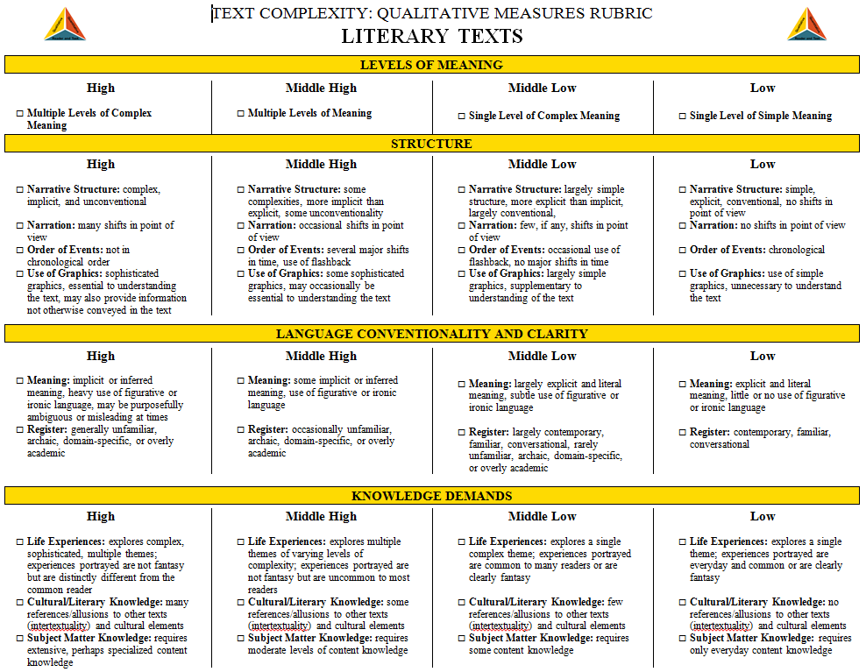
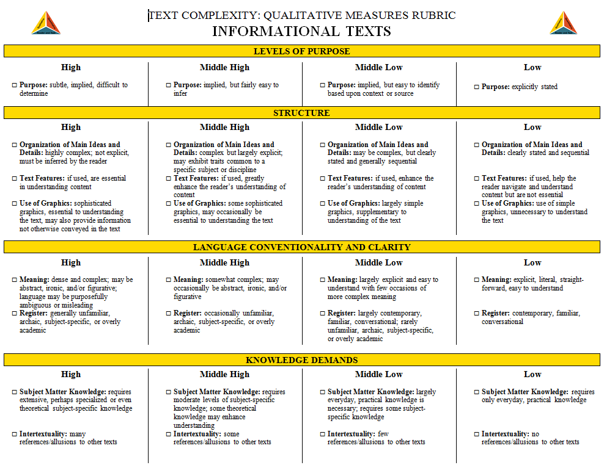
The Qualitative Measures Rubrics for Literary and Informational Text
15
The rubric for literary text and the rubric for informational text allow educators to evaluate the important elements of text that are often missed by computer software.
Literary Texts Informational Texts
(National Governors Association Center for Best Practices, Council of Chief State School Officers, 2010
Notes:
The Chief Council of State School Officers has posted rubrics developed by Kansas to allow educators a way to evaluate qualitative measures that are often missed by computer software programs. Schools can have individuals or teams of educators determine the qualitative measures of a text by using the rubric.

Slide 26
One example of a qualitative rubric... http://www.ksde.org/Default.aspx?tabid=4778#TextRes
Notes:
Educators should keep the following suggestions in mind when using a qualitative rubric.
Teachers may read across the four columns for each row of checkboxes on the rubric, identifying which descriptors best match the text by marking a particular checkbox.
The marked rubric then becomes a GUIDE to educators to continue to evaluate the complexity of a text.
As Appendix A states, “Few, if any, authentic texts will be low or high on all of these measures.” The goal is not for all of the checkmarks to be in a single column; the goal is to accurately reflect these factors of the text.
The marked rubric can then serve as a guide as educators re-evaluate the initial placement of the work into a text complexity band. Such reflection may validate the text’s placement or may suggest that the placement needs to be changed.
Links for the rubrics are found on the resource slide at the end of the presentation.

Slide 27
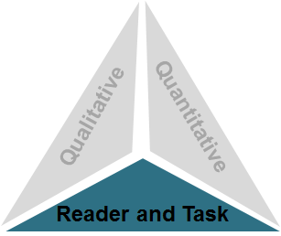
Step 3: Reader and Task
Considerations such as:
Motivation
Knowledge and experience
Purpose for reading
Complexity of task assigned regarding text
Complexity of questions asked regarding text
Notes:
The 3rd step must be determined by the educator. Is the student motivated to read this text? What knowledge and experience do they have about the topic they will be reading about? What is the teacher having the students do with the text as they read?
The complexity of the task should be considered as well. What kind of questions are we asking? Are we having our students consider broader thematic implications?…Are the tasks performance-oriented? (i.e., writing, presenting, creating)

Slide 28
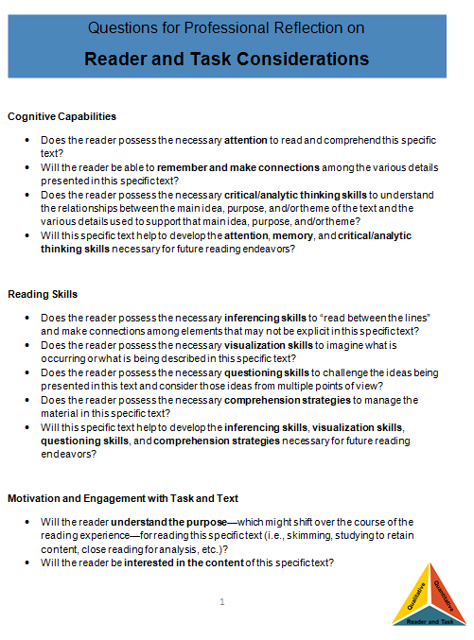
Reader Task and Motivation
18
http://programs.ccsso.org/projects/common%20core%20resources/documents/Reader%20and%20Task%20Considerations.pdf
(National Governors Association Center for Best Practices, Council of Chief State School Officers, 2010)
Notes:
The Council of Chief State School Officers has posted this document on what has been developed by the Kansas Department of Education.

Slide 29
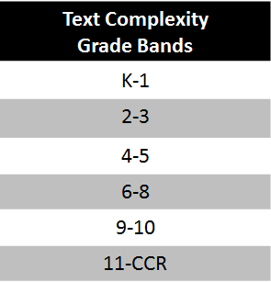
Determining Text Complexity
A Four-step Process:
Determine the quantitative measures of the text.
Qualitative
Analyze the qualitative measures of the text.
Quantitative
Reader and Task
Reflect upon the reader and task considerations.
4. Recommend placement in the appropriate text complexity band.
Notes:
This slide gives educators a four step protocol to follow when determining text complexity.

Slide 30
Read and Measure: “Narrative in the Life of Frederick Douglass”
Read the excerpt from “Narrative in the Life of Frederick Douglass.”
Measure the text according to all three measures for text complexity, discuss, take notes on each of the measures, and choose a spokesperson.
After reading, discuss the features of the text that correspond to each measure for text complexity, and then assign a grade level to the text based on this discussion. (10 minutes)

Slide 31



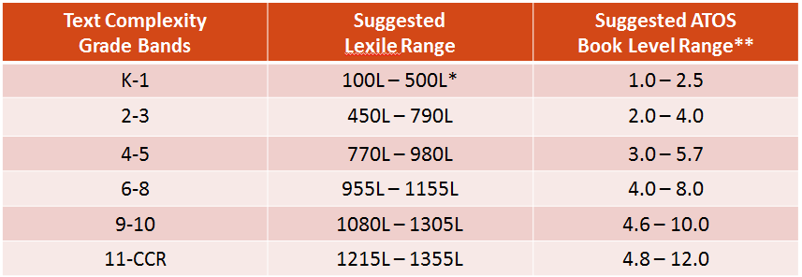
Quantitative Measures: Frederick Douglass
Lexile Text Measure:
1080L
ATOS Book Level:
7.9
In which of the text complexity bands would this text fall?
Table from Appendix A
(Lexile Framework for Reading) ("Ar bookfinder," 2012)
Notes:
When looking at the quantitative measure for the Narrative of the Life of Frederick Douglass, Lexile places it at 1080L and ATOS (Accelerated Reader) at 7.9. When looking at the text complexity grade band table in Appendix A of the Common Core Standards, we see that the book should be placed within the 6-8 grade band.

Slide 32
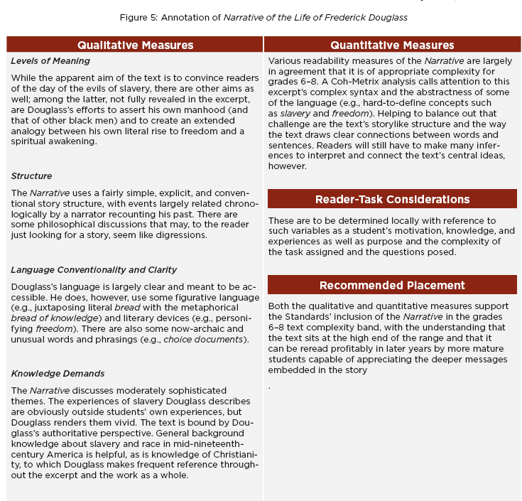

Step 2: Qualitative Measures
Steps 1, 2 & 3 of the process compiled on one document. See Appendix A for more examples.
6-8
Text Complexity Band
(National Governors Association Center for Best Practices, Council of Chief State School Officers, 2010)
Notes:
This slide shows how an educator can compile all components of text complexity onto one document. Appendix A contains a number of example texts (such as the one on the slide) that have been taken through the 3 step process and can now be given a final recommended placement which is step #4. Educators can make a template such as the one on the slide to record all 3 components of text complexity and the grade band recommendation.
After considering all three measures, the teacher has recommended a placement within the 6-8 grade text complexity band for Narrative of the Life of Frederick Douglass.

Slide 33
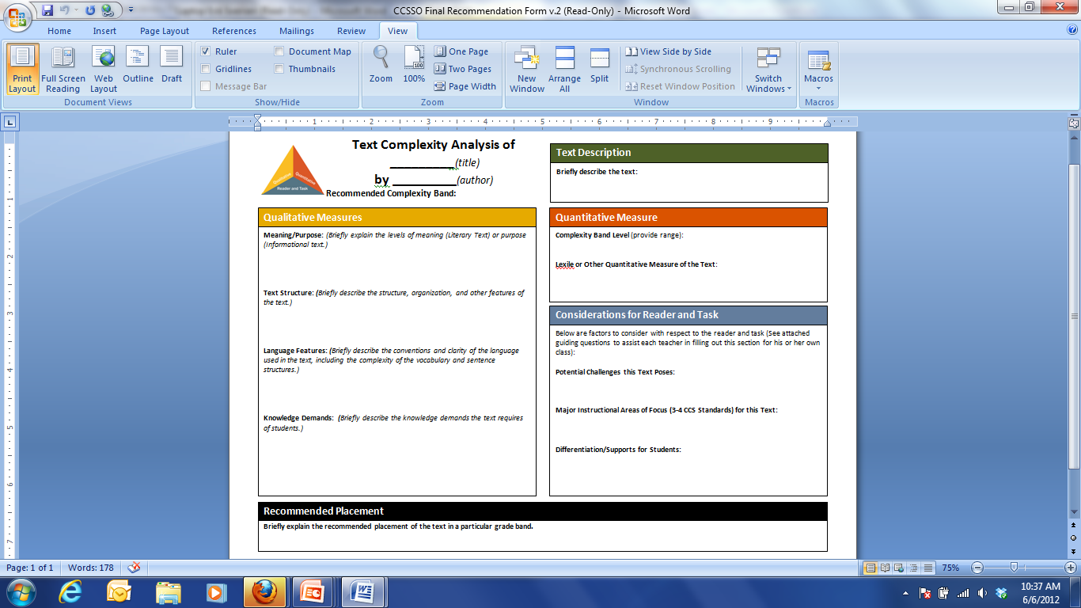

Slide 34
References
21
ACT (2006). Reading between the lines: What the ACT reveals about college readiness in reading. Ames, IA: Author.
Adams, M. J. (2009). The challenge of advanced texts: The interdependence of reading and learning. In E. H. Hiebert (Ed.), Reading more, reading better: Are American students reading enough of the right stuff? (pp. 163–189). NewYork, NY: Guilford.
Biggam, S. and Hess, K. A Discussion of Increasing Text Complexity. Appendix F. NH Curriculum Framework K-12 Reading, Concord, NH: State of New Hampshire, June 2006.
Piercy, T. (2011). “The Text Complexity ‘Staircase’ in the Common Core Standards.” The Leadership and Learning Blog. Leadership and Learning Center. Available at www.leadandlearn.com/blog/2011/04/text-complexity-staircase-common-core-standards?utm_source=feedburner@utm_medium=feed&utm_campaign=Feed%3A+leadandlearn+528The+leadership+and+Learning+Blog%29
Kansas Department of Education. (2011). Text Complexity Resources. http://www.ksde.org/Default.aspx?tabid=4778
National Governors Association Center for Best Practices, Council of Chief State School Officers. (2010). Common core state standards. Retrieved from http://www.corestandards.org/the-standards
The lexile framework for reading. (2012). Retrieved from http://www.lexile.com/
Ar bookfinder. (2012). Retrieved from http://www.arbookfind.com/
MetaMetrics, Inc. How Is Readability Determined within the Lexile Framework for Reading? Durham, NC: June 2001.
Notes:
This slide lists the references cited throughout the webinar.

Slide 35
Resources
20
Web-based Resources
Appendix A – more detailed information about text complexity
Appendix B – text exemplars illustrating the complexity, quality and range of reading appropriate for various grade levels with accompanying performance tasks - www.corestandards.org
Lexile Levels – http://lexile.com
Accelerated Reader http://www.arbookfind.com/
Kansas Department of Education - http://www.ksde.org/Default.aspx?tabid=5575
Books
Fisher, D., Frey, N., and Lapp, D. (2012). Text Complexity: Raising Rigor in Reading. New York: International Reading Association.
Calkins, L., Ehrenworth, M., and Lehman, C. (2011). Pathways to the Common Core: Accelerating Achievement
Rubrics -
Developed by Kansas Department of Education and endorsed by the Chief Council of State School Officials
Informational Text Rubric
http://programs.ccsso.org/projects/common%20core%20resources/documents/Informational%20Text%20Qualitative%20Rubric.pdf
Literary Text Rubric
http://programs.ccsso.org/projects/common%20core%20resources/documents/Literary%20Text%20Qualitative%20Rubric.pdf
Notes:
The resources on this slide were mentioned throughout the presentation. There are two books that are also listed that may also be helpful to educators.

Slide 36
Contact
Questions or comments?
Please contact English Language Arts Specialists at: plscomments@gmail.com
Notes:
This slide lists the English Language Arts Content Specialists for the Illinois State Board of Education who created the presentation.

