Slide 1
Disposition Concerns
Vision and Planning Committee
Notes:
Stacey
-Vision Committee discussed the disposition concerns system for the past year. We researched disposition concern systems at other institutions and we’ve discussed our current process with students, faculty, and staff. We had an enriching conversation with the Tara Kaczorowski, Sara Porter, Susan Hildebrandt, and Debbie Shelden in the Department of Special Education. SED started working on collecting information and feedback on the disposition concerns process about a year ago. They held the same concerns with the disposition system that have been mentioned historically and the same concerns the vision committee holds. The result of the SED work was a moratorium on dispositions within their department and the development of a student success group.

Slide 2
History of Disposition Concerns
1999
Disposition conversation began (NCATE 2000)
2002
Math educators concerned
Fall 2002- faculty may begin submitting
2007
Faculty rarely filing and faculty and students not aware
Notes:
Stacey
March 16, 1999 - E. New Agenda Item: P. Smith requested a new agenda item of what knowledge, skills and disposition every teacher education student on this campus should receive. R. Dammers noted this item will be brought to the Executive Committee's next meeting.
2002-some math educators are concerned about additional faculty review of dispositions, particularly to note patterns of either positive or negative behaviors and attitudes. S. Zielinski shared detailed disposition concerns formats that departments and/or programs could use, to evaluate dispositions such as honesty, respect, and emotional maturity. She noted the importance of logging such behaviors, especially by supervisors and classroom cooperating teachers.
Tuesday, April 16, 2002 - The last item for action was that of the motion regarding the disposition concerns form: “Beginning with Fall 2002, program faculty will begin submitting the Dispositions Concerns form.” D. Curtis asked to change the word “will” to “may” and that “at any point in the teacher candidate’s career at ISU” should be added to the end of the sentence. M. Temple moved to accept the motion, S. Zielinski seconded, motion passed unanimously.
Spring 2003- Teacher candidates write the initial essay on dispositions required for admission to professional studies.
Tuesday, January 16, 2007 - Discussion Items: A. Disposition Concerns: S. Naylor addressed the fact that faculty members are rarely filing disposition concerns. J. Neuleib stated most faculty members are not aware it is available to them. S. Parry agreed the secondary programs do not use this recourse and suggested a workshop to disseminate the information. M. Moore stated that in many instances in reviewing a student’s appeal, disposition concerns have never been filed. D. Curtis suggested it was time to revisit this issue and will discuss it further with M. Munson-Dryer. After their discussion, D. Curtis will bring recommendations to the next CTE meeting.
Tuesday, February 20, 2007 - B. Disposition Concerns: S. Parry stated this resource is not being used very much by faculty members. S. Parry asked for volunteers for an ad hoc committee to disseminate information to the faculty. S. McCrone, J. Nicholson, and B. Allison volunteered. B. Nourie will recommend someone from the Curriculum and Instruction Department and A. Coffman will ask someone from the laboratory schools.

Slide 3
History of Disposition Concerns
2009
Conversation on how they are used in departments
2013/2014
Proactive rather than reactive
How will it be communicated to students
2016
No standard policy for issuing
Notes:
Stacey
Tuesday, April 19, 2011 - Information Items: A. ISBE Certification Update/IACTE Meeting :Although there is no requirement concerning a “Code of Ethics,” higher education is encouraged to ensure teacher candidates are aware of the code and it is recommended that it is included in assessment of professional dispositions.
Tuesday, September 18, 2012 - E. UTE Assessment Committee: A. Adkins reported the Graduate Teacher Assessment Survey will be discussed under Information Items. Also, will revise the disposition concerns form. Special Education Department has a version close to what the revision will be.
Tuesday, January 15, 2013 – E. UTE Assessment Committee: A. Adkins gave an overview for the Internal Review Process for Annual Program Reports. One program was asked to appear before Illinois State Board of Education. All other programs received great reviews. They want disposition assessments to be proactive instead of reactive.
Tuesday, April 1, 2014 - D. Hatch, CAEP4 Examiner had concerns regarding constituents (secretaries, field advisors, etc.) not being able to write dispositions as they currently do. A. Adkins indicated this particular disposition is in addition to the disposition we currently have in place. The purpose of this disposition is to have the teacher candidate assessed four times. Discussion ensued. W. Troxel stated that they have not used it at the graduate level and likes the developmental nature. S. Jones-Bock wanted to know how the information will be communicated to the students.
May 6, 2014- At the urging of the ISBE, the committee is trying to be more proactive and has been meeting for 2 semesters. They are ready with some recommendations on what to assess and have created PEDA, a tool that measures dispositions of all teacher candidates. This information will help with program reviews. It does not replace the Disposition Concerns form – this process will continue.
February 16, 2016- S. Sanden asked if there was a standard campus policy for faculty on issuing dispositions. There is not a standard policy. With so many teacher education programs across five colleges it is difficult to standardize a process. P. Schoon noted that CTE deals with programs, not policy.

Slide 4
History of Disposition Concerns
2017
Secondary programs and non/teacher education faculty and staff
2019
Intentions of their use and how the data is used
Need to create systematic appeal process
Not formative, need to look at process
Lack of awareness among students
2020
Marginalize students of color
Notes:
Stacey
September 19, 2017- C. Borders added that the disposition concerns process is familiar within the College of Education. If the information could get out to secondary programs and non-teacher education faculty/staff, the problematic behavior for a student could be flagged earlier. D. Garrahy added that it needs to go out to all five colleges so the word gets out to new faculty.
M. Noraian added that they have training for new faculty at CTLT and suggested a packet. S. Otto added there were great videos for the clinical documentation form and maybe a video could be done for disposition concerns.
September 17, 2019-C. University Liaison and Faculty Interests Committee: S.Hildebrandt reported there doesn’t seem to be much on faculty interest in description of their charge. Conversations were initiated about dispositions concerns and edDispositions, intentions of their use, and how the data is used.
A. Mustian added that there is a larger conversation that needs to take place regarding disposition concerns. If we have a good student by a broad set of norms – it is punitive of how it becomes. On the forms, it is not formative anymore, needs to be a part that creates a support plan. How many good future teachers are we keeping out; it needs to be a good research- based disposition.
C. Borders indicated that the state committees are looking at disposition concerns across the state. Collecting data from the institutions and the work is being done at the state level.
J. Donnell stated that TCH tracks their dispositions internally; 90-95% are about taking responsibility and they do require their professors to write a plan of action.
P. Hash added the everyone should be using the same dispositions concerns form as it was CTE approved.
February 18, 2020- J. Terrelle shared his experiences as a black student on this campus. Social justice being discussed in classrooms is through the lens of whiteness. He hasn’t had a single teacher education professor who is not white. There are false notions of inclusivity and equity that are actually oppressive. We, as students of color, need faculty of color. Silence and discomfort in the room—your comfort (white faculty, white students) comes at my discomfort. Disposition concerns are problematic and a means to further marginalize students of color. White people and whiteness should not be at the center of race discourse; you are killing us intellectually, mentally, and spiritually.

Slide 5
Challenges with
the Current Process
Deficit-based
Inconsistent implementation
No training offered on the process
Faculty and students unaware
Relatively old model that needs a comprehensive look
Data?
Moral obligation: Are we serving our students the best we can?
Notes:
Andrew
-history of ongoing concerns
-lack of fidelity

Slide 6
Student Concerns
Many students don't know that the dispositions exist
Unsure of where to read about them
Unsure about the disposition process
Each professor sees/applies differently
Notes:
Andrew
Our student voices were important in this process. Two different groups of our student committee members voiced the same concerns. Students outside of the College of Education may be treated differently in the COE than they are in their own programs.

Slide 7
Model Components
University of Minnesota’s Dispositions:
Assets
Role of Self
Collaboration & Communication
Critical Care
Intentional Professional Choices
Navigation: Flexibility & Adaptability
Imagination & Innovation
Advocacy
Ball State’s Dispositions:
Demonstrates Effective Oral Communication Skills
Demonstrates Effective Written Communication Skills
Demonstrates Professionalism
Demonstrates a Positive & Enthusiastic Attitude
Demonstrates Preparedness in Teaching & Learning
Exhibits an Appreciation of & Value of Cultural & Academic Diversity
Collaborates Effectively with Stakeholders
Demonstrates Self-Regulated Learner Behaviors/Takes Initiative
Exhibits Social & Emotional Intelligence to Promote Personal & Educational Goals/Stability
Illinois State’s Dispositions:
Collaboration
Honesty/Integrity
Respect
Reverence for Learning
Emotional Maturity
Reflection
Flexibility
Responsibility
Notes:
Jill and Alan
Why do we like these two models
MN- equity lens
Ball State a more measurable behavior—presented like objectives

Slide 8
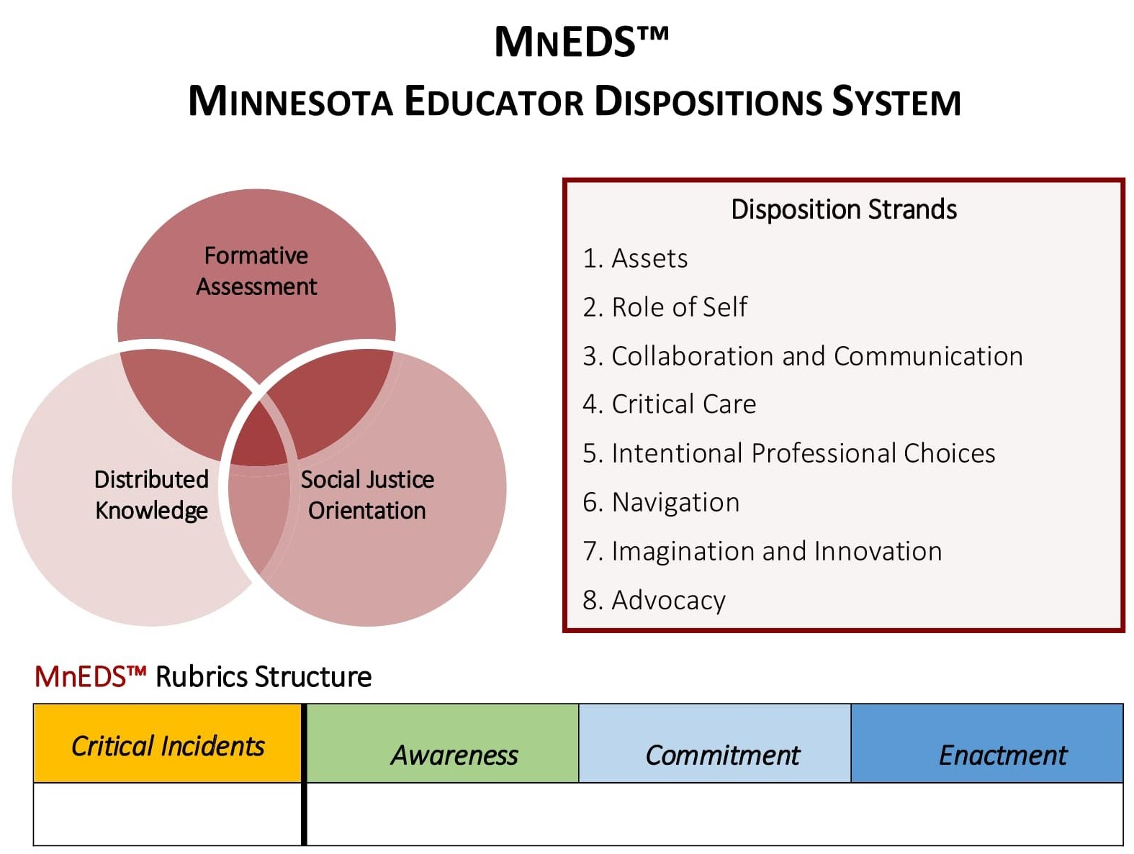
Model Comparison
Comparison of University of Minnesota
University of Minnesota: framework for equity-oriented teaching.
Facilitate dialogue around a teacher candidate’s dispositional growth throughout their teacher preparation program.
Notes:
Jill and Alan

Slide 9
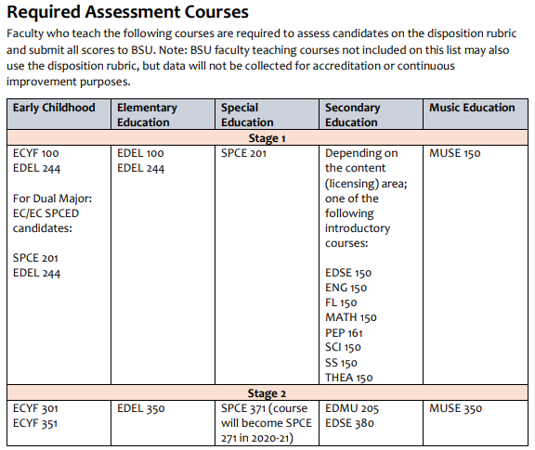
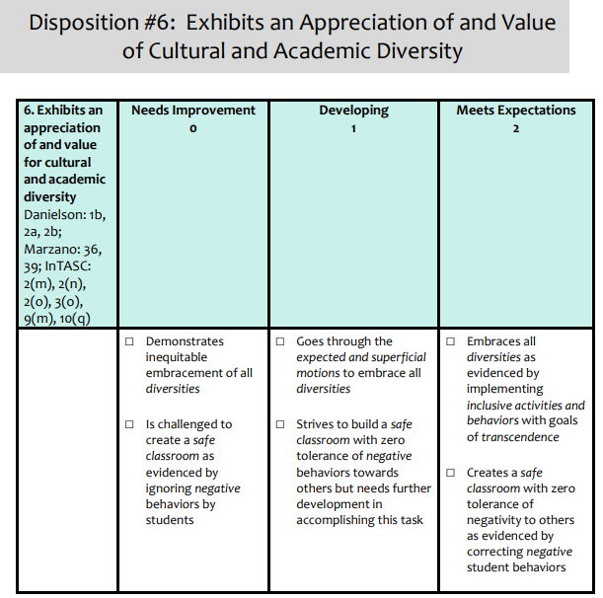
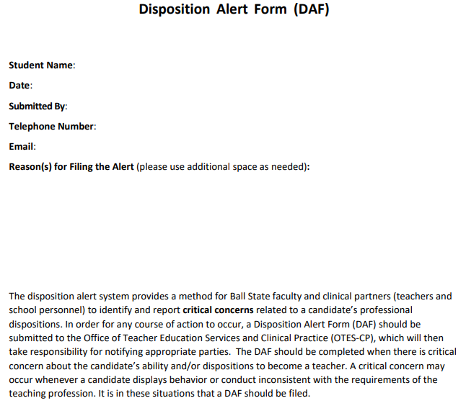
Comparison Ball State University
Ball State University is an Educator Disposition Assessment (EDA) system to assessing and supporting teacher candidates’ disposition growth throughout their preparation.
It is in two parts: Developing and Monitoring Teacher Candidates’ Dispositions.
Proactive: Disposition Rubric System, (EPP courses embedded) and Reactive Components (Disposition Alert System (DAS)).
Model Comparison
Notes:
Jill and Alan

Slide 10
Questions
Do we need programs place a moratorium on the current disposition concerns format/process?
Do we need to develop an early notification system?
Can we provide university and in-house support that addresses the issue at an individualized level with the student?
Notes:
Molly

Slide 11
What do we need to do
for real change?
Update the model’s components
Change the process to be more pro-active, not reactive
Create the process to be two stages; Department and Teacher Center (based on the disposition issue)
Change the process to be fluid for all programs across campus
Make the process accessible to all involved (i.e., Qualtrics)
Teacher Candidate
Director of Teacher Center
Departments; chair, coordinator, and/or instructor
University Supervisor (student teaching)
Cooperating Teacher (clinicals or student teaching)
Notes:
Andrew
Two-part system where there is a proactive, mediation process, and then reactive if necessary

Slide 12
Ad Hoc Committee
Form a committee to write new pillars and processes
Seek feedback from faculty, staff and students
Collect data and establish an assessment loop and committee oversight
Notes:
Alan:
How should the committee be formed?
-Seek membership from faculty and staff that are already passionate and engaged in the work.
-Committee members don’t have to be CTE members.
-Diverse committee should represent Secondary programs, COE departments, CELP.
This process will take time. We don’t have to stay dissatisfied with our current system. We can make changes.

