Slide 1


Chicagoland Partners for ELL Education
ELL 101 for Administrators
NSSD 112
October 13, 2011
11:30 – 12:30
Facilitated by:
Marla Susman Israel, Ed.D.
Associate Professor
Loyola University Chicago

Slide 2
Word Sort
With your tablemates, please sort the words that are in your envelope.
You may sort these words into categories, semantic maps, whatever makes sense to the group.
You may speak in your native language during the sorting. You must, however, be able to explain the sorting to others in English.
Teaching tip: This can be done as a picture sort for non-English readers. This is a great way to pre-teach vocabulary.

Slide 3
This presentation was made possible by:
Chicagoland Partners For English Language Learners (CPELL) Loyola University Chicago project funded by the Office of English Language Acquisition, U.S.
Department of Education School of Education ·
Loyola University Chicago · 820 N. Michigan Avenue, Chicago, Illinois 60611 Phone:312.915.6318 · E-mail: cpell@luc.edu
The teachers at North Shore School District 112 in Cohort 1 & 2:
Melissa Arof, Patricia Castano, Stephanie Labellarte, Beverly Ramirez, Alison Ryan and Janet Van Arsdale

Slide 4
Today’s Goals
Understand the Iceberg of Language
Understand the Nature of Learning a New Language
Based on research, clarify the outcomes that can and cannot be achieved using the various ELL models
Review best ELL teaching practices
Understand the Iceberg of Culture
Increase cultural competency and cultural sensitivity

Slide 5
NSSD 112 Mission Statement
The mission of North Shore School District 112, a community partnership committed to world-class education, is to nurture every child to become an inspired learner, a well-rounded individual and contributing member of a global community by striving for excellence within an environment that fosters innovation, respect, engagement and intellectual inquiry.

Slide 6
Developing new understandings about language and culture
“Educating all children will require the will and commitment to understand and respond to cultural difference. To the extent that teachers know and understand how children’s past experiences have been organized and explained, they are better able to fashion new ones for them.”
(Bowman & Stott, 1994)

Slide 7
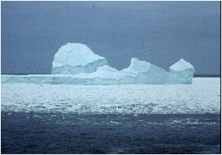
The Iceberg of Language
BICS – Basic Interpersonal Communication Skills: This is conversational language. Language on the surface.
CALPS – Cognitive Academic Language Proficiency Skills (academic language) Language of deep understanding.
Notes:
7

Slide 8
WIDA
World-Class Instructional Design and Assessment
Levels of Language Proficiency (measure with ACCESS)
  Listening, Speaking, Reading, Writing
    Entering
    Beginning
    Developing
    Expanding
    Bridging
    Reaching
Remember, a student can “display” different levels of language proficiency within BICS and CALPS and within each of the language skill areas.
Let us experience what this “feels like” for the ELL student.

Slide 9
Bootstrapping
(Cloud, Genesse, Hamayan, 2009)
ELL’s use their home language to help them learn English much the way a child uses the straps to pull on their boots – it is much easier than if a child just tries to tug away at the boots themselves.
Write down how you “bootstrap” as I read to you the following children’s classic piece of literature.
How could you make the language more comprehensible for your students?

Slide 10
Language Minority Education Programs
Early Exit Bilingual Model – Three years out model. Uses native language as a bridge to target language. Goal is for child to become fluent in target language.
Late Exit Bilingual Model – Five to seven years and out model. Uses native language as a bridge to target language. Goal is for child to become fluent in the target language.

Slide 11
Language Minority Education Programs
Maintenance Heritage Language Program – Class composed of SAME native language speakers. Goal is to maintain language while learning the target language.
Dual Language Model – Class is composed of half native language and half target language speakers. Goal is for both groups of children to become bilingual in both languages.

Slide 12
Language Minority Programs
Immersion Model – Sink or swim. Goal is for child to become fluent in target language.
ELL Model/TPI model (formerly ESL) – Class is composed of many different native language speakers. Using specific strategies, students learn target language through the use of the target language. Children within each language group only speak native language to each other. Goal is for child to become fluent in target language.

Slide 13
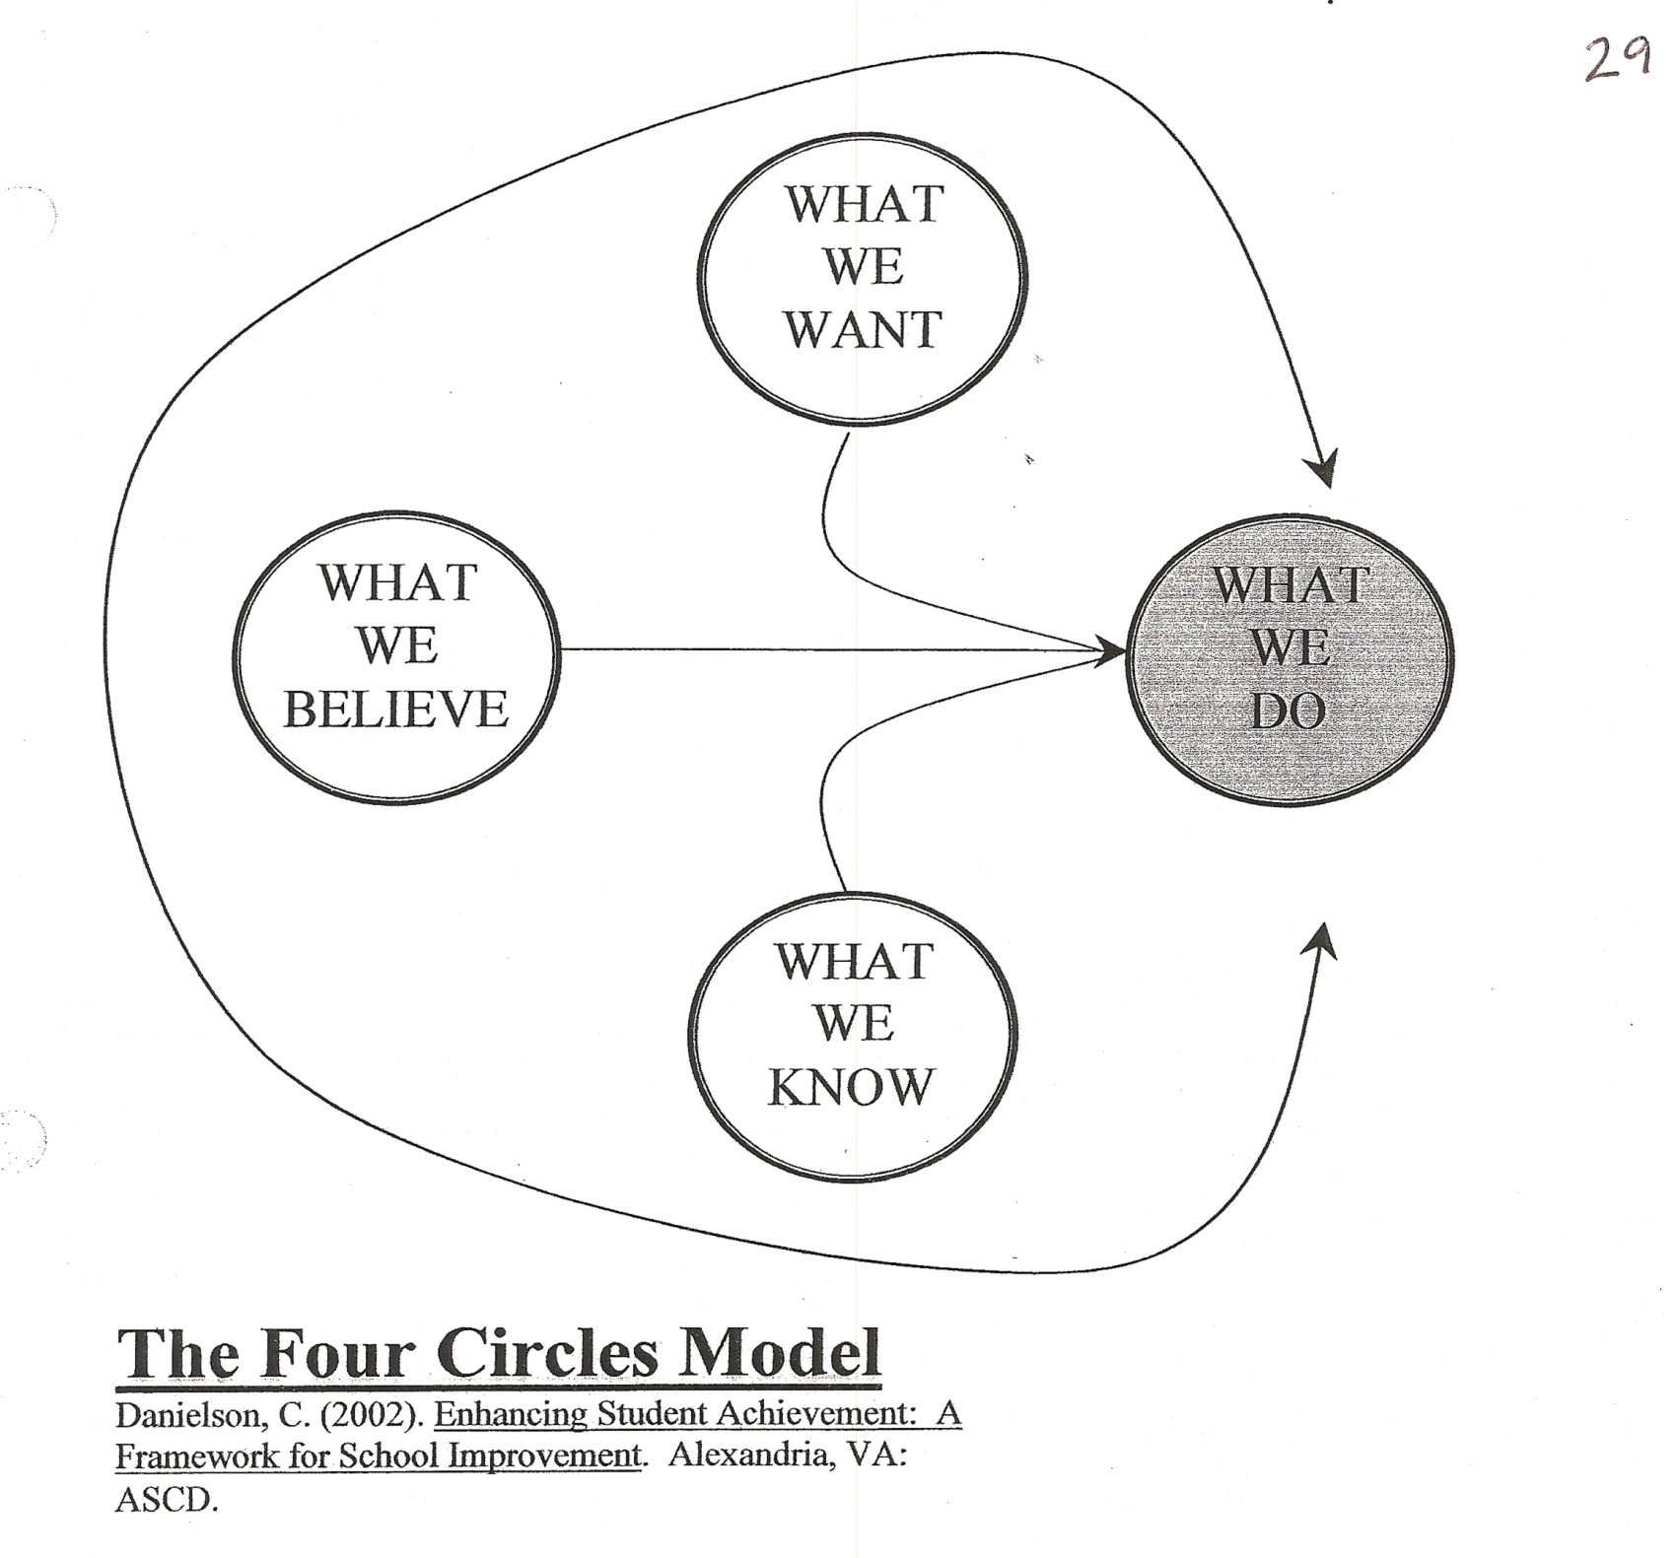

Slide 14
Applying the models to NSSD 112
What should we see in the classroom within each model?
  Teacher Talk (language)
  Student Product (language)
  Overall Student Goal (language)
What constitutes success within each model in NSSD 112?
  Refer to supplemental document

Slide 15
Constructivist/Sheltered Instruction
Theory and Theorists
Krashen:
    The role of MEANING
    The role of COMPREHENSIBLE INPUT
    The role of LOW ANXIETY
Cummins
    Proficiency in English used for COMMUNICATIVE PURPOSES
    Proficiency in English used for ACADEMIC PURPOSES
    EMPOWERMENT OF STUDENTS
Long
    the role of INTERACTION

Slide 16
Best practices in ELL education
  Values prior knowledge
  Is context embedded
  Integrates cooperative group work
  Uses total physical response (gesture)
  Uses multidimensional assessment
  Integrates language, content, and process

Slide 17
Modify Teacher Talk
Be aware of idioms (Jodi Reiss, 2008)
Use meaningful gestures
Teacher think alouds
Slow down
Use visuals
Un-clutter the classroom environment
Think-pair-share while teaching
Allow extended wait time

Slide 18
Selecting Words to Teach
(Cloud, Genesee, Hamayan, 2009)
Select words that are important for understanding the essential learnings and the text.
Do not exceed the number of words that student can remember (around 6 to 10 per lesson, depending on the learners’ age and/or stage of proficiency.
Select words that can advance student’s word learning skills (words with particular prefixes or suffixes for example)
Teach words that are frequent, useful and likely to be encountered in the content area. They should be highly transferrable to other units or content areas.
Do not directly teach words if students can use context or structural analysis skills to discover the word’s meaning.
Be sure that you select an appropriately leveled passage to begin with, one for which you will only need to teach a small number of words prior to reading.

Slide 19
Sources for Observing and Evaluating Teaching and Learning
WIDA Standards and the Common Core
  www.wida.us (World Class Instructional Design and Assessment)
  -SIOP model (Sheltered Instruction Observation Protocol) http://www.misd.net/bilingual/ELL.pdf

Slide 20
Application
For the student described in your scenario, answer the following questions:
First, using the knowledge gleaned from your classroom observations of good teaching for all children, what teaching strategies should you see for your chosen student in the classroom– be specific.
Second:
  What data do you have about this student?
  What data do you still need about this student?
  What needs to be communicated amongst the teaching team members?
  What should possible next steps be for this student?

Slide 21
The Cultural Competency Game
You have each been given a “label” that everyone can see – except you.
When given the “go” sign, you need to get up and ask people about yourself. People will answer you with a “yes” or “no” answer.
Move around. Ask multiple people questions until you guess correctly “who you are.”
When you know “who you are,” put your sign to the front of your body.
Debrief-
  What types of questions did you ask?
  What types of answers did you give?
  How did you feel during this game?
  What implications does this have for your work?

Slide 22
The Iceberg of Culture
Notes:
22

Slide 23
The Iceberg of Culture
“The privatization of moral discourse in our society has created a deep sense of moral loneliness and moral illiteracy, the absence of a common language prevents people from reading about and talking about the moral issues they face.”
Bolman & Deal: Leading with Soul (1995)

Slide 24
A common feature of culture is that it is a collective creation.
That is, people construct their social interactions with others.
Cultural ideas are shared by a group of people who recognize the knowledge, attitudes, and values of one another.
These people also agree on which cultural elements are to adhered to and followed.

Slide 25
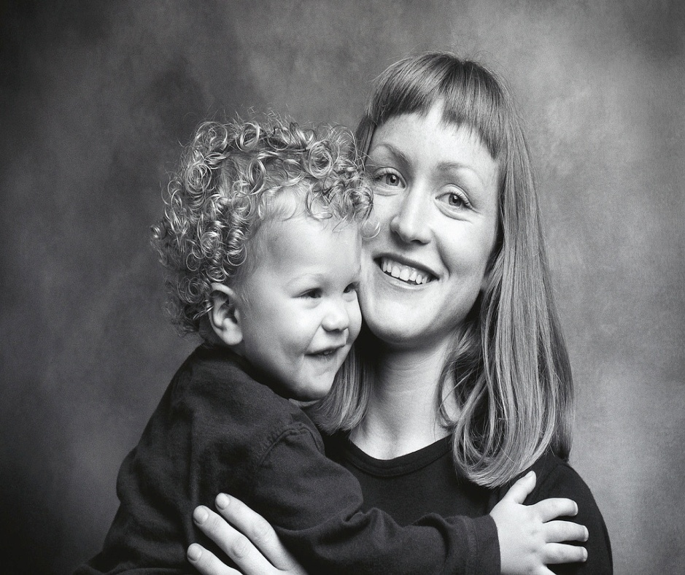
Culture is transmitted across generations by such people as parents, teachers, respected elders and religious leaders.
It is mediated through a variety of sources, including the media, the stories parents tell their children, and the various experiences one has in a given culture’s institutions and schools.

Slide 26
There exists clear childhood experiences that individuals can identify that help to develop and teach particular values and practices.
Among many in the middle class in the United States (particularly among certain ethnic groups), individualism and self-reliance are strongly valued.
On the contrary, people of some ethnic or cultural backgrounds strongly value interdependence and a collective orientation, or a strong group identity.

Slide 27
Ethic of Critique: An ethical lens to develop intercultural competence
Whose voice is not considered?
Whose voice is silenced?
What does this mean for our work as educators?

Slide 28

Intercultural competence requires that every member of an educational community answer four questions for themselves . . . .
28

Slide 29
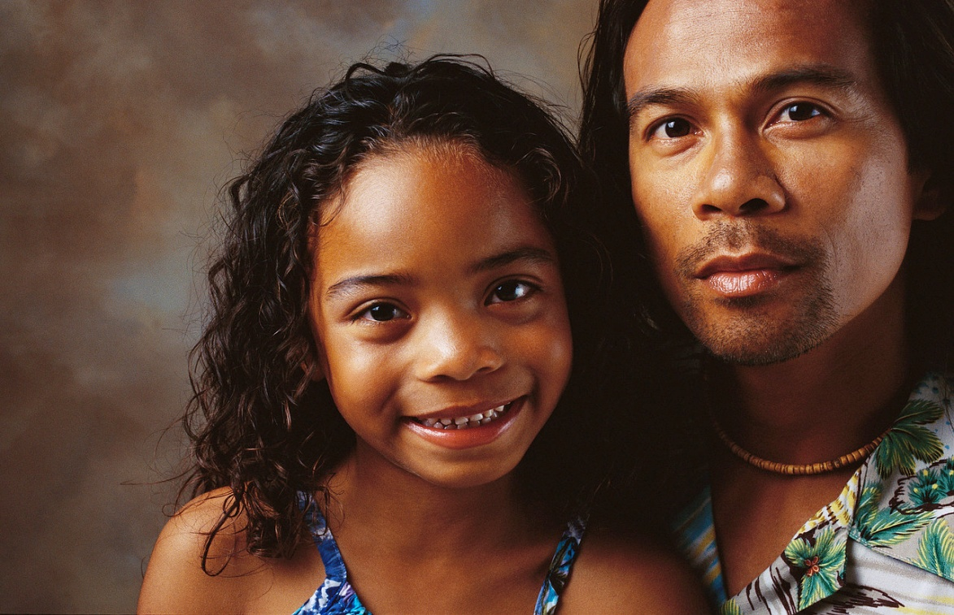
What is culture?
29

Slide 30

What modifications and insights need to be created as one seeks to bring culturally different individuals together?
30

Slide 31
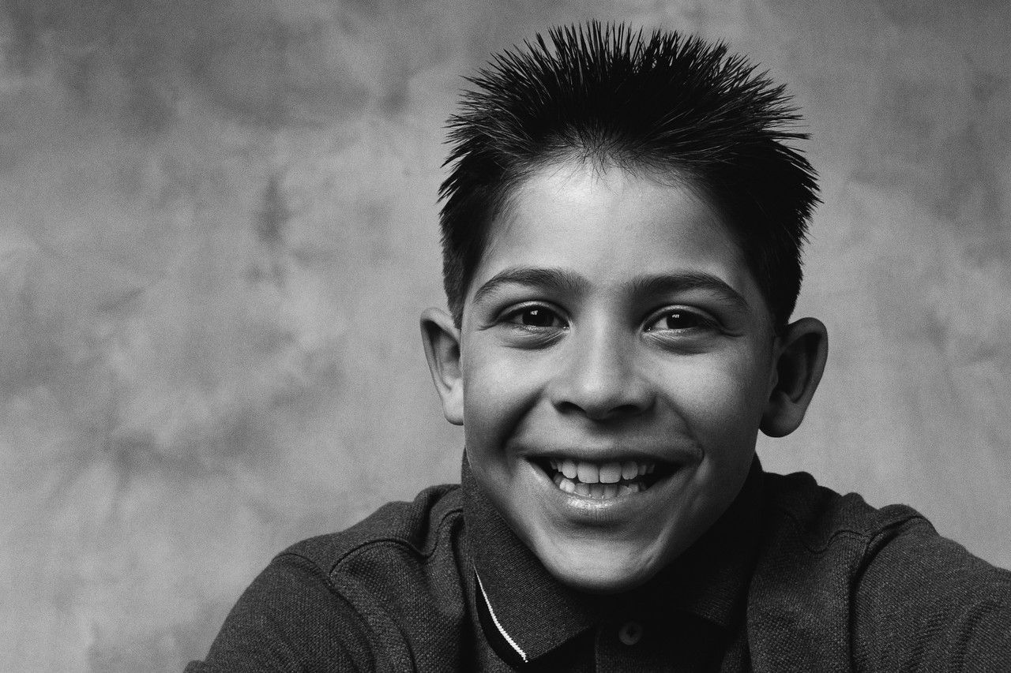
What information (cultural guideposts) do I need to aid others in understanding the culture of school in a way that facilitates their acculturation and academic success?
31

Slide 32
Who are our cultural ambassadors?
Who can hear the silenced voice?
Administrators, teachers, teacher assistants
Bus Drivers (see Roger E. Axtell’s {1998} Gestures: The Do’s and Taboos of Body Language Around the World.
Crossing Guards
Food Service Personnel
School Psychologists/Social Workers
P.E. Teachers
School Nurse
Technology Specialists

Slide 33
Tools for increasing cultural competency
Be aware of your own biases
Actively listen
Read about other cultures
Spend time with people from other cultures
Immerse yourself in a culture – take the role of other
Culturegrams: http://online.culturegrams.com
  Login ID: cpellremote
  Password: library

Slide 34
Thank you and Feedback
Please visit our website at:
  www.luc.edu/cpell
    You will find symposium power-points for administrators, teachers, and parents.
    You will find out more about our great CPELL scholars and graduates.
    You will find additional resources to help you serve your ELL students and families.
Feedback:
  2 CPDU forms – complete and turn in the form with the checkboxes; keep the other form for your records.
  1 CPELL feedback form – complete and turn in. Please make sure you mark your position at the top of the form.

