Slide 1
Empowerment through service-learning: What and How?
Miranda Lin, Professor
School of Teaching and Learning

Slide 2
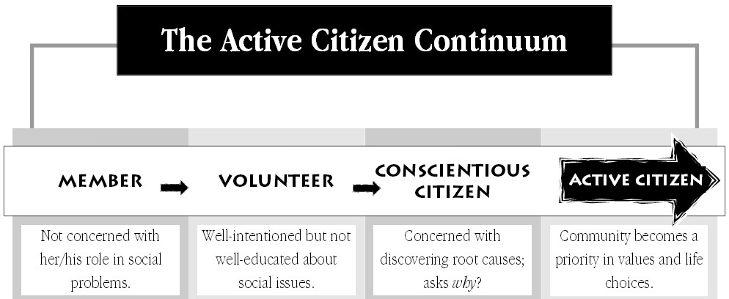
Partnership on Purpose

Slide 3
Questions for Discussion
1. Where do you fall on the Active Citizen Continuum?
2. What are some challenges you might face as you move along the continuum?
3. What can you make an effort to move towards being an active citizen, if you are not already there?

Slide 4
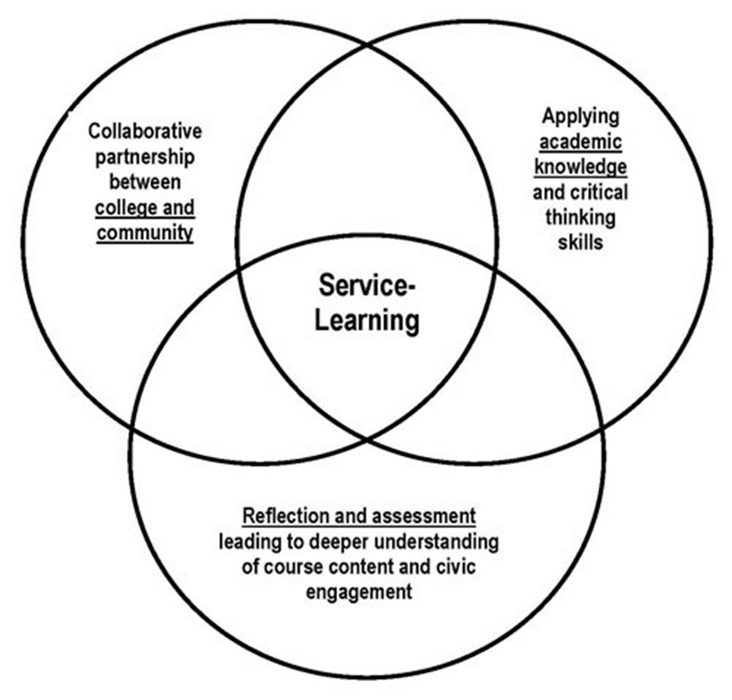
What Is Service-learning?
Students participate in an organized service activity and reflect on that activity to gain further understanding of course content, a broader appreciation of the discipline, and an enhanced sense of personal values and civic responsibility.
Service-learning engages students in active, collaborative, and inquiry-based learning experiences that meet identified community needs.

Slide 5
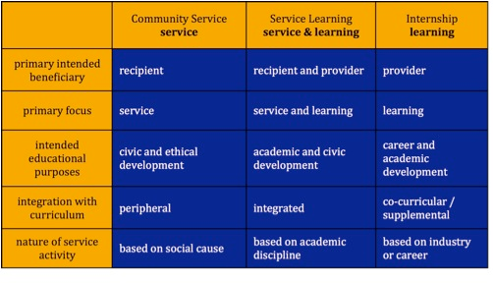
Service-learning compared

Slide 6
4 types of service-learning
There are four main types of service learning (Kaye, 2004):
1. Direct Service (tutoring children, working with elders, cleaning up the street)
2. Indirect Service (no direct action with those who will benefit from the
service, e.g., preparing kits for hospitalized patients,
parent handbook)
3. Advocacy (letter writing campaigns, petitions) and
4. Research (develop surveys, do experiments, conduct interviews).
***Of course, all four types involve some level of research and content specific
knowledge.

Slide 7
5 stages (lakes & Jones, 2012)
1. Investigation
Learn about the issues
Discover your strengths and abilities
Identify a need
2. Preparation
Draw upon previously acquired skills and knowledge
Acquire new information
Analyze underlying problem
Collaborate with community partners
Develop a plan that encourages responsibility
Recognize the integration of service and learning
Become ready to provide meaningful service
3. Action
Perform direct service, indirect service, research or advocacy
Your actions have value, purpose and meaning
Your actions offer unique learning experiences
Your actions have consequences
4. Reflection
Describe what happened
Examine the difference it made
Discuss thoughts and feelings
Place experience in a larger context
Identify questions
Receive feedback
5. Demonstration
Report to peers, faculty, parents, and/or community members
Write articles or letters to local newspaper regarding issues of
public concern
Create a publication or website that helps others learn from
your experiences
Make a presentation/performance
Create visual art form/mural

Slide 8
Resources and support
Center for Civic and Political Engagement and Service Learning
American Democracy Project
Student Affairs, local partners, & National RSOs
Action Research Center (IWU)
Senior Professionals at ISU (Civic Engagement Grant)
Existing non-profits and community agencies (Partnerships)
Illinois Humanities
Illinois Prairie Community Foundation
Community Foundation of Central Illinois
United Way of McLean County
Walmart Foundation & Community Grant Program
Home Depot Community Impact Grants

Slide 9
Reflection Tools
Journals: Writing in journals is widely used by service-learning programs to promote reflection.
Creative Projects: Students make a collage or write a poem or song to express an experience.
Case Studies Papers: Students analyze an organizational issue and write a case study that identifies a decision that needs to be made.
Multimedia Class Presentations: Students create a video or photo documentary on the community experience.
Presentations to Community Organizations: Students present work to community organization staff, board members, and participants.
Mapping: Create a visual map that shows how the service-learning experience connects to larger issues at the state/national/global level.
Blog: Create a course blog where students can post comments on their experiences.

Slide 10
The 4 Cs of Reflection
Reflection is one of the most academically rigorous components of a service-learning experience. Effective strategies for fostering reflection are based on four core elements of reflection known as the Four Cs. (Eyler & Giles, 1996). Continuous reflection: Reflection should be an ongoing component in the learner's education, happening before, during, and after an experience. Connected reflection: Link the "service" in the community with the structured "learning" in the classroom. Without structured reflection, students may fail to bridge the gap between the concrete service experience and the abstract issues discussed in class. Challenging reflection: Instructors should be prepared to pose questions and ideas that are unfamiliar or even uncomfortable for consideration by the learner in a respectful atmosphere. Contextualized reflection: Ensures that the reflection activities or topics are appropriate and meaningful in relation to the experiences of the students.

Slide 11
Service learning & beyond!
One big component of reflection is “COMMITMENT” to yourself and others as you move through life. The goal is to continue past the project & experience.
“Unguided” Reflection! Reflect like nobody is watching!!! Create a time, prompts, and situations for you to continue the internal & interpersonal dialogue. Continue to develop your cultural sensitivities, communication skills, community awareness. In other words, recognize your place in your “community” and take an active role.
What kind of citizen do you want to be?
How have you changed?
What did you learn?
What difference did you make?
What can you do next?
How will you continue to grow, contribute, and make a difference?
Is this relationship worth continuing?
Personal…how does this experience represent who I am as a person?

Slide 12
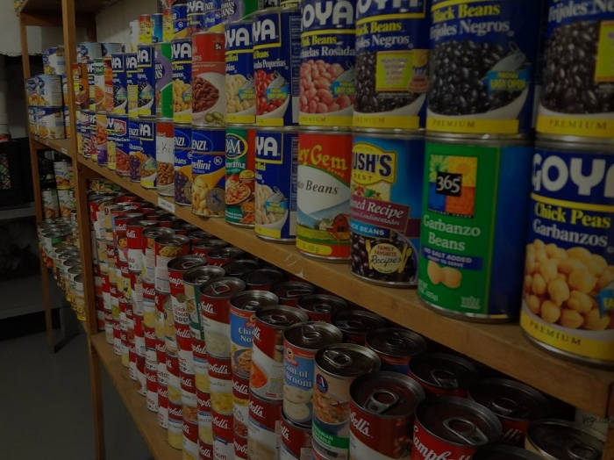
ISU FOOD PANTRY EFFORT
Noah Tang, Kaitlyn Remian, Michelle Pappas, Rhiannon Stringer, Samantha Tabor

Slide 13
ISU Pride
Presented by: Erica, Cheryl, Ana, Olivia, and Alexandra

Slide 14
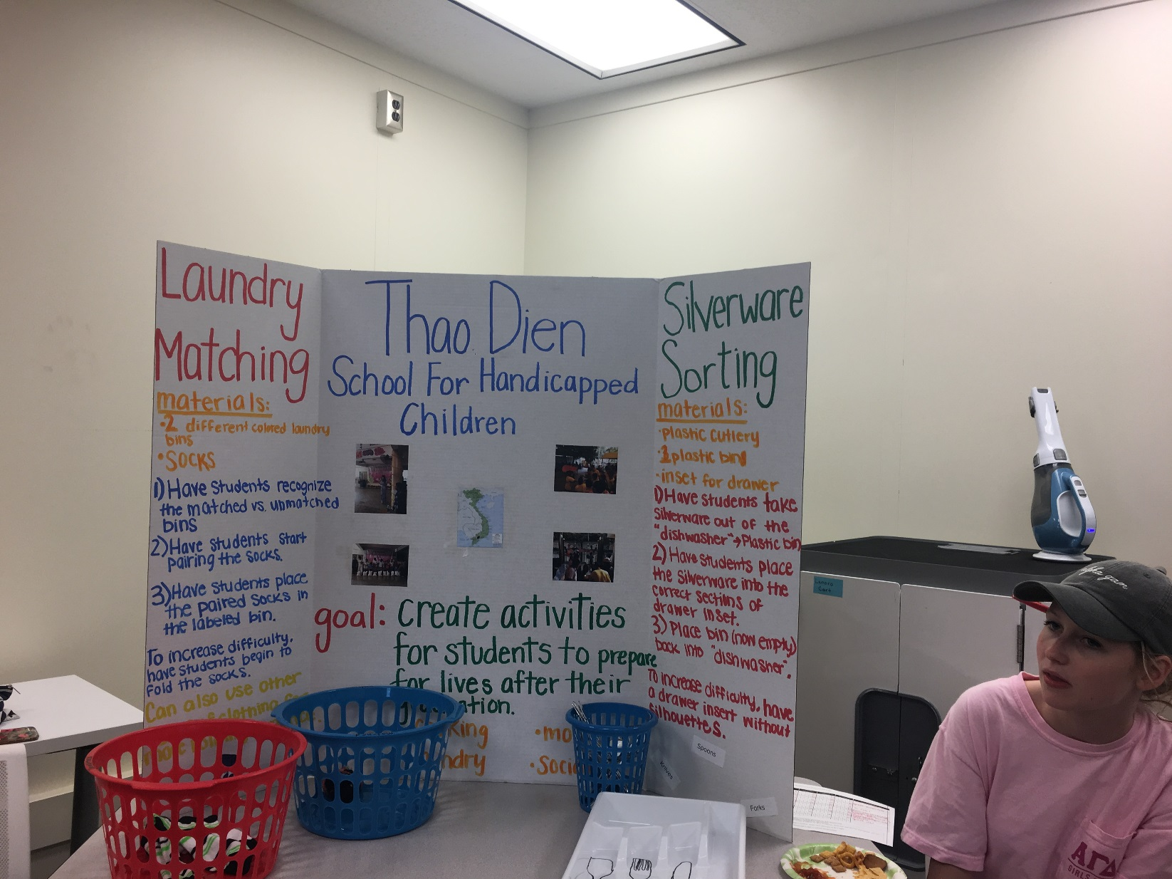

Slide 15
“Instead, let yourself approach it with enthusiasm and dedication. Throw yourself into it. Get excited…even passionate. Then the requirement becomes secondary, the credit or school evaluation unimportant, because you’re doing it for yourself” (Lewis, 2009, p. 6).

